Slide 1
NC Department of Health and Human Services
Firearm injury death and morbidity in North Carolina,
North Carolina Division of Public Health
Injury and Violence Prevention Branch

Slide 2
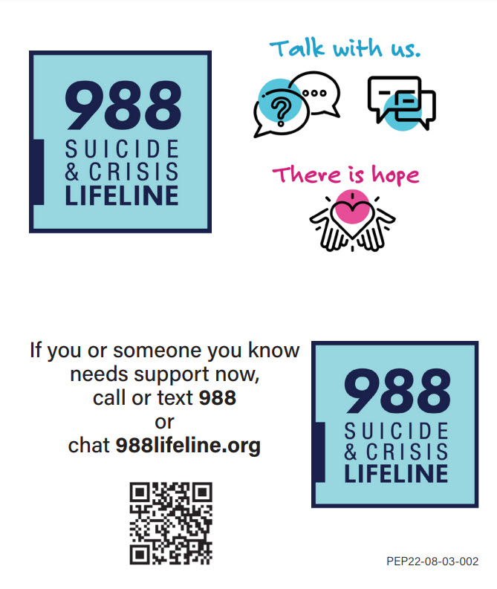
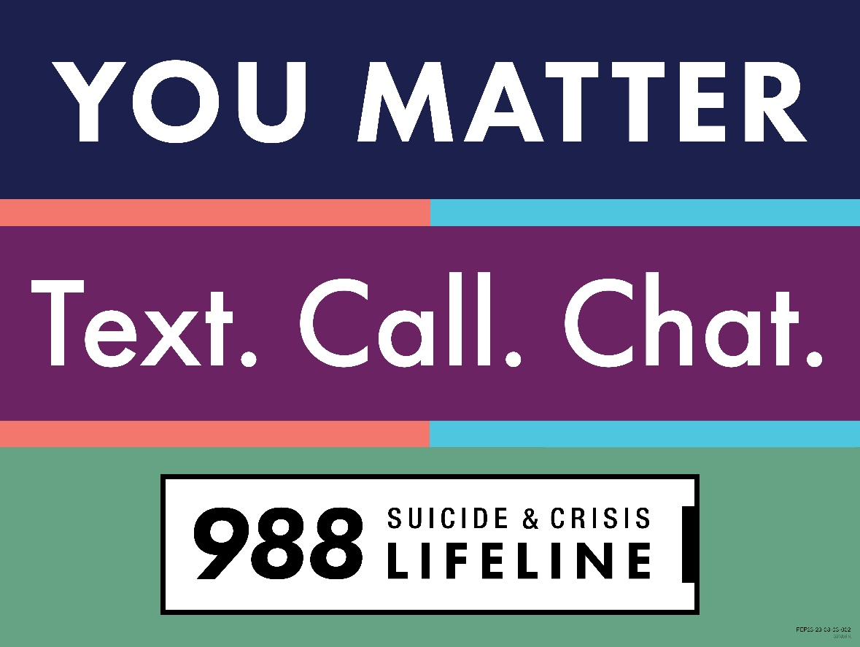
If you or someone you know needs support now, call or text 988 or chat 988lifeline.org
NCDHHS, Division of Public Health Ι Injury and Violence Prevention Branch I Firearm injury deaths and morbidity in North Carolina, 2021
2

Slide 3
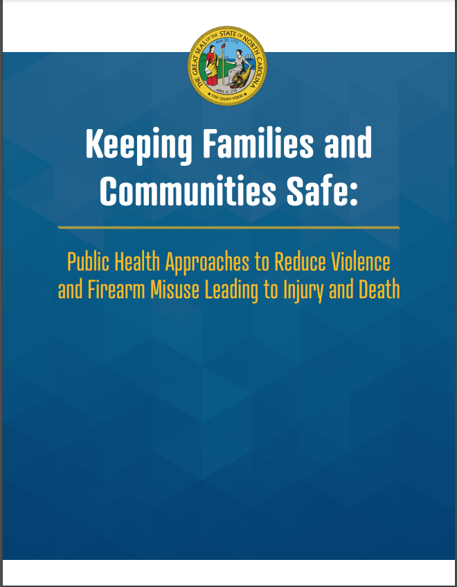
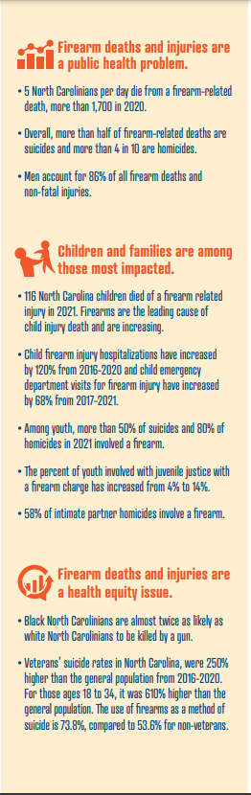
November 2022
NC DHHS white paper describing strategies to reduce firearm violence and misuse, addresses:
    Self-Injury & Suicide
    Intentional interpersonal injury & Homicide
    Unintentional Injury & Death
https://www.ncdhhs.gov/media/18351/open

Slide 4

NCDHHS, Division of Public Health Ι Injury and Violence Prevention Branch I Firearm injury deaths and morbidity in North Carolina, 2021
4

Slide 5
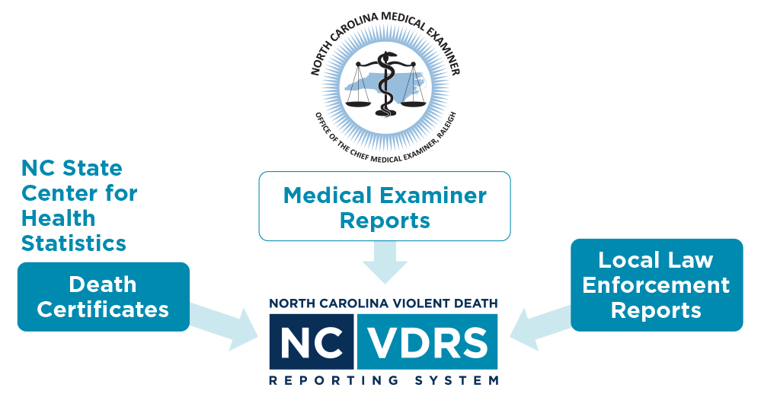
NC-VDRS
North Carolina-Violent Death Reporting System
CDC-funded statewide surveillance system collecting data on deaths resulting from violence such as homicide, suicide, legal intervention
Funded in 2003
  Data collection began in 2004
  ~35,000 incidents reported to date
Multi-sourced incident-based system
NCDHHS, Division of Public Health Ι Injury and Violence Prevention Branch I Firearm injury deaths and morbidity in North Carolina, 2021
5

Slide 6

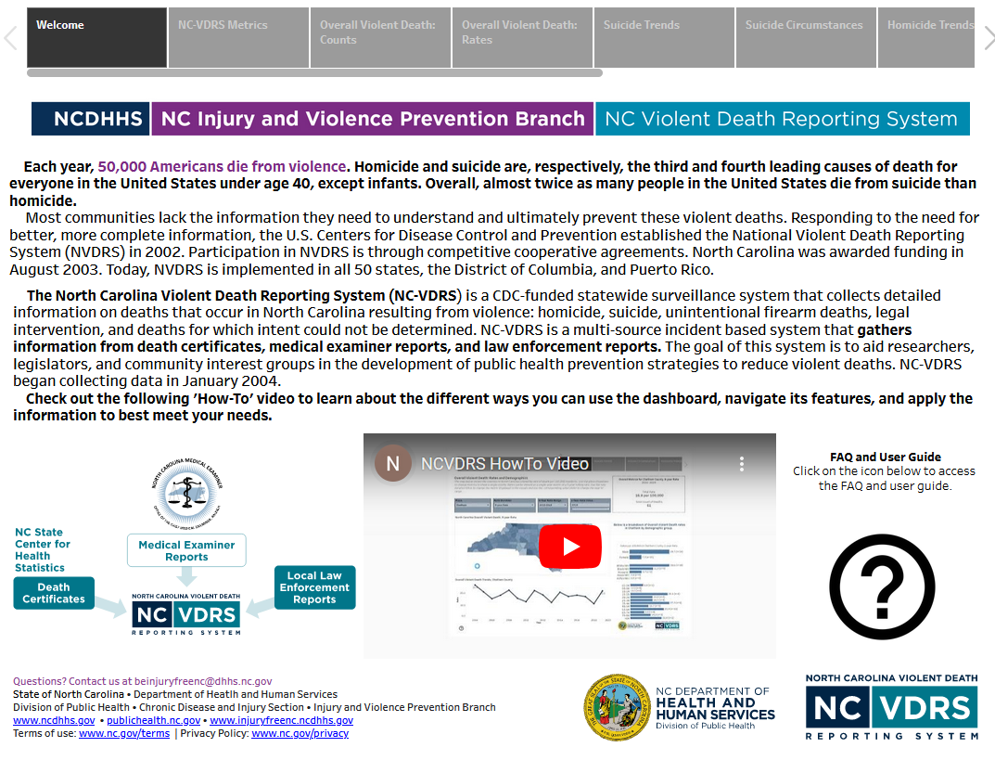
QR code- use your phone
Access more data on the NC-VDRS dashboard
NCDHHS, Division of Public Health Ι Injury and Violence Prevention Branch I Firearm injury deaths and morbidity in North Carolina, 2021
6

Slide 7
Firearms are the most common weapon used in violent deaths in NC.
NCDHHS, Division of Public Health Ι Injury and Violence Prevention Branch I Firearm injury deaths and morbidity in North Carolina, 2021
7

Slide 8
NCDHHS, Division of Public Health Ι Injury and Violence Prevention Branch I Firearm injury deaths and morbidity in North Carolina, 2021
8

Slide 9
Firearms
NCDHHS, Division of Public Health Ι Injury and Violence Prevention Branch I Firearm injury deaths and morbidity in North Carolina, 2021
9
Notes:
s
9

Slide 10
NCDHHS, Division of Public Health Ι Injury and Violence Prevention Branch I Firearm injury deaths and morbidity in North Carolina, 2021
10

Slide 11
NCDHHS, Division of Public Health Ι Injury and Violence Prevention Branch I Firearm injury deaths and morbidity in North Carolina, 2021
11

Slide 12
Firearm homicide
Firearm suicide
NCDHHS, Division of Public Health Ι Injury and Violence Prevention Branch I Firearm injury deaths and morbidity in North Carolina, 2021
12
Notes:
s
12

Slide 13
Firearm homicide
Firearm suicide
NCDHHS, Division of Public Health Ι Injury and Violence Prevention Branch I Firearm injury deaths and morbidity in North Carolina, 2021
13
Notes:
s
13

Slide 14
NCDHHS, Division of Public Health Ι Injury and Violence Prevention Branch I Firearm injury deaths and morbidity in North Carolina, 2021
14

Slide 15
NCDHHS, Division of Public Health Ι Injury and Violence Prevention Branch I Firearm injury deaths and morbidity in North Carolina, 2021
15

Slide 16
Circumstances of
Firearm Suicide
NCDHHS, Division of Public Health Ι Injury and Violence Prevention Branch I Firearm injury deaths and morbidity in North Carolina, 2021
16

Slide 17
NCDHHS, Division of Public Health Ι Injury and Violence Prevention Branch I Firearm injury deaths and morbidity in North Carolina, 2021
17
Notes:
s
17
As a state we are part of the national surveillance system. Each state has it’s own set-up and unique circumstances although there are required data elements and standards employed. Because NC-VDRS has experience in linkage multiple data sources, it was thought that this project fit well within its capabilities.

Slide 18
Circumstances of
Firearm Homicide
NCDHHS, Division of Public Health Ι Injury and Violence Prevention Branch I Firearm injury deaths and morbidity in North Carolina, 2021
18

Slide 19
NCDHHS, Division of Public Health Ι Injury and Violence Prevention Branch I Firearm injury deaths and morbidity in North Carolina, 2021
19
Notes:
s
19
As a state we are part of the national surveillance system. Each state has it’s own set-up and unique circumstances although there are required data elements and standards employed. Because NC-VDRS has experience in linkage multiple data sources, it was thought that this project fit well within its capabilities.

Slide 20
Circumstances of Unintentional Firearm Deaths
NCDHHS, Division of Public Health Ι Injury and Violence Prevention Branch I Firearm injury deaths and morbidity in North Carolina, 2021
20

Slide 21
NCDHHS, Division of Public Health Ι Injury and Violence Prevention Branch I Firearm injury deaths and morbidity in North Carolina, 2021
21
Notes:
s
21
As a state we are part of the national surveillance system. Each state has it’s own set-up and unique circumstances although there are required data elements and standards employed. Because NC-VDRS has experience in linkage multiple data sources, it was thought that this project fit well within its capabilities.

Slide 22



Firearm deaths are just the tip of the iceberg.
Despite NC’s excellent reporting systems, the
total burden of
firearm-related
outcomes in
the state is
unknown.
1,517
Firearm-Related Hospitalizations
3,953
Firearm-Related ED Visits
Roughly 840,000
Adults store their firearm(s) loaded and unlocked
About 3.5 million
NC adults have a firearm in or around the home
INJURY PYRAMID
; BRFSS Firearm Safety Module (2021)
NCDHHS, Division of Public Health Ι Injury and Violence Prevention Branch I Firearm injury deaths and morbidity in North Carolina, 2021
22

Slide 23
1,634
1,517
1,476
1,174
1,201
1,168
1,177
NCDHHS, Division of Public Health Ι Injury and Violence Prevention Branch I Firearm injury deaths and morbidity in North Carolina, 2021
23

Slide 24
20.2
19.3
12.0
12.5
11.7
NCDHHS, Division of Public Health Ι Injury and Violence Prevention Branch I Firearm injury deaths and morbidity in North Carolina, 2021
24

Slide 25
Firearm injury ED visits also increased by 28% from 2019 to 2020 and remain higher in 2022.
NCDHHS, Division of Public Health Ι Injury and Violence Prevention Branch I Firearm injury deaths and morbidity in North Carolina, 2021
25

Slide 26
Rates of firearm-related ED visits were also highest among NH Black residents, males, and young adults ages 19-24.
NCDHHS, Division of Public Health Ι Injury and Violence Prevention Branch I Firearm injury deaths and morbidity in North Carolina, 2021
26

Slide 27
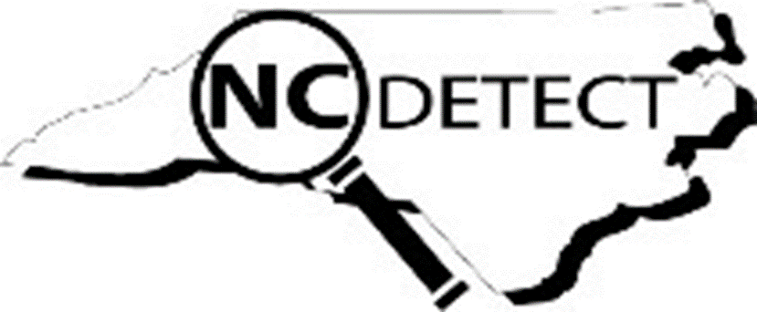
NC-FASTER
Firearm Injury Surveillance Through Emergency Rooms
NC is one of 10 states funded for enhanced surveillance of non-fatal firearm injuries
3-year award, started September 1, 2020
SRATEGY 1
Increase the timeliness of ED visits for firearm injuries reporting.
STRATEGY 2
Disseminate surveillance findings to key stakeholders.
Increase availability of rapid, reliable, and geographically-specific surveillance data on ED visits for nonfatal firearm injuries.
Improve firearm injury syndromic surveillance methodology.
NCDHHS, Division of Public Health Ι Injury and Violence Prevention Branch I Firearm injury deaths and morbidity in North Carolina, 2021
27

Slide 28
NC-FASTER Definition Compared to the Current Code-Based Definition for Firearm Injury ED Visits
NCDHHS, Division of Public Health Ι Injury and Violence Prevention Branch I Firearm injury deaths and morbidity in North Carolina, 2021
28

Slide 29

Intent coding in the ED visit data is inaccurate and in need of improvement for firearm injury tracking.
There is an overcount of unintentional firearm injuries and an undercount of intentional injuries, such as assaults and self-harm.
ICD-10-CM coding guidance currently defaults to unintentional injury if intent is not directly documented in the medical record and should be revised.
Source: NC DETECT, ED Visit Data, NC-FASTER Firearm Injury - All Intents CDC V2 Syndrome
NCDHHS, Division of Public Health Ι Injury and Violence Prevention Branch I Firearm injury deaths and morbidity in North Carolina, 2021
29
Notes:
An important aspect of our work with NC-FASTER is examining the intent of firearm injuries treated in the ED.
As you can see from this diagram of 5 years of firearm related ED visits, the majority are reported to be unintentional injury with far fewer coded as assaults and even fewer as self-harm. You’ll note that there are many for which intent is not indicated at all and others which are coded with more than one intent, which is contradictory. This pattern of intent for non-fatal firearm injury is very different than the pattern for fatal firearm injury, which is not necessarily surprising given the lethality of firearms. However, we do suspect that there is miscoding of intent in these data and we are working to determine to what extent that may be occurring.
Most of our work for NC-FASTER is using the ED visit data in NC DETECT but we are also now beginning to also work with the EMS encounter data in NC DETECT. Our work is exploring firearm injury by demographics and geography and we try to find clear but innovative ways to visually present the information. Eventually, we want to add a public facing dashboard to make firearm injury data available to anyone interested.

Slide 30
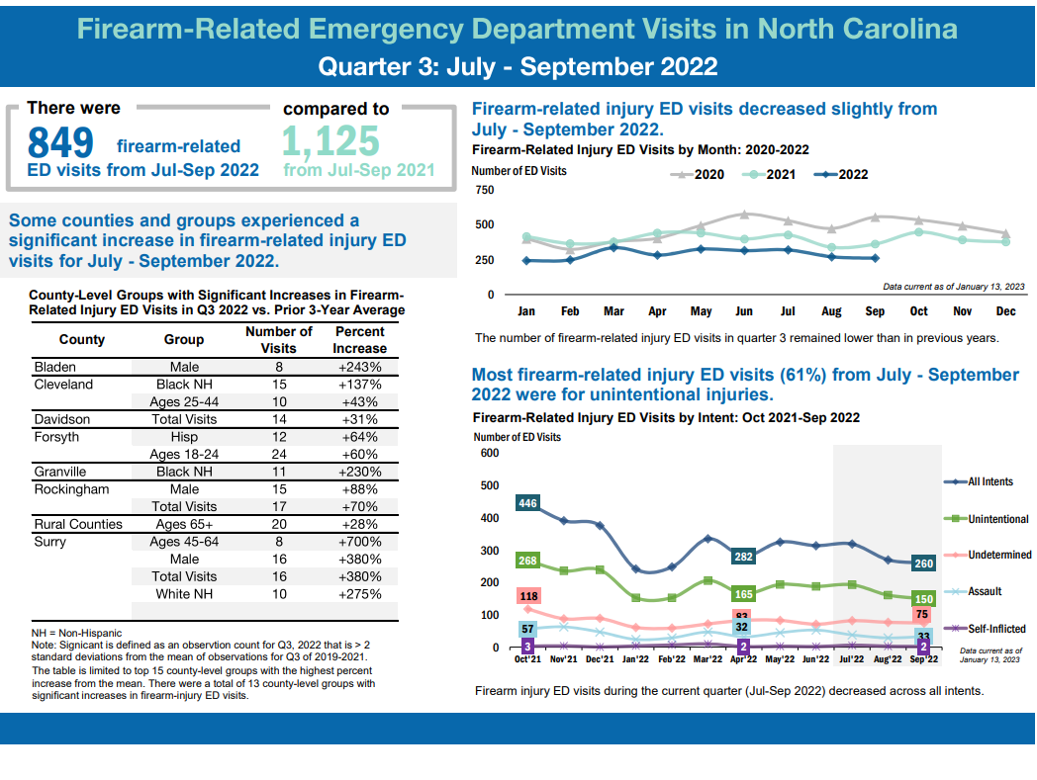
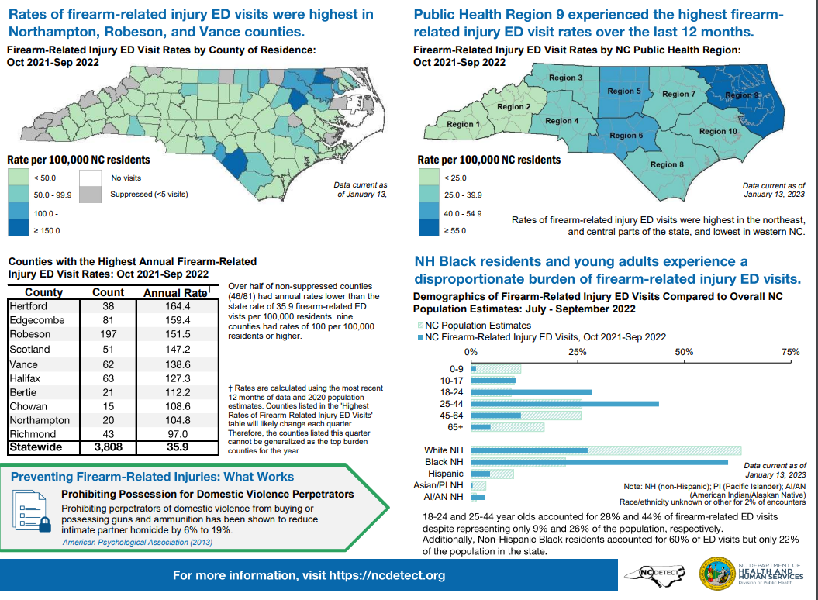
NC-FASTER
Data Products
Quarterly & Annual Reports
https://ncdetect.org/nc-faster-firearm-quarterly-reports/
NCDHHS, Division of Public Health Ι Injury and Violence Prevention Branch I Firearm injury deaths and morbidity in North Carolina, 2021
30
Notes:
Investigating intent
Data by demographic group
Data by county/ region
Plans for a FASTER dashboard in the future

Slide 31
More than 2/5 of NC adults have a firearm in or around the home.¹ Over half of firearms that are stored loaded are also unlocked.¹
42%
45%
53%
of NC adults surveyed
of those with firearms kept
at home
of those with loaded firearms at home
¹ NC BRFSS Firearm Safety Module, 2021 https://schs.dph.ncdhhs.gov/data/brfss/2021/nc/all/topics.htm#fr
² NC High School Youth Risk Behavior Survey, 2021, presented to the Child Fatality Task Force 12/12/2022 https://webservices.ncleg.gov/ViewDocSiteFile/72555
NCDHHS, Division of Public Health Ι Injury and Violence Prevention Branch I Firearm injury deaths and morbidity in North Carolina, 2021
31
Notes:
30% of high school students reported that it would take them less than an hour to get and be ready to fire a loaded gun without a parent or other adult’s permission; for white high school students it was 40%.
YRBS 2021

Slide 32
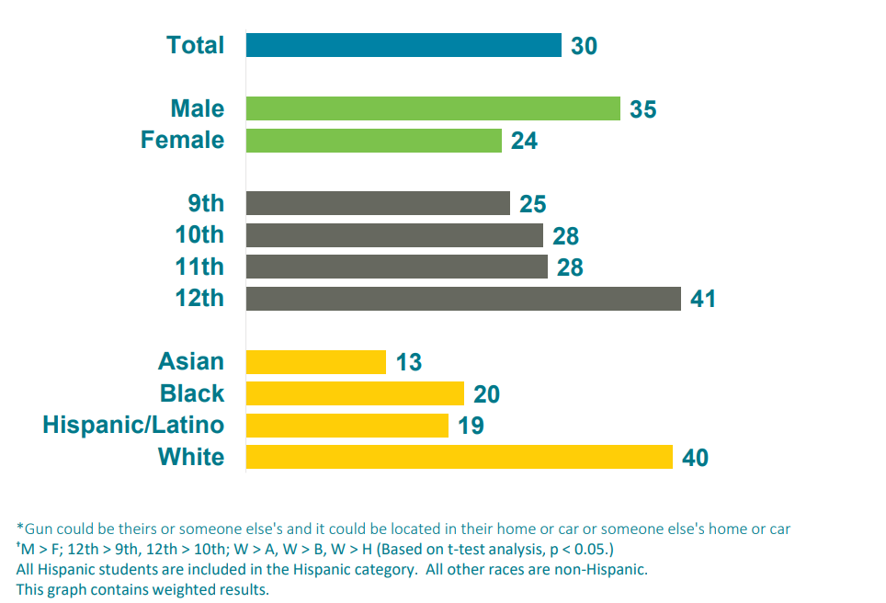
30% of high school students say they could be ready to fire a loaded gun in less than an hour without a parent or other adult’s permission.
Percentage
Source: North Carolina Department of Public Instruction, Youth Risk Behavior Survey, 2021
NCDHHS, Division of Public Health Ι Injury and Violence Prevention Branch I Firearm injury deaths and morbidity in North Carolina, 2021
32

Slide 33
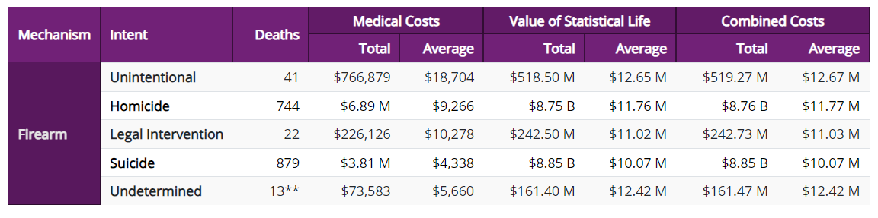
The financial tole of firearm injury and violence on society is costly
Firearm deaths alone in NC resulted in a combined cost of over $18 Billion in 2020
  $1,748 per capita
NCDHHS, Division of Public Health Ι Injury and Violence Prevention Branch I Firearm injury deaths and morbidity in North Carolina, 2021
33

Slide 34
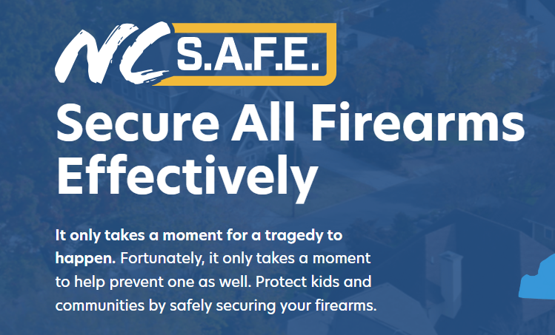
https://www.ncsafe.org/
NCDHHS, Division of Public Health Ι Injury and Violence Prevention Branch I Firearm injury deaths and morbidity in North Carolina, 2021
34

Slide 35
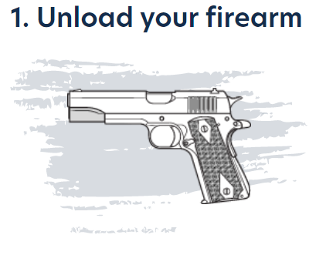
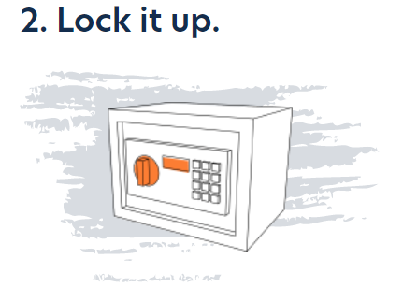
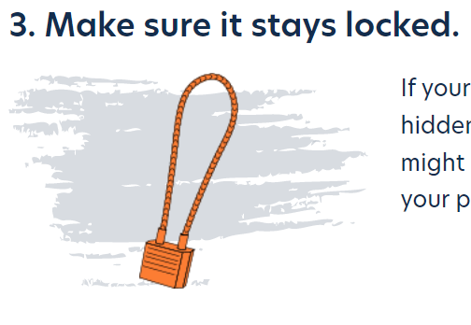
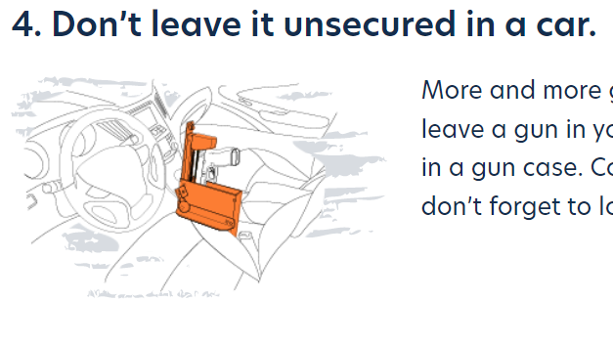

Protect your children and your community by safely securing your firearm.
https://www.ncsafe.org/safestorage/
NCDHHS, Division of Public Health Ι Injury and Violence Prevention Branch I Firearm injury deaths and morbidity in North Carolina, 2021
35

Slide 36
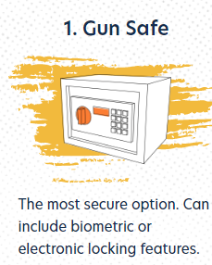

Ways To Lock Your Firearm
5
There are many ways to prevent your gun from being stolen or fired by somebody else.
https://www.ncsafe.org/safestorage/
NCDHHS, Division of Public Health Ι Injury and Violence Prevention Branch I Firearm injury deaths and morbidity in North Carolina, 2021
36

Slide 37
Where to find more data on firearm injury?
NC Injury and Violence Prevention Branch Firearm Data Page
  NC-VDRS Annual Report
  NC-VDRS Fact Sheets
  NC-VDRS Data Dashboard
  NC DETECT quarterly NC-FASTER reports
State Center for Health Statistics (SCHS) Death Certificate Data
  NC Health Data Query System
CDC WISQARS – Fatal Injury and Violence Data
CDC NVDRS - CDC NVDRS
NCDHHS, Division of Public Health Ι Injury and Violence Prevention Branch I Firearm injury deaths and morbidity in North Carolina, 2021
37

Slide 38

North Carolina Medical Journal
Special Issue on Firearm Injury and Violence Prevention https://ncmedicaljournal.com/issue/7874
NCDHHS, Division of Public Health Ι Injury and Violence Prevention Branch I Firearm injury deaths and morbidity in North Carolina, 2021

Slide 39
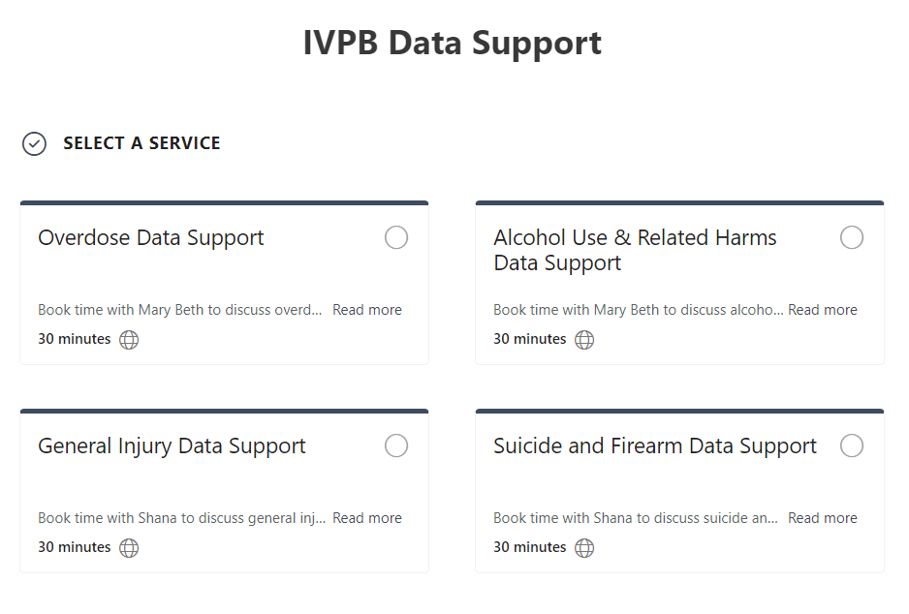

IVPB Data Support now available!
Book time with an IVPB epidemiologist to discuss available data products, to talk through custom data requests, or for general data questions.
IVPB Data Request Policy
IVPB Data Support Bookings
NCDHHS, Division of Public Health Ι Injury and Violence Prevention Branch I Firearm injury deaths and morbidity in North Carolina, 2021
39

