Slide 1
Leading Causes of Injury in North Carolina, 2022
Division of Public Health
Data updated: December 31, 2024
Notes:
This slide set was created to provide basic data trends and public health surveillance around mortality and morbidity of the leading causes of injury in North Carolina. They are meant to offer a state-level background on the leading causes of injury. If you’d like a copy of the slides, please visit the “Data Surveillance” page on our branch website, www.dph.ncdhhs.gov/programs/chronic-disease-and-injury/injury-and-violence-prevention-branch. The direct link is also shared at the end of this presentation.
Feel free to incorporate these slides into your own presentations, grant proposals, reports, or any other way they may be useful.
Please read both the speaking and technical notes to ensure that data are presented in a consistent manner.

Slide 2
Leading Causes of Injury Technical Notes
Surveillance methods have been updated to identify any mention of an injury in our morbidity data sources. Individual records with multiple injuries listed will be included in the total for each of those injuries but counted only once for overall total injury count. Previously, only the first listed injury was counted, which has resulted in an increase in the number of specific injuries identified.
For questions or for more information see technical notes document available at:
https://injuryfreenc.dph.ncdhhs.gov/DataSurveillance/Technical-Notes.pdf?ver=1.0
Notes:
For more detailed technical notes on any of the data shared in this slide set, please contact us at InjuryData@dhhs.nc.gov.

Slide 3
Injury deaths are just the tip of the iceberg.
In 2022, injuries resulted in:
11,580
Deaths
49,534
Hospitalizations
Despite NC’s extensive reporting systems,
the total burden
of injuries in the
state is
unknown.
843,434
ED Visits
? EMS
? Outpatient Injuries
? Medically Unattended Injuries
INJURY ICEBURG
Limited to NC Residents, 2022
Source: NC State Center for Health Statistics, Vital Statistics Deaths (2022) and Hospital Discharge Data (2022); NC DETECT (2022)
Analysis by the DPH, Injury and Violence Prevention Branch, Injury Epidemiology, Surveillance and Informatics Unit
Notes:
In 2022 there were 11,580 deaths, 49,534 hospitalizations, and 843,434 emergency department visits associated with injuries in North Carolina. However, this is just the tip of the iceberg and the total burden of injury in North Carolina is unknown.

Slide 4
Injury Deaths

Slide 5
Injury deaths among NC residents continue to rise
39%
increase
Data limited to NC residents, 2018-2022
Source: NC State Center for Health Statistics, Vital Statistics Deaths (2018-2022)
Analysis by the DPH, Injury and Violence Prevention Branch, Injury Epidemiology, Surveillance and Informatics Unit
Notes:
The number of injury deaths in North Carolina continues to rise, with a 39% increase since 2018.

Slide 6
Leading causes of injury death among NC Residents, 2022
The leading cause of injury death in 2022 was unintentional poisoning.
Total Deaths = 11,580
MVT = Motor Vehicle Traffic; Unintentional poisoning includes both medication/drug overdoses and non-drug poisonings
Data limited to NC residents, 2022
Source: NC State Center for Health Statistics, Vital Statistics Deaths (2022)
Analysis by the DPH, Injury and Violence Prevention Branch, Injury Epidemiology, Surveillance and Informatics Unit
Notes:
In 2022, there were 11,580 injury deaths in North Carolina. The leading cause of injury death was unintentional poisoning (4,199), followed by unintentional falls (1,846) and unintentional motor vehicle traffic-related injury (1,796).

Slide 7
Percent change in leading causes of injury death among NC residents, 2018-2022
Unintentional poisoning had the largest five-year increase.
MVT = Motor Vehicle Traffic
Data limited to NC residents, 2018 & 2022
Source: NC State Center for Health Statistics, Vital Statistics Deaths (2018 & 2022)
Analysis by the DPH, Injury and Violence Prevention Branch, Injury Epidemiology, Surveillance and Informatics Unit
Notes:
Over the past five years (2018-2022), the number of deaths due to unintentional poisonings increased the most (88% increase), followed by firearm assault (54% increase) and unintentional falls (33% increase). The 24% decrease in deaths for unspecified injuries notes a shift toward better injury coding practices.

Slide 8
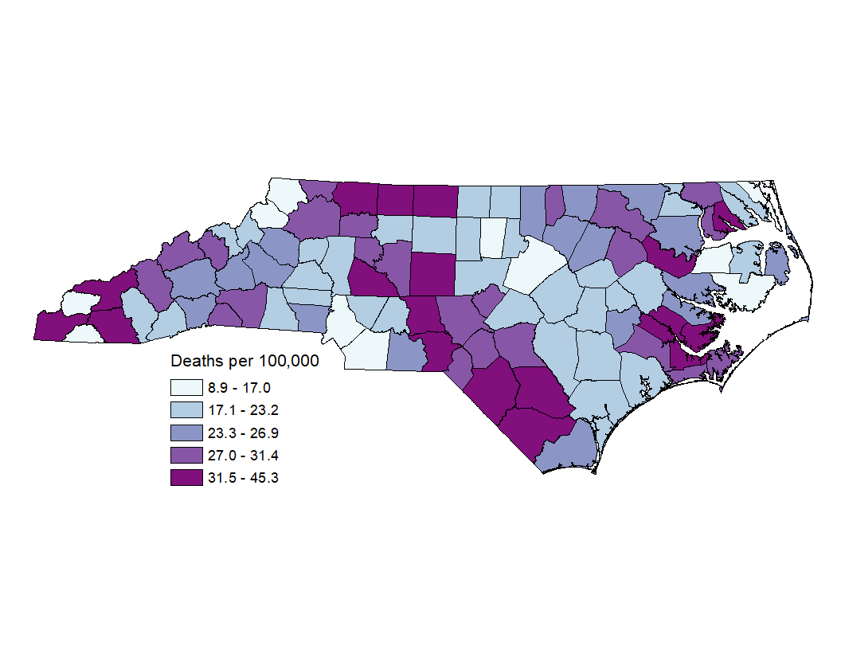
Injury Death Rates among NC Residents by County, 2018-2022
Statewide, the rate of injury deaths from 2018-2022 was 23.2 per 100,000 people.
Data limited to NC residents, 2018-2022
Source: NC State Center for Health Statistics, Vital Statistics Deaths (2018-2022)
Analysis by the DPH, Injury and Violence Prevention Branch, Injury Epidemiology, Surveillance and Informatics Unit
Notes:
The rate of injury deaths among North Carolinians from 2018 to 2022 was 23.2 per 100,000 residents. Counties with the highest rates included Swain (45.3 per 100,000), Robeson (45.0 per 100,000), and Pamlico (40.2 per 100,000). Counties with the lowest rates included Washington (8.9 per 100,000), Graham (9.8 per 100,000), and Currituck (10.4 per 100,000).

Slide 9
Injury Hospitalizations

Slide 10
Injury-related hospitalizations increased by 3% over the last five years
3%
increase
Data limited to NC residents, 2018-2022
Source: Hospitalization Discharge Data (2018-2022)
Analysis by the DPH, Injury and Violence Prevention Branch, Injury Epidemiology, Surveillance and Informatics Unit
Notes:
In 2022, the number of injury-related hospitalizations in North Carolina increased by 3% since 2018.

Slide 11
Leading causes of injury hospitalization among NC Residents, 2022
The leading cause of injury hospitalization in 2022 was unintentional falls.
Total Hospitalizations = 49,534
MVT = Motor Vehicle Traffic; Unintentional poisoning includes both medication/drug overdoses and non-drug poisonings
Data limited to NC residents, 2022
Source: Hospital Discharge Data (2022)
Analysis by the DPH, Injury and Violence Prevention Branch, Injury Epidemiology, Surveillance and Informatics Unit
Notes:
In 2022, there were 49,534 injury-related hospitalizations in North Carolina. The leading cause of injury hospitalization was unintentional falls (25,727), followed by unintentional motor vehicle traffic-related injury (7,161) and unintentional poisoning (5,283).

Slide 12
Percent change in leading causes of injury hospitalization among NC residents, 2018-2022
Unintentional firearm injuries had the largest five-year increase.
MVT = Motor Vehicle Traffic
Data limited to NC residents, 2018 & 2022
Source: Hospital Discharge Data (2018 & 2022)
Analysis by the DPH, Injury and Violence Prevention Branch, Injury Epidemiology, Surveillance and Informatics Unit
Notes:
Over the past five years (2018-2022), the number of hospitalizations due to unintentional firearm injury increased the most (64% increase). The 51% decrease in hospitalizations for “no mech or intent determined” notes a shift toward better injury coding practices.

Slide 13
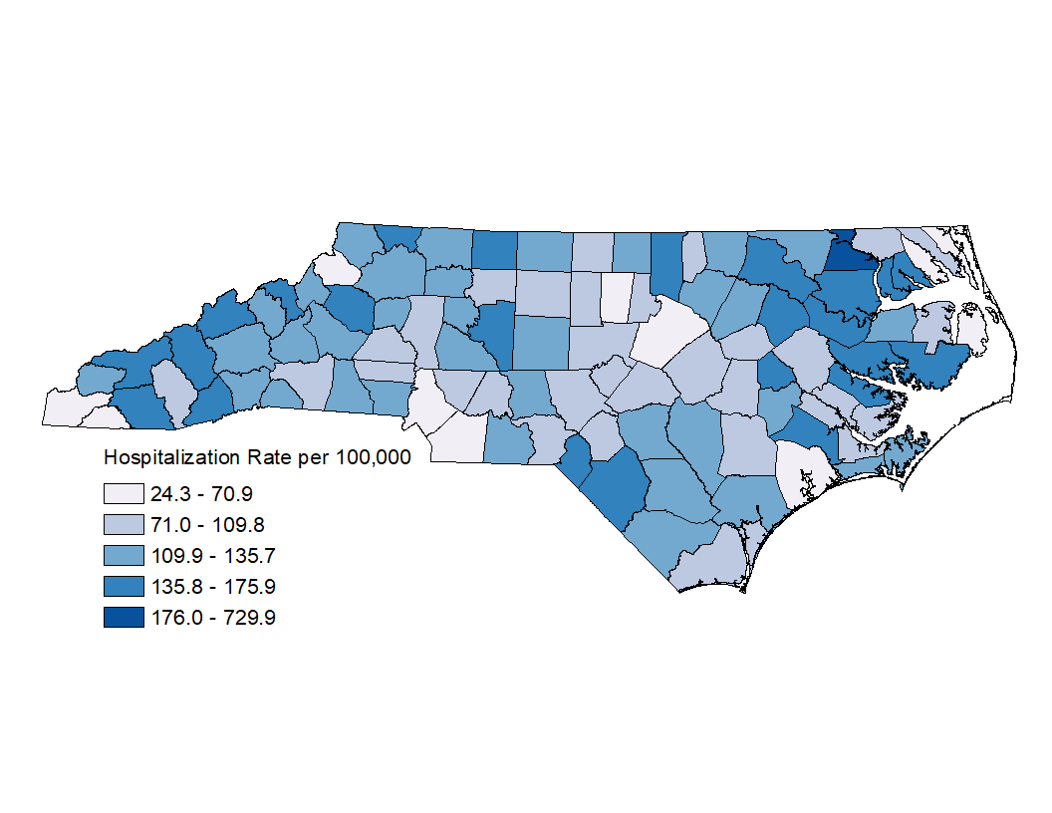
Injury Hospitalization Rates among NC Residents by County, 2018-2022
Statewide, the rate of injury hospitalizations from 2018-2022 was 100.8 per 100,000 people.
Data limited to NC Residents, 2018-2022
Source: Hospital Discharge Data (2018-2022)
Analysis by the DPH, Injury and Violence Prevention Branch, Injury Epidemiology, Surveillance and Informatics Unit
Notes:
The rate of injury hospitalization among North Carolinians from 2018 to 2022 was 100.8 per 100,000 residents. Counties with the highest rates included Hertford (729.9 per 100,000), Jones (175.9 per 100,000), and Martin (167.8 per 100,000). Counties with the lowest rates included Currituck (24.3 per 100,000), Pasquotank (41.1 per 100,000), and Clay (51.3 per 100,000).

Slide 14
Injury Emergency Department (ED) Visits

Slide 15
Injury-related ED visits remain high, but decreased 10% over the last five years
10%
decrease
Data limited to NC residents, 2018-2022
Source: NC DETECT, 2018-2022
Analysis by the DPH, Injury and Violence Prevention Branch, Injury Epidemiology, Surveillance and Informatics Unit
Notes:
The number of injury-related emergency department visits in North Carolina has decreased by 10% over the last 5 years (2018-2022). A decrease was observed until the pandemic in 2020. Since 2020, the number of injury-related ED visits has increased by 13%.
Note: Overall ED visit counts (for any cause) declined in 2020 and have not returned to pre-COVID volumes.

Slide 16
Leading causes of injury ED Visits among NC Residents, 2022
The leading cause of injury ED visits in 2022 was unintentional falls.
Total ED Visits = 843,434
Data limited to NC residents, 2022
Source: NC DETECT, 2022
Analysis by the DPH, Injury and Violence Prevention Branch, Injury Epidemiology, Surveillance and Informatics Unit
Notes:
In 2022, there were 843,434 injury-related ED visits in North Carolina. The leading cause of injury ED visit was unintentional falls (221,168) and unintentional motor vehicle traffic-related injury (111,991). The high number of ED visits with no mechanism or intent determined (239,881) shows the need for better injury coding practices in emergency department settings.

Slide 17
Percent change in leading causes of injury ED visits among NC residents, 2018-2022
Unintentional poisoning had the largest five-year increase.
Data limited to NC residents, 2018 & 2022
Source: NC DETECT, 2018 & 2022
Analysis by the DPH, Injury and Violence Prevention Branch, Injury Epidemiology, Surveillance and Informatics Unit
Notes:
Over the past five years (2018-2022), the number of injury-related ED visits decreased. However, when looking at type of injury, ED visits related to unintentional poisonings increased by 19%.

Slide 18
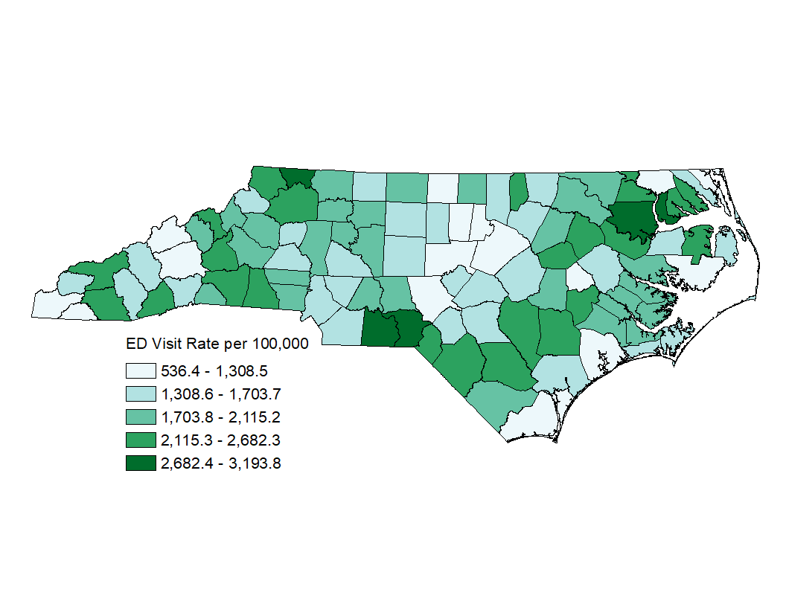
Injury ED Visit Rates among NC Residents by County, 2018-2022
Statewide, the rate of injury Ed visits from 2018-2022 was 1,739.3 per 100,000 people.
Data limited to NC residents, 2022
For more information on these data, see the Injury Surveillance Technical Notes: https://www.injuryfreenc.ncdhhs.gov/DataSurveillance/Technical-Notes.pdf
Source: NC DETECT, 2022
Analysis by the DPH, Injury and Violence Prevention Branch, Injury Epidemiology, Surveillance and Informatics Unit
Notes:
The rate of injury ED visits among North Carolinians from 2018 to 2022 was 1,739.3 per 100,000 residents. Counties with the highest rates included Anson (3,193.8 per 100,000), Chowan (3,073.4 per 100,000), and Bertie (3,055.7 per 100,000). Counties with the lowest rates included Clay (536.4 per 100,000), Currituck (851.3 per 100,000), and Hyde (856.6 per 100,000).

Slide 19
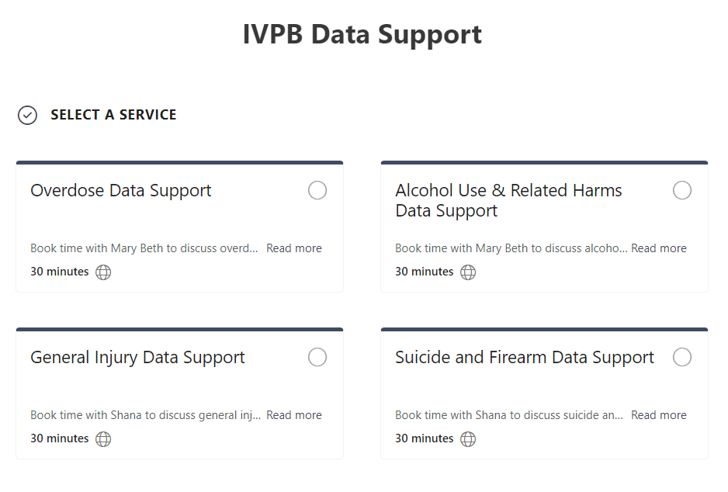

IVPB Data Support now available!
Book time with an IVPB epidemiologist to discuss available data products, to talk through custom data requests, or for general data questions.
IVPB Data Request Policy
IVPB Data Support Bookings

Slide 20
Questions?
InjuryData@dhhs.nc.gov
Injury and Violence Prevention Branch
NCDHHS Division of Public Health
www.dph.ncdhhs.gov/programs/chronic-disease-and-injury/injury-and-violence-prevention-branch

