Slide 1
Unintentional Fall Injuries in North Carolina
2022
Division of Public Health
Data updated October 2, 2024
Notes:
This slide set was created to provide basic data trends and public health surveillance around mortality and morbidity of falls. They are meant to offer a state-level background on unintentional fall injury. If you’d like a copy of the slides, please visit the “Falls” Data page on our branch website, Injuryfreenc.dph.dhhs.gov. The direct link is also shared at the end of this presentation.
Feel free to incorporate these slides into your own presentations, grant proposals, reports, or any other way they may be useful.
Please read both the speaking and technical notes to ensure that data are presented in a consistent manner.

Slide 2
Unintentional Falls Technical Notes
Surveillance methods have been updated to identify any mention of an injury in our morbidity data sources. Individual records with multiple injuries listed will be included in the total for each of those injuries, but only counted once for overall total injury count. Previously, only the first listed injury was counted, which has resulted in an increase in the number of specific injuries identified.
For questions or for more information see technical notes document available at
https://www.injuryfreenc.ncdhhs.gov/DataSurveillance/
Case Definitions used:
Deaths – ICD10 code W00-W19 listed cause of death
Notes:
For more detailed technical notes on any of the data shared in this slide set, please contact us at InjuryData@dhhs.nc.gov.

Slide 3
Technical Notes, Continued
Hospitalizations – Among records with an ICD-10-CM injury code*, any mention of the CD-10-CM codes below (includes records resulting in death)
Emergency Department Visits – Any mention of the ICD-10-CM codes below: (includes records resulting in hospitalization or death)
V00.11-V00.89 with 6th character=1 | Falls related to pedestrian conveyance
W00-W15, W17, W19 | Falls
W16 with 6th character=2 (Except 16.4 and 16.9 with 5th character=2) | Fall, jump, or diving into water
W18.1, W18.2, W18.3 | Other falls
7th character of A or missing (reflects initial encounter, active treatment)
*See technical notes document for a full list of ICD-10-CM injury diagnosis codes
Notes:
For more detailed technical notes on any of the data shared in this slide set, please contact us at InjuryData@dhhs.nc.gov.

Slide 4
The populations most at risk of falls are projected to have the fastest growth over the next 20 years
2022 Population
2042 Population
Percent Change 2022-2042
N=10,705,403
N=13,242,528
Overall increase of 24%
Source: North Carolina OSBM, Standard Population Estimates, Vintage 2021 & Population Projections, Vintage 2022
Notes:
Over the next 20 years, people ages 60 and over are projected to have the fastest population growth (39-114%), outpacing the overall 20-year population growth (24%). 20 years from now, the population of people ages 60 and over is expected to increase by 39%. The largest increase in population growth is expected among people ages 85 and older (114%).

Slide 5
Most older adults in NC are non-Hispanic White
*Non-Hispanic
Source: National Center for Health Statistics, 2022; ages 65 and older
Notes:
In 2022, most North Carolinians ages 65 and older are non-Hispanic White (77%). The second largest racial/ethnic group among North Carolinians ages 65 and older are non-Hispanic Blacks (17%).

Slide 6
Demographic characteristics among older adults in North Carolina
43%
of housing units with people 65 and older are single person households
Source: American Community Survey, 2022 5-year estimates. Table S0103: Population 65 and older
Notes:
According to the 2022 American Community Survey, 43% of housing units with people 65 and older are single person households. More than 1/3 (34%) of North Carolina adults ages 65 and older have a disability. 30% of North Carolina adults ages 65 and older have a high school education/G.E.D.

Slide 7
One in five older adults in NC reports trouble walking
Source: American Community Survey, 2022 5-year estimates. Table S1810: Population 65 and older
Notes:
According to the 2022 American Community Survey, approximately 1 in 5 North Carolina adults ages 65 and over reported having trouble walking. Furthermore, North Carolina adults ages 65 and over experience hearing (14%), cognitive (8%), vision (6%), and self-care disabilities (7%). About 13% of people ages 65 and older in North Carolina also reported living alone/independently.

Slide 8
Around 40% of older adults in NC have one or more chronic diseases
Source: NC State Center of Health Statistics, 2022 Behavioral Risk Factor Surveillance System (BRFSS)
Survey Results
Notes:
In North Carolina, approximately 40% of adults ages 65 and older have one or more chronic disease. Among adults ages 65-74, 56% have 2 or more chronic disease. About 58% of North Carolina adults ages 75 and older have 2 or more chronic disease.

Slide 9
Proportion of demographic groups reporting two or more falls in the last 12 months, 2020 BRFSS
Overall 13%
Overall 13%
Source: NC State Center of Health Statistics, 2022 Behavioral Risk Factor Surveillance System (BRFSS) Survey Results
Notes:
According to the 2020 Behavior Risk Factor Surveillance System (BRFSS) Survey, 13% of North Carolina respondents reported two or more falls in the last 12 months. However, several demographic groups had lower proportions of respondents reporting two or more falls in the last 12 months. Individuals who reported no disability (5%) and individuals who reported being a college graduate (9%) had the lowest proportions of reporting two or more falls in the last 12 months. Individuals with disability (28%), less than high school education (22%), individuals over ages 75 (19%), and veterans (15%) had the highest proportions of reporting two or more falls in the last 12 months.

Slide 10
Unintentional fall-related deaths are the tip of the iceberg
1,846*
Despite NC’s excellent reporting systems, the total burden of fall injury in the state
is unknown.
Deaths
25,727*
Hospitalizations
221,168*
ED Visits
? EMS
? Outpatient Visits
? Medically Unattended Injuries
INJURY ICEBURG
Limited to NC Residents, 2022
Source: NC State Center for Health Statistics, Vital Statistics-Deaths (2022) and Hospitalization Discharge Data (2022); NC DETECT (2022)
Analysis by Injury Epidemiology and Surveillance Unit
Notes:
In 2022 there were 1,846 deaths, 25,727 hospitalizations, and 221,168 emergency department visits associated with unintentional fall injuries in North Carolina. However, this is just the tip of the iceberg and the total burden of fall injury in North Carolina is unknown.

Slide 11

Unintentional Fall
Deaths

Slide 12
Unintentional fall-related deaths have continued to increase over the last 10 years
87%
increase
Limited to NC Residents, 2013 – 2022
Source: NC State Center for Health Statistics, Vital Statistics-Deaths (2013 – 2022)
Analysis by Injury Epidemiology and Surveillance Unit
Notes:
The number of fall deaths in North Carolina has increased by 87% over the last 10 years (2013-2022).

Slide 13
Unintentional falls were the leading cause of injury death* in 2022
second
*by mechanism and intent
MVT = Motor Vehicle Traffic
Limited to NC Residents, 2022
Source: NC State Center for Health Statistics, Vital Statistics-Deaths (2022)
Analysis by Injury Epidemiology and Surveillance Unit
Notes:
In 2022, there were 1,846 unintentional fall deaths in North Carolina. This places unintentional fall deaths as the second leading cause of injury-related deaths among North Carolinians in 2022.

Slide 14
Unintentional falls were the cause of injury death among older adults*
number one
88%
of fall-related
deaths
*Adults ages 65 and older
Limited to NC Residents, 2022 (N = 1,846)
Source: NC State Center for Health Statistics, Vital Statistics-Deaths (2022)
Analysis by Injury Epidemiology and Surveillance Unit
Notes:
In 2022, unintentional falls were the number one cause of injury death among North Carolina adults ages 65 and older. Approximately 88% of fall-related deaths were among North Carolina adults ages 65 and over.

Slide 15
Unintentional fall death rates are highest among those ages
85 and older
Rates begin increasing among ages 45-54
*Rate suppressed due to count being less than 5
Limited to NC Residents, 2022 (N = 1,846)
Source: NC State Center for Health Statistics, Vital Statistics-Deaths (2022)
Analysis by Injury Epidemiology and Surveillance Unit
Notes:
In 2022, the death rates of unintentional falls were highest among North Carolina adults ages 85 and older (470.3 per 100,000). The death rates of unintentional falls begin increasing among adults ages 45-54.

Slide 16
Most fall-related deaths occurred among women and non-Hispanic Whites
NH - non-Hispanic; There were 0 deaths where the race/ethnicity was unknown
Limited to NC Residents, 2022 (N = 1,846)
Source: NC State Center for Health Statistics, Vital Statistics-Deaths (2022)
Analysis by Injury Epidemiology and Surveillance Unit
Notes:
In 2022, most fall-related deaths occurred amongst female North Carolina residents (n=946) and non-Hispanic Whites (n=1576).

Slide 17
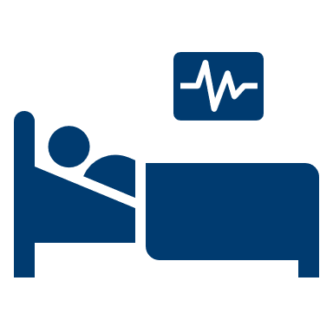
Unintentional Fall
Hospitalizations

Slide 18
Unintentional fall-related hospitalizations increased by over the last five years
7%
7%
increase
Limited to NC Residents, 2018 – 2022
Source: NC State Center for Health Statistics, Hospitalization Discharge Data (2018 – 2022)
Analysis by Injury Epidemiology and Surveillance Unit
Notes:
In 2022, the number of unintentional fall-related hospitalizations in North Carolina has increased by 7% since 2018.

Slide 19
of fall-related hospitalizations occurred among adults 65 and older
78%
Age was unknown for 0 hospitalizations
Limited to NC Residents, 2022
Source: NC State Center for Health Statistics, Hospitalization Discharge Data (2022)
Analysis by Injury Epidemiology and Surveillance Unit

Slide 20
Adults have the highest rates of fall-related hospitalizations
85 and older
Age was unknown for 0 hospitalizations
Limited to NC Residents, 2022
Source: NC State Center for Health Statistics, Hospitalization Discharge Data (2022)
Analysis by Injury Epidemiology and Surveillance Unit
Notes:
In 2022, the highest rates for fall-related hospitalizations occurred amongst North Carolina residents ages 85 and older (3,995.4 per 100,000). These hospitalization rates begin to increase among adults ages 55 and older.

Slide 21
Most fall-related hospitalizations occurred among
women and non-Hispanic Whites
NH – non-Hispanic
Sex was unknown for 1(<0.1%) injury hospitalizations and race/ethnicity was unknown for 246(0.1%) injury hospitalizations
Limited to NC Residents, 2022
Source: NC State Center for Health Statistics, Hospitalization Discharge Data (2022)
Analysis by Injury Epidemiology and Surveillance Unit
Notes:
In 2022, the most fall-related hospitalizations occurred amongst female North Carolina residents (n=15,943) and non-Hispanic Whites (n=21,363).

Slide 22
Fall-related hospitalization rates were highest among
women and non-Hispanic Whites
NH – non-Hispanic
Sex was unknown for 1(<0.1%) injury hospitalizations and race/ethnicity was unknown for 246(0.1%) injury hospitalizations
Limited to NC Residents, 2022
Source: NC State Center for Health Statistics, Hospitalization Discharge Data (2022)
Analysis by Injury Epidemiology and Surveillance Unit
Notes:
In 2022, the highest rates for fall-related hospitalizations occurred amongst female North Carolina residents (291.7 per 100,000) and non-Hispanic Whites (327.2 per 100,000).

Slide 23

Unintentional Fall Emergency Department Visits

Slide 24
Unintentional fall-related ED visits remain high, but decreased over the last five years
2%
2%
decrease
Limited to NC Residents, 2018 – 2022
Source: NC DETECT (2018 – 2022)
Analysis by Injury Epidemiology and Surveillance Unit
Notes:
The number of unintentional fall-related emergency department visits in North Carolina has decreased by 2% over the last 5 years (2018-2022). A decrease was observed until the pandemic in 2020. Since 2020, the emergency department visits related to fall-related injuries has increased.

Slide 25
of fall-related ED visits occurred among adults 65 and older
50%
Age was unknown for 656 ED Visits
Limited to NC Residents, 2022
Source: NC DETECT (2022)
Analysis by Injury Epidemiology and Surveillance Unit
Notes:
In 2022, most unintentional fall-related emergency department visits occurred amongst North Carolina residents ages 65 and older. Adults ages 65 and older accounted for approximately 50% of all fall-related emergency department visits in 2022.

Slide 26
Adults have the highest rates of fall-related ED Visits
85 and older
Age was unknown for 656 ED Visits
Limited to NC Residents, 2022
Source: NC DETECT (2022)
Analysis by Injury Epidemiology and Surveillance Unit
Notes:
In 2022, the highest rates for fall-related emergency department visits occurred amongst North Carolina residents ages 85 and older (18,219.3 per 100,000). The rates of unintentional fall-related emergency department visits begin increasing among adults ages 55 and older.

Slide 27
Most fall-related ED visits occurred among
women and non-Hispanic Whites
NH - non-Hispanic; sex was unknown for 505(<0.1%) injury ED visits and race/ethnicity was unknown for 2,731(<0.1%) injury ED visits
Limited to NC Residents, 2022
Source: NC DETECT (2022)
Analysis by Injury Epidemiology and Surveillance Unit

Slide 28
Rates of fall-related ED visits were highest among
women and non-Hispanic Whites
NH - non-Hispanic; sex was unknown for 505(<0.1%) injury ED visits and race/ethnicity was unknown for 2,731(<0.1%) injury ED visits
Limited to NC Residents, 2022
Source: NC DETECT (2022)
Analysis by Injury Epidemiology and Surveillance Unit

Slide 29
Leading diagnosis codes for fall-related
ED Visits
Limited to NC Residents, 2022
Source: NC DETECT (2022)
Analysis by Injury Epidemiology and Surveillance Unit

Slide 30
Summary of unintentional fall-related injuries in North Carolina
In 2022, unintentional fall-related injuries resulted in:
  Almost deaths
  Nearly hospitalizations
  Over emergency department visits
Most falls occur among females and Non-Hispanic whites
Rates of fall-related injuries are highest in the 75-84 and 85 and older age groups
2,000
26,000
220,000

Slide 31
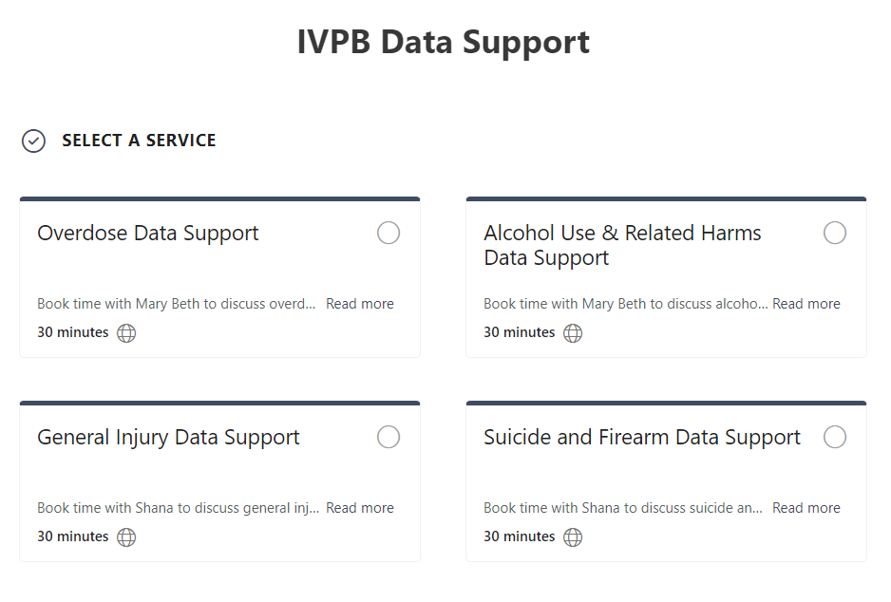

IVPB Data Support now available!
Book time with an IVPB epidemiologist to discuss available data products, to talk through custom data requests, or for general data questions.
IVPB Data Request Policy
IVPB Data Support Bookings

Slide 32
Questions?
InjuryData@dhhs.nc.gov
Injury and Violence Prevention Branch
NC Division of Public Health
www.injuryfreenc.dph.ncdhhs.gov

