Slide 1
Unintentional Fall Injuries in North Carolina
2023
Division of Public Health
Data updated March 6, 2025
Notes:
This slide set was created to provide basic data trends and public health surveillance around mortality and morbidity of falls. They are meant to offer a state-level background on unintentional fall injury. If you’d like a copy of the slides, please visit the “Falls” Data page on our branch website, https://www.dph.ncdhhs.gov/programs/chronic-disease-and-injury/injury-and-violence-prevention-branch. The direct link is also shared at the end of this presentation.
Feel free to incorporate these slides into your own presentations, grant proposals, reports, or any other way they may be useful.
Please read both the speaking and technical notes to ensure that data are presented in a consistent manner.

Slide 2
Unintentional Falls Technical Notes
Surveillance methods have been updated to identify any mention of an injury in our morbidity data sources. Individual records with multiple injuries listed will be included in the total for each of those injuries but only counted once for overall total injury count. Previously, only the first listed injury was counted, which has resulted in an increase in the number of specific injuries identified.
For questions or for more information, see technical notes document available at
https://www.injuryfreenc.ncdhhs.gov/DataSurveillance/
Case Definitions used:
Deaths – ICD10 code W00-W19 listed cause of death
Notes:
For more detailed technical notes on any of the data shared in this slide set, please contact us at InjuryData@dhhs.nc.gov.

Slide 3
Technical Notes, Continued
Hospitalizations – Among records with an ICD-10-CM injury code,* any mention of the ICD-10-CM codes below (includes records resulting in death)
Emergency Department Visits – Any mention of the ICD-10-CM codes below: (includes records resulting in hospitalization or death)
V00.11-V00.89 with 6th character=1 | Falls related to pedestrian conveyance
W00-W15, W17, W19 | Falls
W16 with 6th character=2 (Except 16.4 and 16.9 with 5th character=2) | Fall, jump, or diving into water
W18.1, W18.2, W18.3 | Other falls
7th character of A or missing (reflects initial encounter, active treatment)
*See technical notes document for a full list of ICD-10-CM injury diagnosis codes
Notes:
For more detailed technical notes on any of the data shared in this slide set, please contact us at InjuryData@dhhs.nc.gov.

Slide 4
Overview
Vulnerable Populations
Unintentional Fall Deaths
Unintentional Fall Morbidity
  Hospitalizations and Emergency Department Visits
Unintentional Fall Injury/Harm data are available at https://injuryfreenc.dph.ncdhhs.gov/DataSurveillance/FallsData.htm
For custom data requests see https://injuryfreenc.dph.ncdhhs.gov/DataSurveillance/DataRequestPolicy.htm
Notes:
This presentation is not intended to cover all data related to unintentional fall-related injury. Rather it gives an overview of some of the key trends in North Carolina. It includes information on statewide vulnerable populations, unintentional fall deaths, and unintentional fall injury hospitalizations and emergency department visits. Please note that when the COVID-19 pandemic began in 2020, there were many implications, including major changes to the numbers and rates within the unintentional fall injury data in this slide deck. The Injury and Violence Prevention Branch is still assessing how each aspect of the data were impacted.
If this slide deck does not contain the information you need, please see our custom data request policy and contact us at InjuryData@dhhs.nc.gov.

Slide 5
The populations most at risk of falls are projected to have the fastest growth over the next 20 years
2023 Population
2043 Population
Percent Change 2023-2043
N=10,846,274
N=13,327,333
Overall increase of 23%
Source: North Carolina OSBM, Standard Population Estimates, Vintage 2023 & Population Projections, Vintage 2023
Notes:
Over the next 20 years, North Carolinians ages 60 and over are projected to have the fastest population growth (36-142%), outpacing the overall 20-year population growth (23%). Twenty years from now, the population of North Carolinians ages 60 and over is expected to increase by 36%. The largest increase in population growth is expected among those ages 85 and older (142%).

Slide 6
Most older adults in North Carolina are non-Hispanic White
*Non-Hispanic
Source: National Center for Health Statistics, 2023; ages 65 and older
Notes:
In 2023, most North Carolinians ages 65 and older were non-Hispanic White (76%). The second largest racial/ethnic group among North Carolinians ages 65 and older were non-Hispanic Blacks (17%).

Slide 7
Demographic characteristics among older adults in North Carolina
43%
of housing units with people 65 and older are single person households
Source: American Community Survey, 2023 5-year estimates. Table S0103: Population 65 and older
Notes:
The American Community Survey (ACS) is a yearly survey conducted by the US Census Bureau that collects demographic and socioeconomic information about the nation’s population. According to the 2023 ACS, 43% of NC housing units with residents 65 years and older were single person households. One-third (33%) of NC residents ages 65 and older reported that they have a disability. 30% of NC residents ages 65 and older have a high school education or G.E.D.

Slide 8
One in five older adults in NC reports trouble walking
Source: American Community Survey, 2023 5-year estimates. Table S1810: Population 65 and older
Notes:
In 2023, approximately 1 in 5 North Carolina residents ages 65 and over reported that they have trouble walking (21%). NC residents ages 65 and over also reported experiencing hearing (14%), independent living (13%), cognitive (8%), vision (6%), and self-care (7%) disabilities.

Slide 9
Around 75% of older adults in NC have one or more chronic diseases, 2023 BRFSS
Source: NC State Center of Health Statistics, 2023 Behavioral Risk Factor Surveillance System (BRFSS) Survey Results
Notes:
The Behavioral Risk Factor Surveillance System, developed by the Centers for Disease Control and Prevention (CDC), is a random telephone survey of state residents aged 18 years and older. The purpose is to obtain estimates of the prevalence of personal health behaviors that contribute to morbidity and mortality. In 2023, about 75% of NC respondents ages 65 and older reported having one or more chronic diseases. Among those ages 65-74, 38% reported 2 or more chronic diseases and 47% of those ages 75 and older reported 2 or more chronic diseases.

Slide 10
Proportion of demographic groups reporting two or more falls in the last 12 months, 2023 BRFSS
Overall 12%
Overall 12%
Source: NC State Center of Health Statistics, 2023 Behavioral Risk Factor Surveillance System (BRFSS) Survey Results
Notes:
In 2023, 12% of NC respondents reported two or more falls in the last 12 months. However, when broken out by demographics and socioeconomic status, more than 12% (state overall) reported two or more falls in the last 12 months. These groups included females (12.4%), those ages 55 years and older (13%, 13%, and 14%), individuals with some post high school education (13%), individuals with a disability (25%), veterans (14%), respondents living in suburban areas (16%), and those in the 3rd quartile of social vulnerability (17%). Less than 10% of college graduates (9%), respondents living in urban areas (9%), and those with no disability (5%) reported two or more falls in the last 12 months.

Slide 11
Unintentional fall-related deaths are the tip of the iceberg
2,007
Despite NC’s excellent reporting systems, the total burden of fall injury in the state
is unknown.
Deaths
27,880
Hospitalizations
259,507
ED Visits
? EMS
? Outpatient Visits
? Medically Unattended Injuries
INJURY ICEBURG
Limited to NC Residents, 2023
Source: NC State Center for Health Statistics, Vital Statistics-Deaths (2023) and Hospitalization Discharge Data (2023); NC DETECT (2023)
Analysis by Injury Epidemiology and Surveillance Unit
Notes:
In 2023 there were 2,007 deaths, 27,880 hospitalizations, and 259,507 emergency department visits associated with unintentional fall injuries in North Carolina. However, this is just the tip of the iceberg and the total burden of unintentional fall injury in NC is unknown.

Slide 12

Unintentional Fall
Deaths

Slide 13
Unintentional fall-related deaths have continued to increase over the last 10 years
86%
increase
Limited to NC Residents, 2014 – 2023
Source: NC State Center for Health Statistics, Vital Statistics-Deaths (2014 – 2023)
Analysis by Injury Epidemiology and Surveillance Unit
Notes:
The number of unintentional fall-related deaths in North Carolina has increased by 86% over the last 10 years (2014-2023).

Slide 14
Unintentional falls were the leading cause of injury death* in 2023
second
*by mechanism and intent
MVT = Motor Vehicle Traffic
Limited to NC Residents, 2023
Source: NC State Center for Health Statistics, Vital Statistics-Deaths (2023)
Analysis by Injury Epidemiology and Surveillance Unit
Notes:
In 2023, unintentional falls were the second leading cause of injury-related death in North Carolina, with 2,007 unintentional fall-related deaths among NC residents.

Slide 15
Unintentional falls were the cause of injury death among older adults*
number one
89%
of fall-related
deaths
*Adults ages 65 and older
Limited to NC Residents, 2023 (N = 2,007)
Source: NC State Center for Health Statistics, Vital Statistics-Deaths (2023)
Analysis by Injury Epidemiology and Surveillance Unit
Notes:
In 2023, unintentional falls were the number one cause of injury death among North Carolina residents ages 65 and older. Approximately 89% of unintentional fall-related deaths were among those ages 65 and over.

Slide 16
Unintentional fall death rates are highest among those ages
85 and older
Rates begin increasing among ages 45-54
*Rate suppressed due to count being less than 5
Limited to NC Residents, 2023 (N = 2,007)
Source: NC State Center for Health Statistics, Vital Statistics-Deaths (2023)
Analysis by Injury Epidemiology and Surveillance Unit
Notes:
In 2023, North Carolina residents ages 85 and older (477.9 per 100,000) had the highest unintentional fall-related death rates. The death rates of unintentional falls began increasing at age 45.

Slide 17
Rates of unintentional fall-related deaths were highest among men and non-Hispanic Whites
NH - non-Hispanic; There were 0 deaths where the race/ethnicity was unknown
Limited to NC Residents, 2023 (N = 2,007)
Source: NC State Center for Health Statistics, Vital Statistics-Deaths (2023)
Analysis by Injury Epidemiology and Surveillance Unit
Notes:
In 2023, the highest rates for unintentional fall-related deaths occurred amongst male (18.6 per 100,000) and non-Hispanic White (26.4 per 100,000) North Carolina residents.

Slide 18

Unintentional Fall
Hospitalizations

Slide 19
Unintentional fall-related hospitalizations increased by over the last five years
11%
11%
increase
Limited to NC Residents, 2019 – 2023
Source: NC State Center for Health Statistics, Hospitalization Discharge Data (2019 – 2023)
Analysis by Injury Epidemiology and Surveillance Unit
Notes:
In 2023, the number of unintentional fall-related hospitalizations in North Carolina has increased by 11% since 2019.

Slide 20
of unintentional fall-related hospitalizations occurred among adults 65 and older
78%
Age was unknown for 0 hospitalizations
Limited to NC Residents, 2023
Source: NC State Center for Health Statistics, Hospitalization Discharge Data (2023)
Analysis by Injury Epidemiology and Surveillance Unit
Notes:
In 2023, 78% of fall-related hospitalizations were among NC residents ages 65 and over.

Slide 21
Adults have the highest rates of unintentional fall-related hospitalizations
85 and older
Age was unknown for 0 hospitalizations
Limited to NC Residents, 2023
Source: NC State Center for Health Statistics, Hospitalization Discharge Data (2023)
Analysis by Injury Epidemiology and Surveillance Unit
Notes:
In 2023, the highest rates for fall-related hospitalizations occurred amongst NC residents ages 85 and older (4,052.5 per 100,000). These hospitalization rates began increasing at age 55.

Slide 22
Unintentional fall-related hospitalization rates were highest among women and NH Whites
NH – non-Hispanic
Sex was unknown for 1 (<0.1%) injury hospitalizations and race/ethnicity was unknown for 312 (0.1%) injury hospitalizations
Limited to NC Residents, 2023
Source: NC State Center for Health Statistics, Hospitalization Discharge Data (2023)
Analysis by Injury Epidemiology and Surveillance Unit
Notes:
In 2023, the highest rates for fall-related hospitalizations occurred amongst female (308.1 per 100,000) and non-Hispanic White (348.8 per 100,000) North Carolina residents.

Slide 23

Unintentional Fall Emergency Department Visits

Slide 24
Unintentional fall-related ED visits increased by over the last five years
17%
17%
increase
Limited to NC Residents, 2019 – 2023
Source: NC DETECT (2019 – 2023)
Analysis by Injury Epidemiology and Surveillance Unit
Notes:
Overall, the number of unintentional fall-related emergency department visits in North Carolina increased by 17% over the last 5 years (2019-2023). A decrease was observed until the pandemic in 2020. Since 2020, there has been an increase in ED visits for unintentional fall-related injuries.

Slide 25
of unintentional fall-related ED visits occurred among adults 65 and older
53%
Age was unknown for 348 ED Visits
Limited to NC Residents, 2023
Source: NC DETECT (2023)
Analysis by Injury Epidemiology and Surveillance Unit
Notes:
In 2023, more than half (53%) of unintentional fall-related emergency department visits were among NC residents ages 65 and older.

Slide 26
Adults have the highest rates of unintentional fall-related ED Visits
85 and older
Age was unknown for 348 ED Visits
Limited to NC Residents, 2023
Source: NC DETECT (2023)
Analysis by Injury Epidemiology and Surveillance Unit
Notes:
In 2023, the highest rates for unintentional fall-related emergency department visits occurred amongst North Carolina residents ages 85 and older (22,130.5 per 100,000). The rates of unintentional fall-related ED visits began increasing at age 55.

Slide 27
Rates of unintentional fall-related ED visits were highest among women and NH Whites
NH - non-Hispanic; sex was unknown for 332 (<0.1%) injury ED visits and race/ethnicity was unknown for 3,904(<0.1%) injury ED visits
Limited to NC Residents, 2023
Source: NC DETECT (2023)
Analysis by Injury Epidemiology and Surveillance Unit
Notes:
In 2023, the highest rates for unintentional fall-related ED visits occurred amongst female (2,803.7 per 100,000) and non-Hispanic white (2,810.5 per 100,000) North Carolina residents.

Slide 28
Leading diagnosis codes for unintentional fall-related ED Visits
Limited to NC Residents, 2023
Source: NC DETECT (2023)
Analysis by Injury Epidemiology and Surveillance Unit
Notes:
Over two-thirds (70.1%) of unintentional fall-related ED visits are categorized as unspecified falls. Of those with a specified reason, 7.6% are falls related to slipping, tripping and stumbling.

Slide 29
Summary of unintentional fall-related injuries in North Carolina
In 2023, unintentional fall-related injuries resulted in:
  Over deaths
  Nearly hospitalizations
  Over emergency department visits
Most falls occur among females and Non-Hispanic White NC residents
Rates of fall-related injuries are highest in the 75-84 and 85 and older age groups
2,000
28,000
259,000
Notes:
In 2023, unintentional fall-related injuries resulted in over 2,000 deaths, nearly 26,000 hospitalizations, and over 259,000 emergency department visits in North Carolina. The highest rates of unintentional fall-related injuries and death occurred among females, non-Hispanic whites, and residents ages 75 years and older.

Slide 30
Where to find more data on unintentional fall-related death and injury?
NC Injury and Violence Prevention Branch Falls Injury Data
NC DETECT Unintentional Falls Dashboard
State Center for Health Statistics (SCHS) Death Certificate Data
  NC Health Data Query System
CDC WISQARS – Fatal Injury and Violence Data

Slide 31
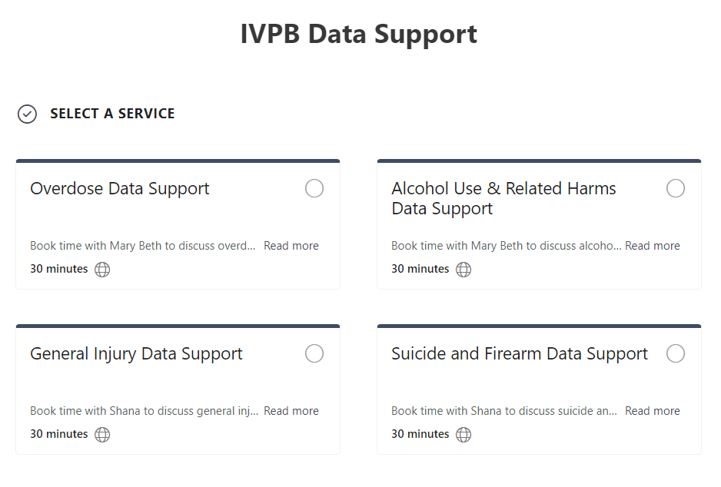

IVPB Data Support now available!
Book time with an IVPB epidemiologist to discuss available data products, to talk through custom data requests, or for general data questions.
IVPB Data Request Policy
IVPB Data Support Bookings

Slide 32
Questions?
InjuryData@dhhs.nc.gov
Injury and Violence Prevention Branch
NC Division of Public Health
www.dph.ncdhhs.gov/programs/chronic-disease-and-injury/injury-and-violence-prevention-branch

