Slide 1
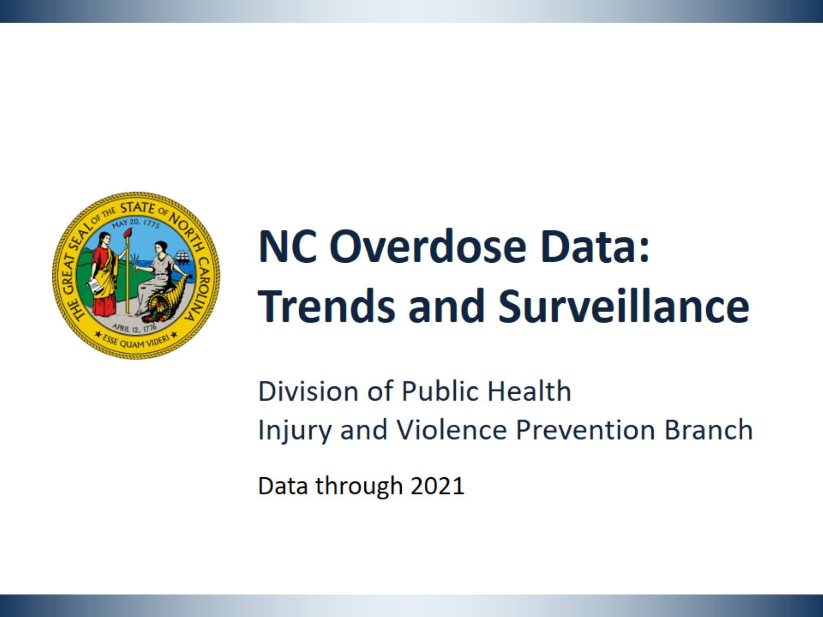
Notes:
This slide set was created to provide basic data trends and public health surveillance around the drug overdose epidemic. They are meant to offer a state-level background on drug overdose. If you’d like a copy of the slides please visit the Overdose Data page on our branch website, Injuryfreenc.dhhs.gov. The direct link is also shared at the end of this presentation.
Feel free to incorporate these slides into your own presentations, grant proposals, reports, or any other way they may be useful.
Please read both the speaking and technical notes to ensure that data are presented in a consistent manner.

Slide 2
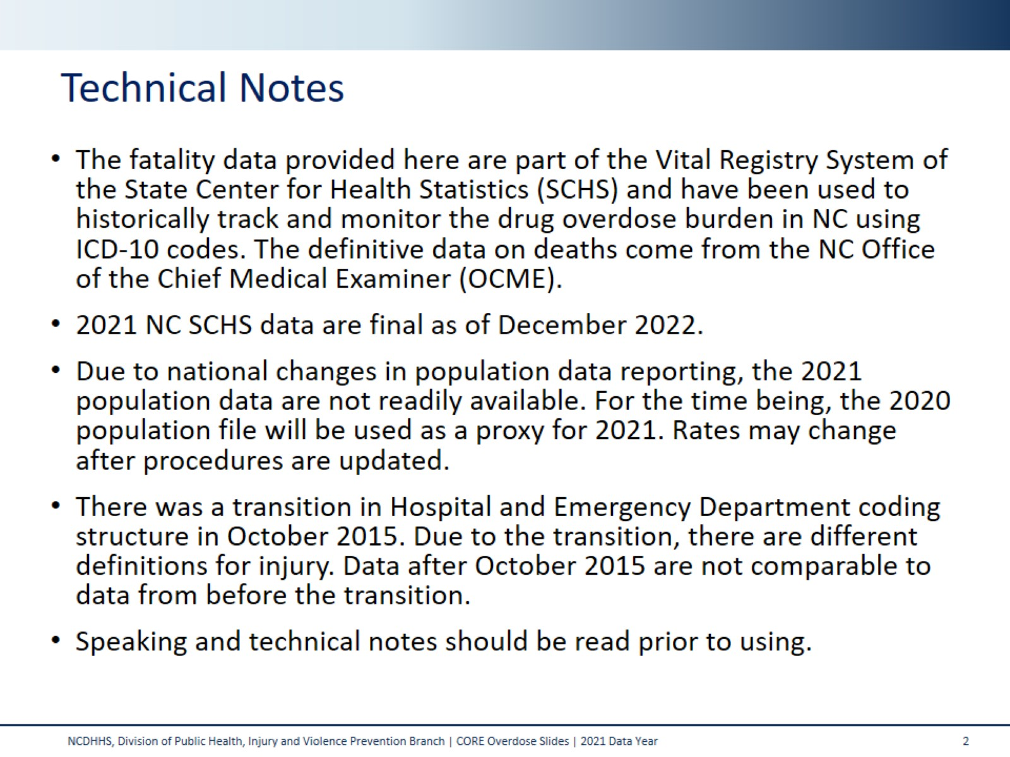
Technical Notes
Notes:
For more detailed technical notes on any of the data shared in this slide set, please contact us at SubstanceUseData@dhhs.nc.gov

Slide 3
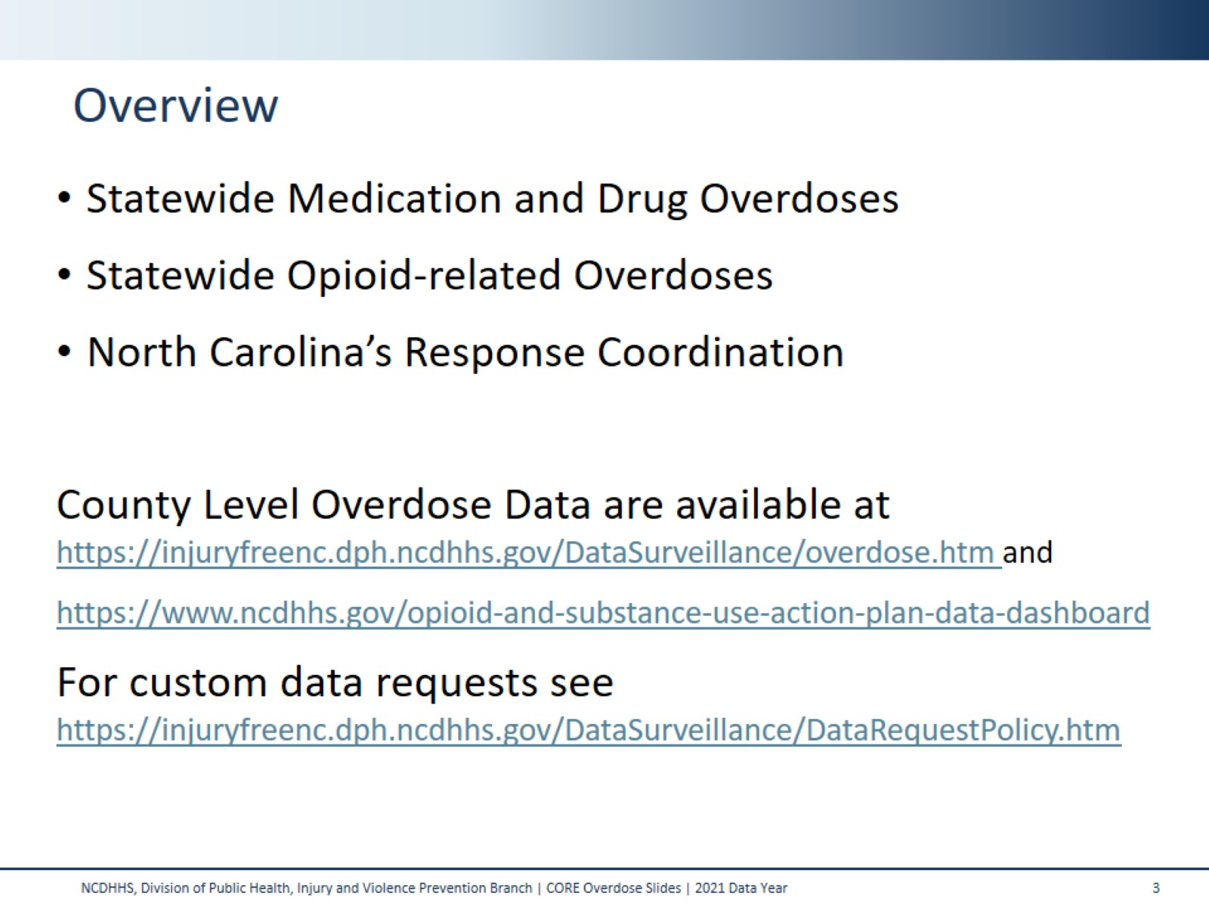
Overview
Notes:
This presentation is not intended to cover all data related to the overdose epidemic. Rather it gives an overview of some of the key trends in North Carolina. It includes information on statewide medication and drug overdoses, opioid-related overdoses, and our state’s response coordination. Please note that when the COVID-19 pandemic began in 2020, there were many implications, including major changes to the numbers and rates within the overdose data in this slide deck. The Injury and Violence Prevention Branch is still assessing how each aspect of the data were impacted.
County and Regional Level slides are available on the IVPB Poisoning Data page linked on this slide.
If this slide deck does not contain the information you need, please see our custom data request policy and contact us at SubstanceUseData@dhhs.nc.gov.

Slide 4
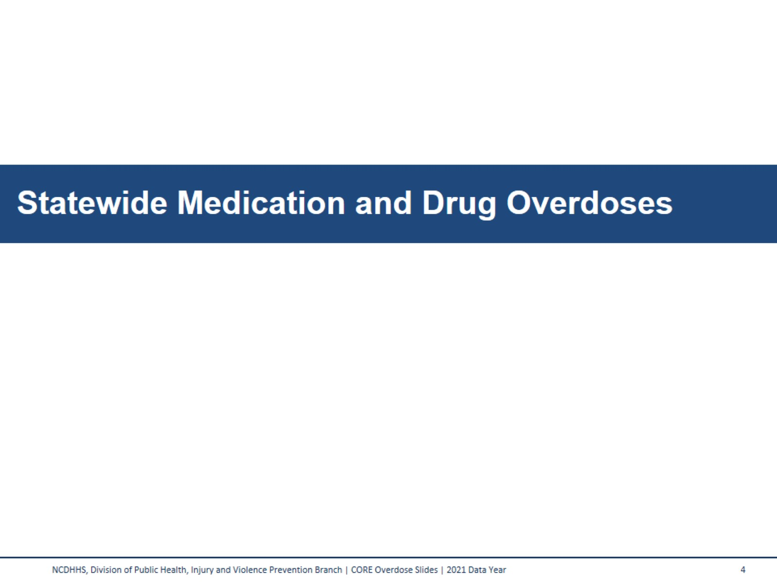
Statewide Medication and Drug Overdoses
Notes:
Medication and drug overdose deaths consist of a broad category of medications and drugs, including prescription, over-the-counter, and illicit substances.

Slide 5
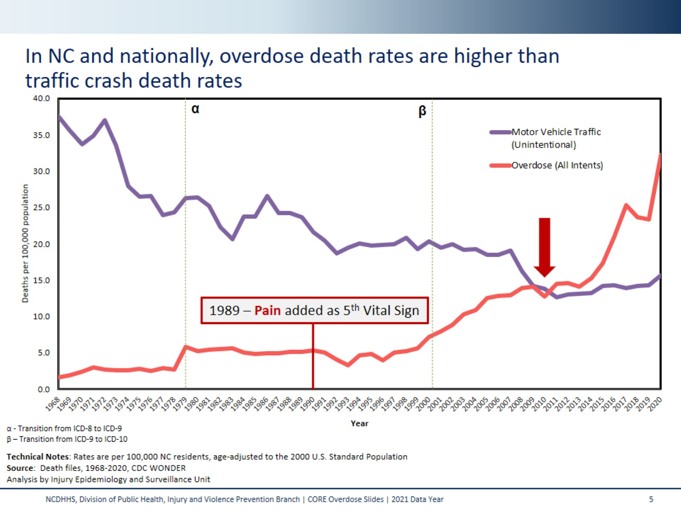
In NC and nationally, overdose death rates are higher than traffic crash death rates
Notes:
Here are nearly 50 years of data for two specific types of injuries. For most of the past century, motor vehicle deaths were the leading cause of injury death in NC and US. In North Carolina, poisonings from all intents overtook motor vehicle crashes in 2010 to become the leading cause of injury death.
The decrease in motor vehicle crash fatalities can be attributed to the implementation of seat belt laws, and several changes to safety measures in the construction of automobiles and roadways. The rise in poisoning deaths can be linked to a shift in focus to treating pain as the 5th vital sign, new formulations of opioids such as oxycodone, and increased marketing of pain medications to the public.
Motor vehicle crash deaths have been on a continuous decline for many years, but drug poisoning deaths continue to rise. These two lines tell a powerful story of public health’s ability, and that of society at large, to address a significant health issue over time. With a combined approach, similar to that used to reduce motor vehicle crash fatalities, poisoning deaths can be prevented as well.

Slide 6
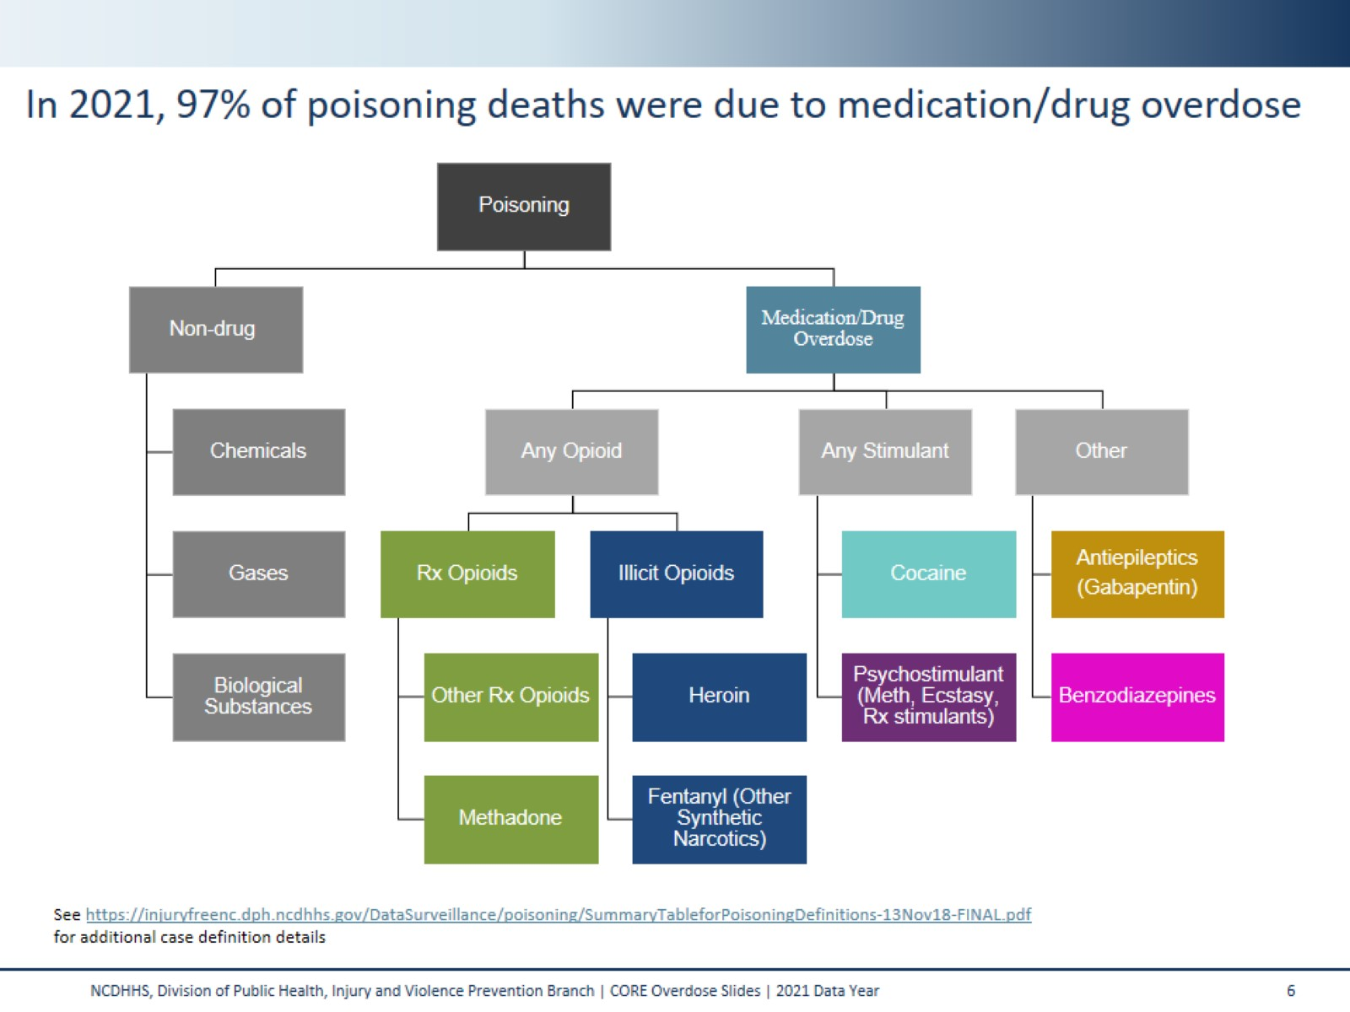
In 2021, 97% of poisoning deaths were due to medication/drug overdose
Notes:
In North Carolina, there were 4,172 deaths in 2021 due to any poisoning.
4,041 of these were medication and/or drug overdoses. Ultimately, 96.8% of all poisoning deaths were due to medication and/or drug overdose.

Slide 7
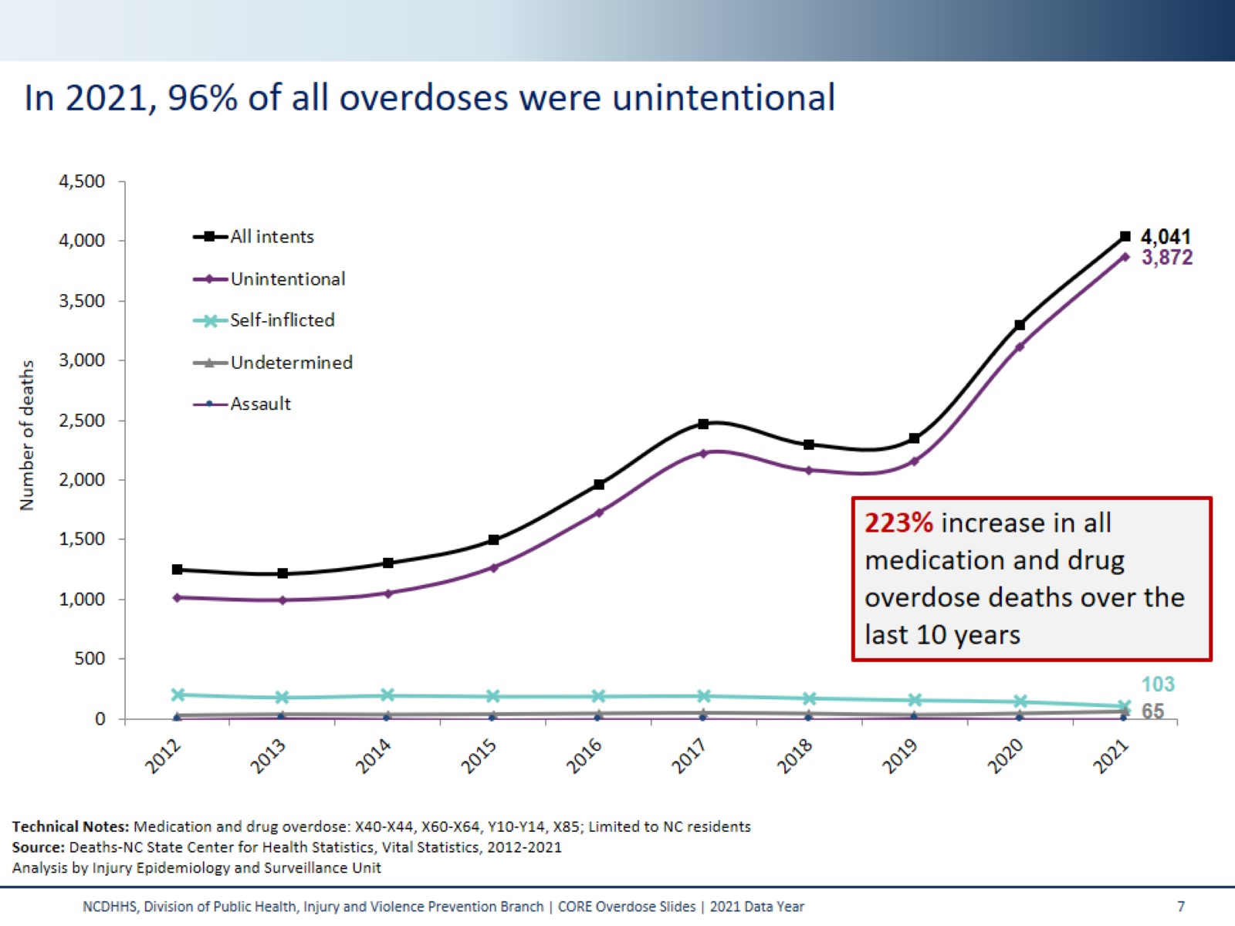
In 2021, 96% of all overdoses were unintentional
Notes:
In North Carolina, and in the United States as whole, deaths due to an overdose have been steadily increasing since 1999, and in 2021 the vast majority (95.8%) of these are unintentional.
The number of overdose deaths in NC has increased 223%, over the last 10 years (2012-2021).

Slide 8
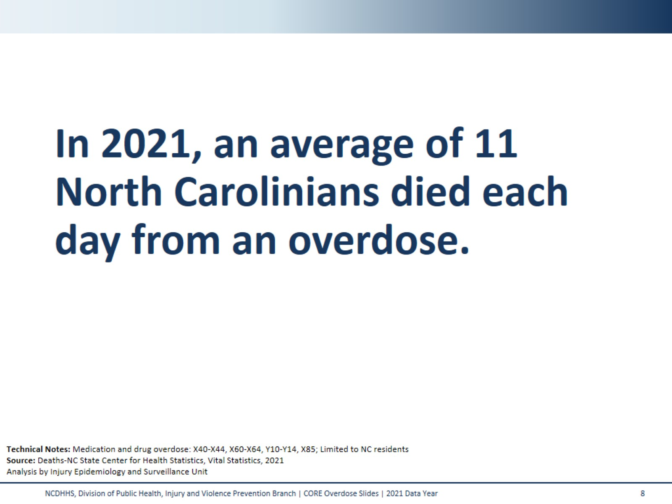
In 2021, an average of 11 North Carolinians died each day from an overdose.
Notes:
In 2021, an average of 11 North Carolinians died each day from an overdose. Though largely driven by opioids, this number includes overdose deaths from other medications and drugs (cocaine, benzodiazepines, etc). This number includes all medication and/or drug overdoses, including unintentional, self-inflicted, undetermined, and assault.

Slide 9
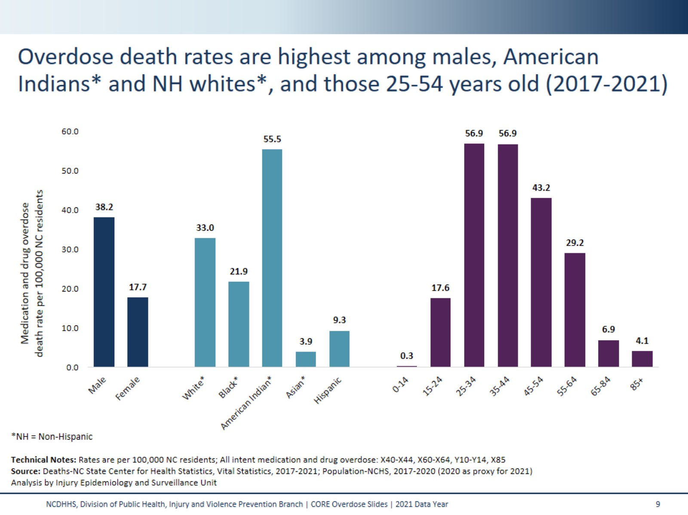
Overdose death rates are highest among males, American Indians* and NH whites*, and those 25-54 years old (2017-2021)
Notes:
The highest rates of overdose deaths occurred amongst NC residents ages 25-34 (56.9 per 100,000) and 35-44 (56.9 per 100,000), males (38.2 per 100,000), NH American Indians (55.5 per 100,000). These rates are calculated over a five-year time period (2017-2021).
Technical Notes:
Due to changes within NC SCHS, the 2021 population file is currently on hold. The 2020 population file will be used as a proxy for 2021. Rates will be subject to change until a new file is created.

Slide 10
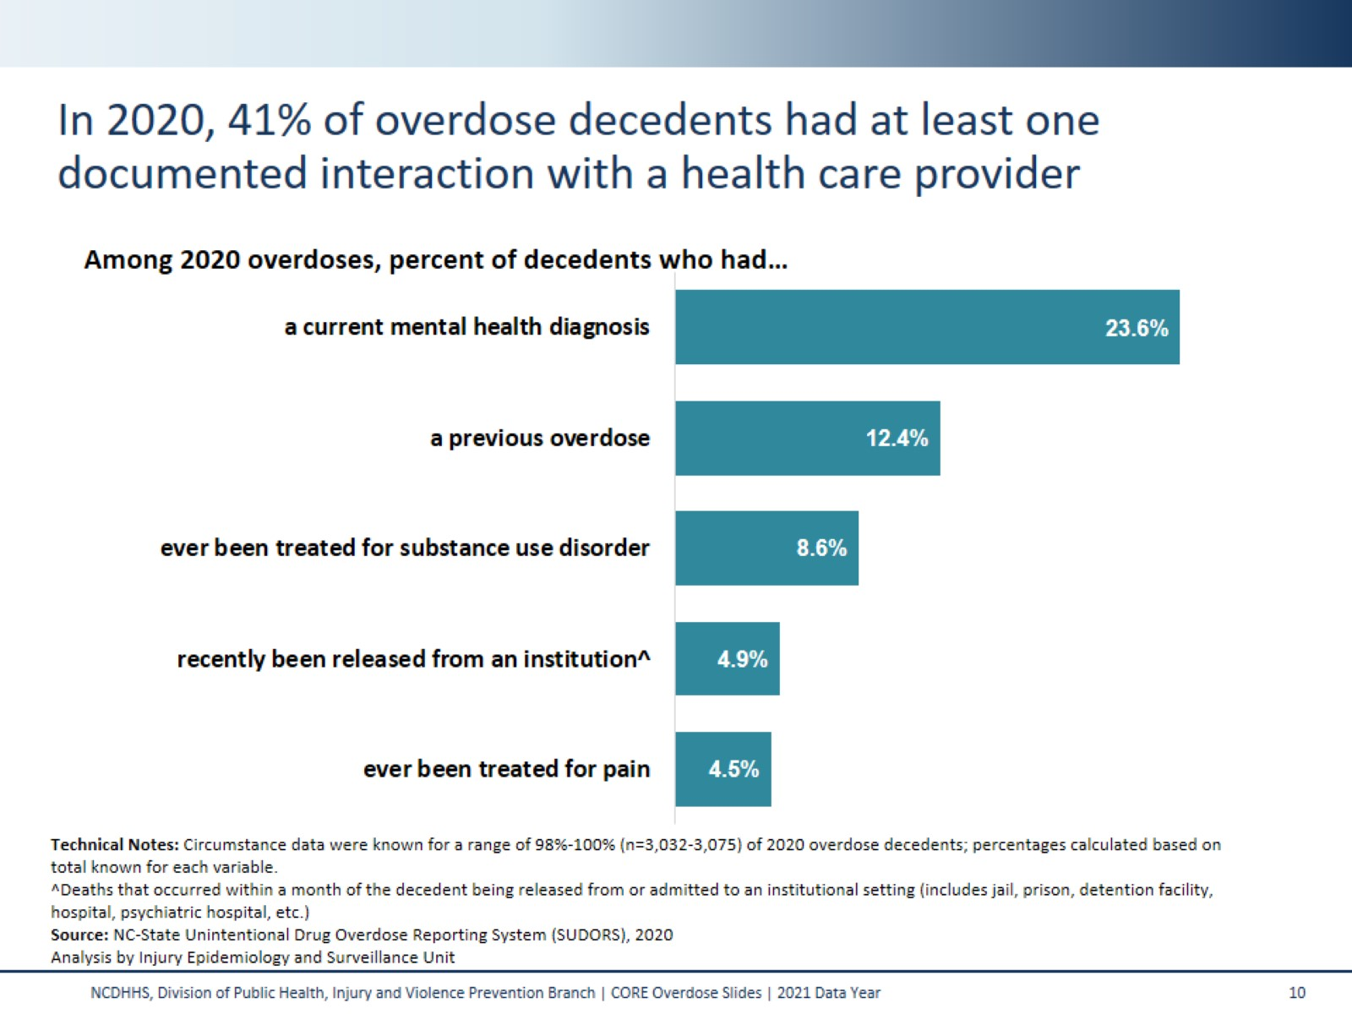
In 2020, 41% of overdose decedents had at least one documented interaction with a health care provider
Notes:
Opportunities for intervention exist every time a patient interacts with a medical provider in the healthcare system.
When accounting for undiagnosed, undocumented, or unreported events/conditions, these percentages are likely higher than shown here.
These data come from the State Unintentional Drug Overdose Reporting System (SUDORS), a program developed by the Centers for Disease Control and Prevention (CDC) as a response to the opioid overdose epidemic to enable states to collect detailed overdose death information. SUDORS provides rich circumstance data and highlights opportunities where intervention could save lives.

Slide 11
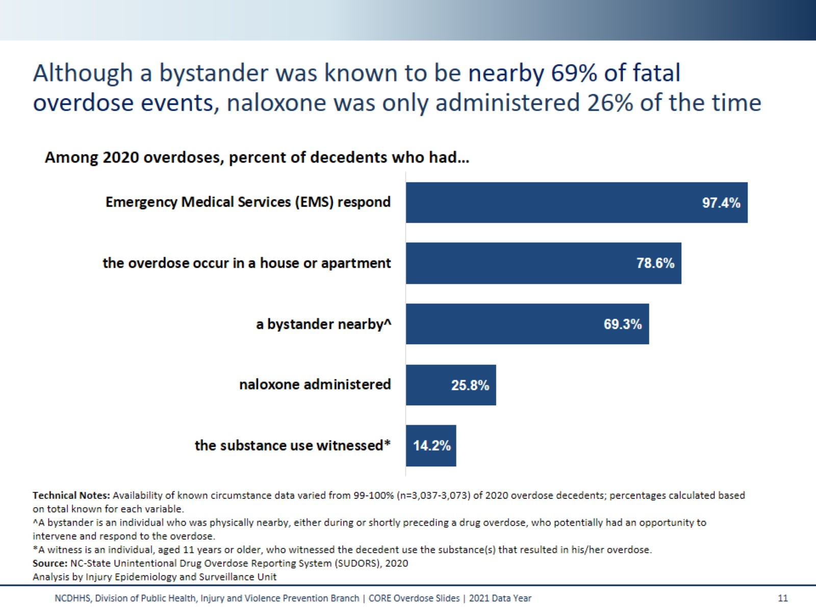
Although a bystander was known to be nearby 69% of fatal overdose events, naloxone was only administered 26% of the time
Notes:
Location of an overdose and the response of bystanders and or EMS personnel are important factors that can be used to inform and guide overdose prevention efforts in North Carolina. Naloxone should be provided to any individual at risk for overdose, their family and friends with directions for use.
These data come from the State Unintentional Drug Overdose Reporting System (SUDORS), a program developed by the Centers for Disease Control and Prevention (CDC) as a response to the opioid overdose epidemic to enable states to collect detailed overdose death information. SUDORS provides rich circumstance data and highlights opportunities where intervention could save lives.

Slide 12
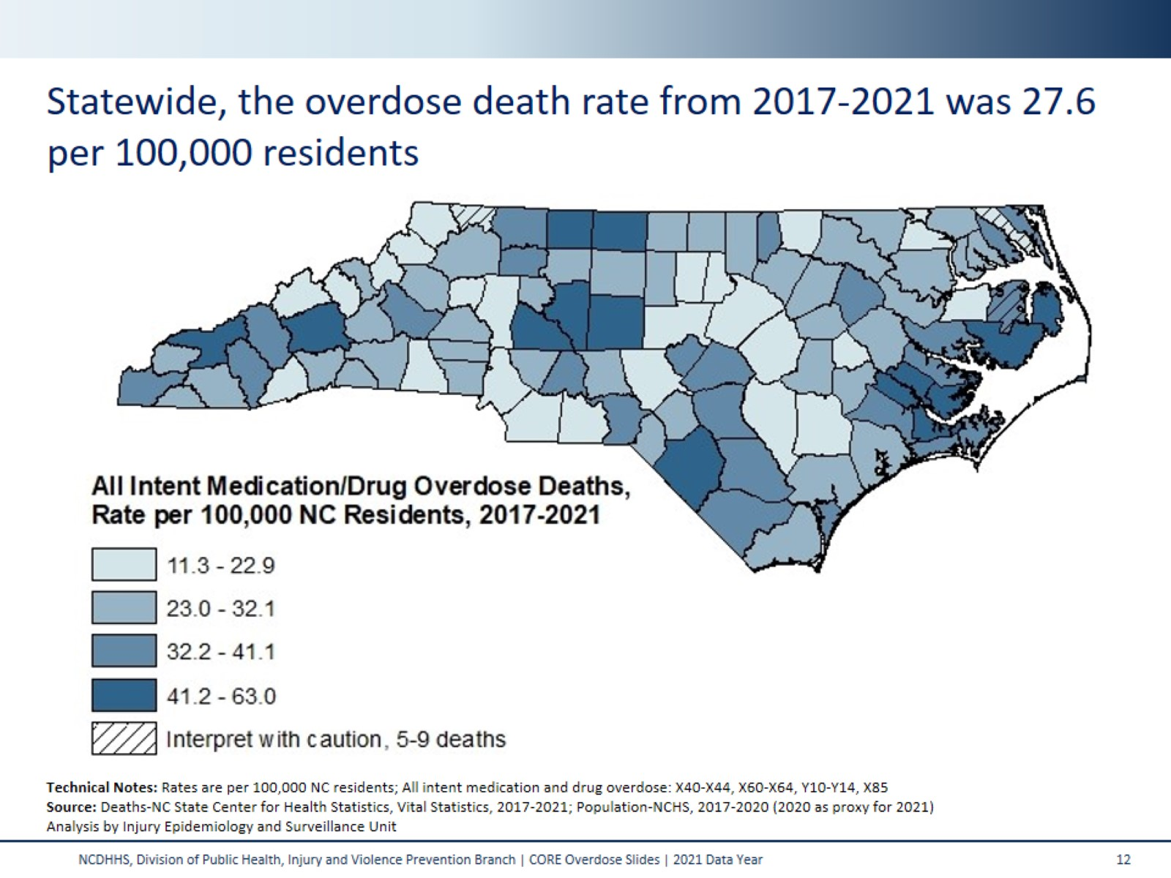
Statewide, the overdose death rate from 2017-2021 was 27.6 per 100,000 residents
Notes:
This map shades the counties of NC based on their respective overdose death rate. The statewide rate was 27.6 per 100,000 residents from 2017-2021. This five-year period was used in order to provide greater reliability in county-level rate estimates.
All counties had more than four deaths, so all rates were calculated. Interpret rates with caution in counties with fewer than 10 deaths.
Technical Notes:
Due to changes within NC SCHS, the 2021 population file is currently on hold. The 2020 population file will be used as a proxy for 2021. Rates will be subject to change until a new file is created.

Slide 13
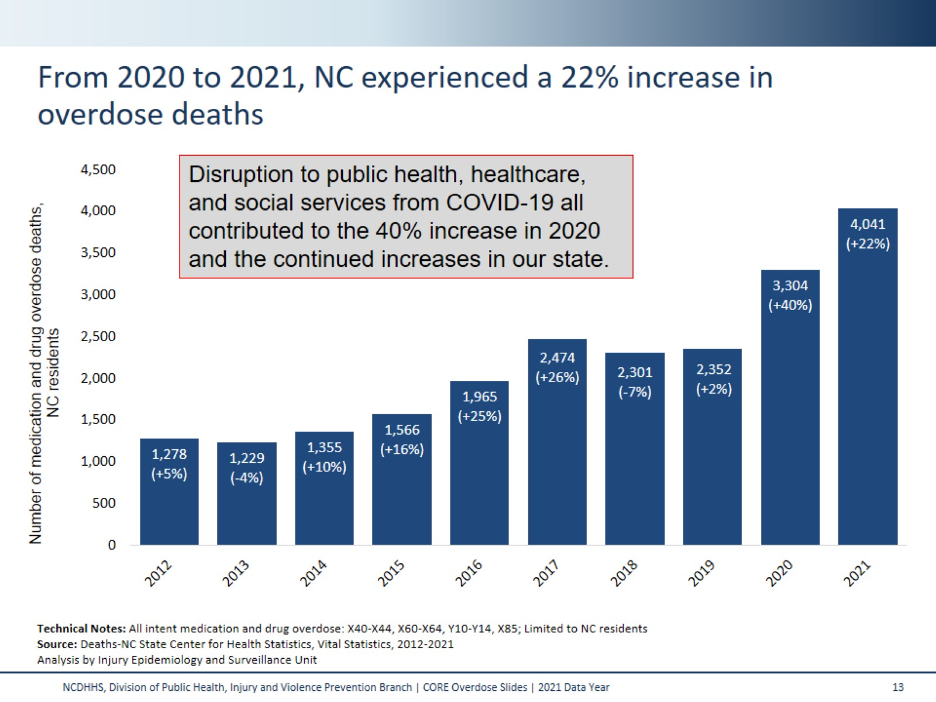
From 2020 to 2021, NC experienced a 22% increase in overdose deaths
Notes:
This slide looks at both the number and the percent change in overdose deaths among NC residents over the last decade. Under the number of deaths in each bar, you’ll see the percent increase or decrease compared to the previous year in parenthesis. From 2020 to 2021, North Carolina saw a 22% increase in the number of overdose deaths.

Slide 14
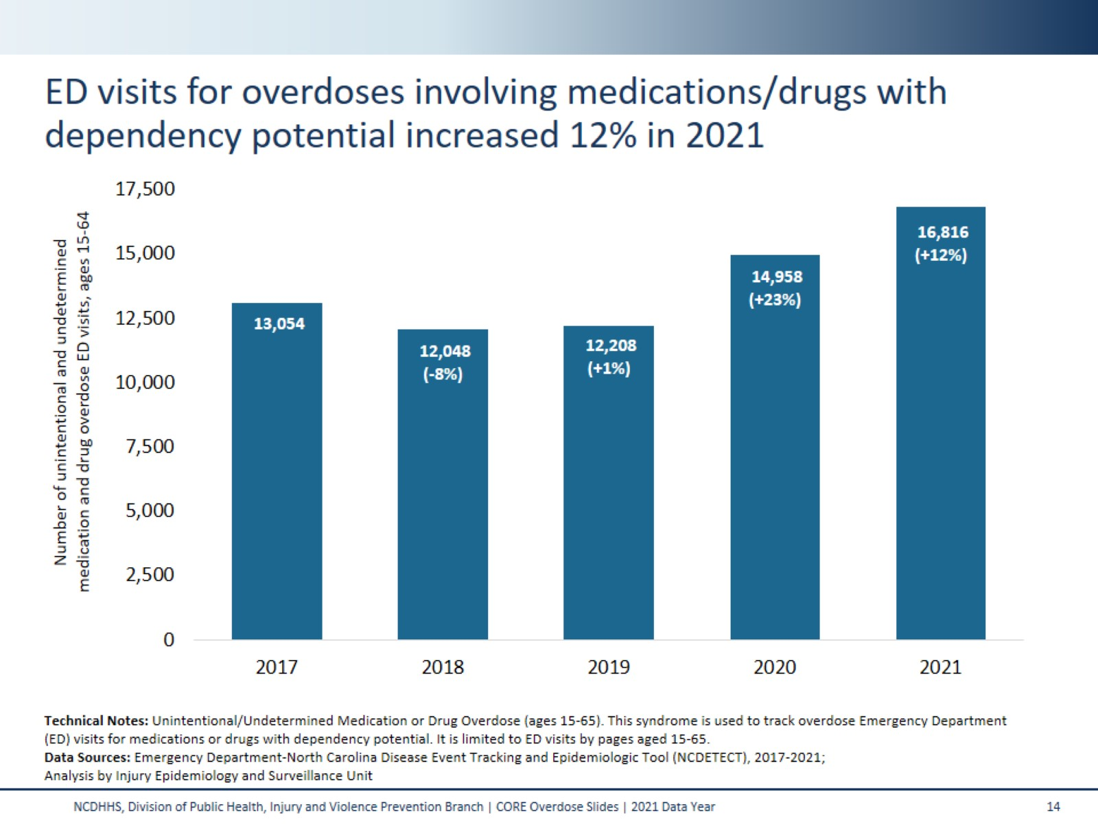
ED visits for overdoses involving medications/drugs with dependency potential increased 12% in 2021
Notes:
This slide shows counts and percent increase or decrease in the number of unintentional and undetermined overdoses with the potential for misuse among those ages 15 to 64 visits to the Emergency Department. In 2021, we see a 12.4% increase from 2020 in the number unintentional/undetermined overdose ED visits with dependency potential among ages 15 to 64.

Slide 15
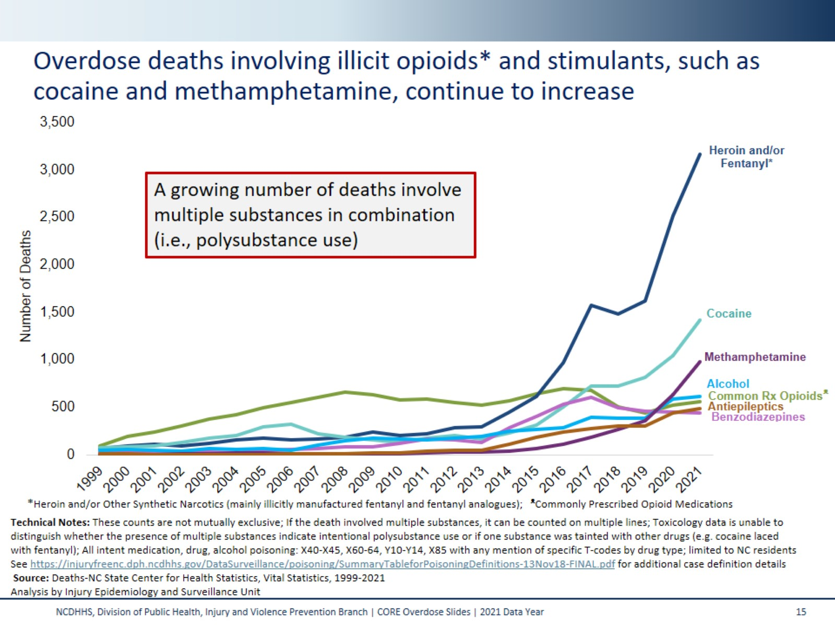
Overdose deaths involving illicit opioids* and stimulants, such as cocaine and methamphetamine, continue to increase
Notes:
The overdose epidemic is mostly driven by opiates. Historically, prescription opioids (drugs like hydrocodone, oxycodone, morphine) have contributed to an increasing number of medication/drug overdose deaths. In recent years, illicit opioids like heroin and synthetic narcotics such as fentanyl, and fentanyl analogues* have resulted in increased deaths. The number of deaths involving other substances like cocaine, benzodiazepines, alcohol, antiepileptics (gabapentin), and psychostimulants (which includes methamphetamine) continue to rise.
These counts are not mutually exclusive. If a death involved multiple substances, it can be counted on multiple lines. A growing number deaths involve multiple substances in combination.
*Fentanyl analogues are drugs that are similar to fentanyl but have been chemically modified in order to bypass current drug laws.

Slide 16
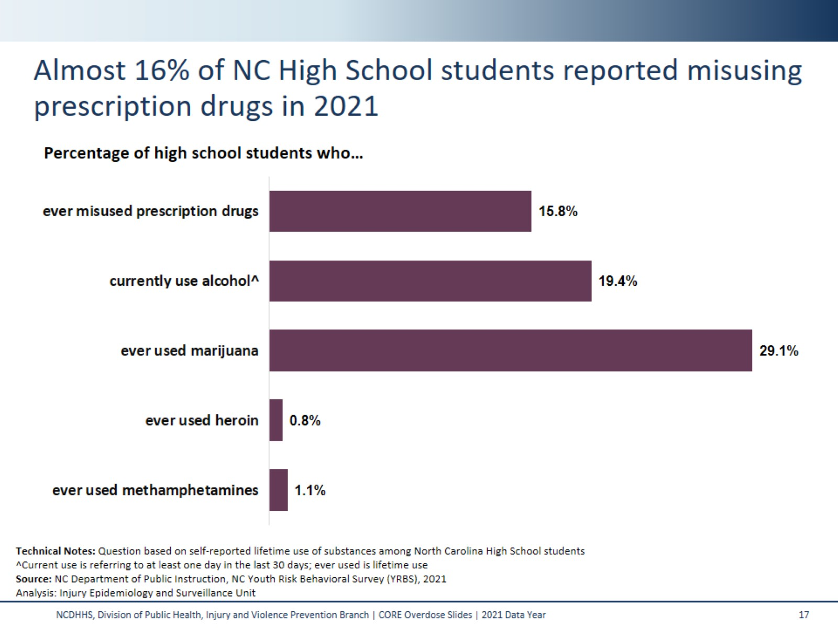
Almost 16% of NC High School students reported misusing prescription drugs in 2021
Notes:
This slide contains data from the NC Youth Risk Behavioral Survey (YRBS). YRBS is a representative sample of high school and middle school students in NC. This chart only represents students in high school. Self-reported survey data often give an underestimate of drug use.
In 2021, students were asked if they’d ever taken a prescription drug without a prescription or differently than indicated by a doctor. This question asks specifically about prescription pain medicines such as codeine, Vicodin, oxycontin, hydrocodone, or Percocet.
Questions about prescriptions drugs, marijuana, heroin, and methamphetamines ask about any lifetime use. The question regarding alcohol asks specifically about use in the last 30 days.
Technical Notes:
The NC-YRBS is administered every other year to a representative sample of high school students across the state.

Slide 17
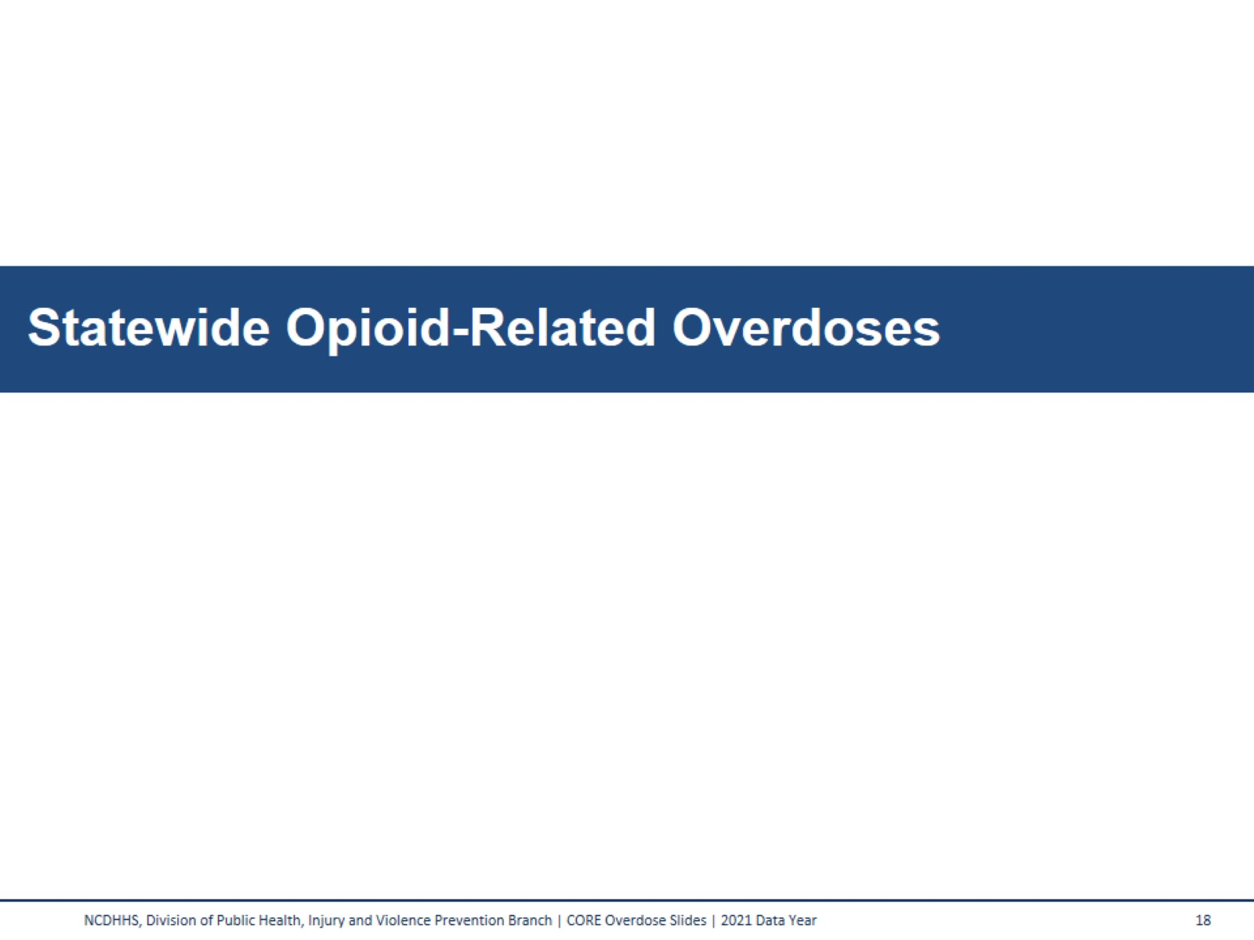
Statewide Opioid-Related Overdoses
Notes:
With an unprecedented availability of cheap heroin and fentanyl, more people are dying. Heroin is twice as potent as morphine, fentanyl is 100 times as potent as morphine, and carfentanil (a fentanyl analogue) is 10,000 times as potent as morphine.
Note: Figure not to scale.

Slide 18
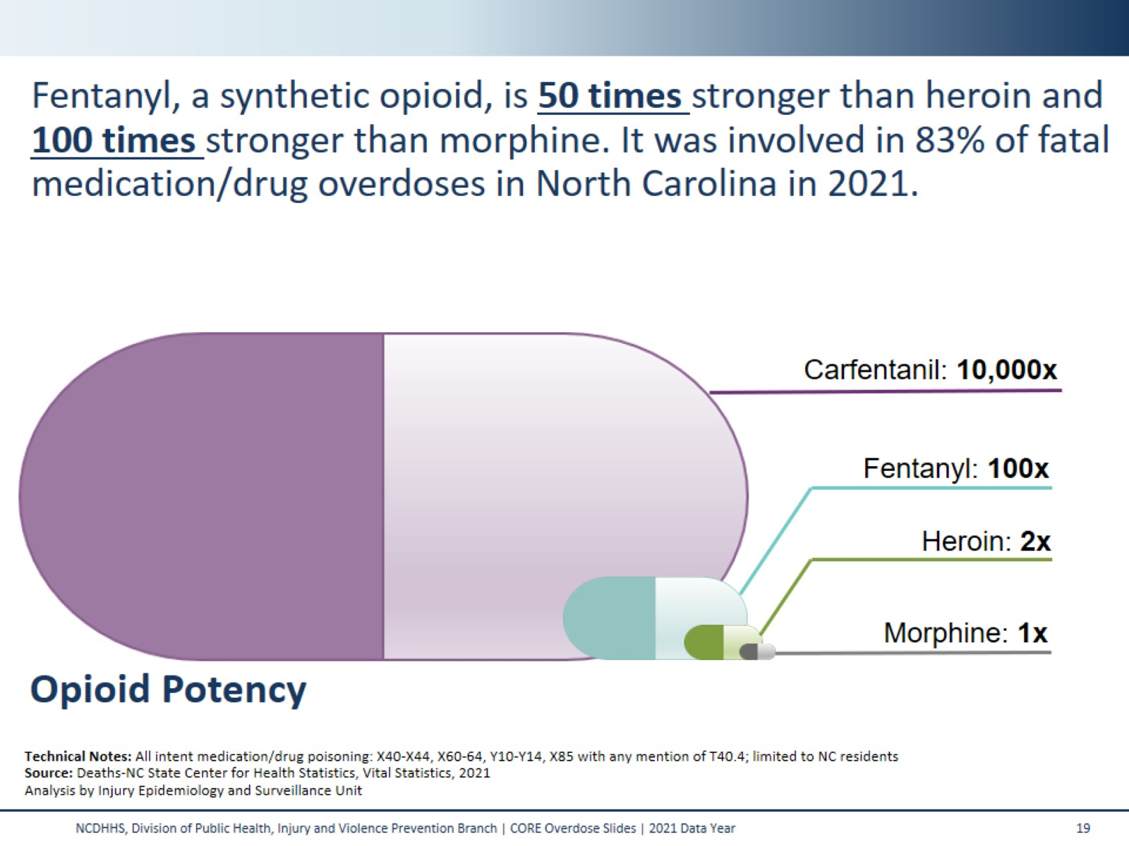

Slide 19
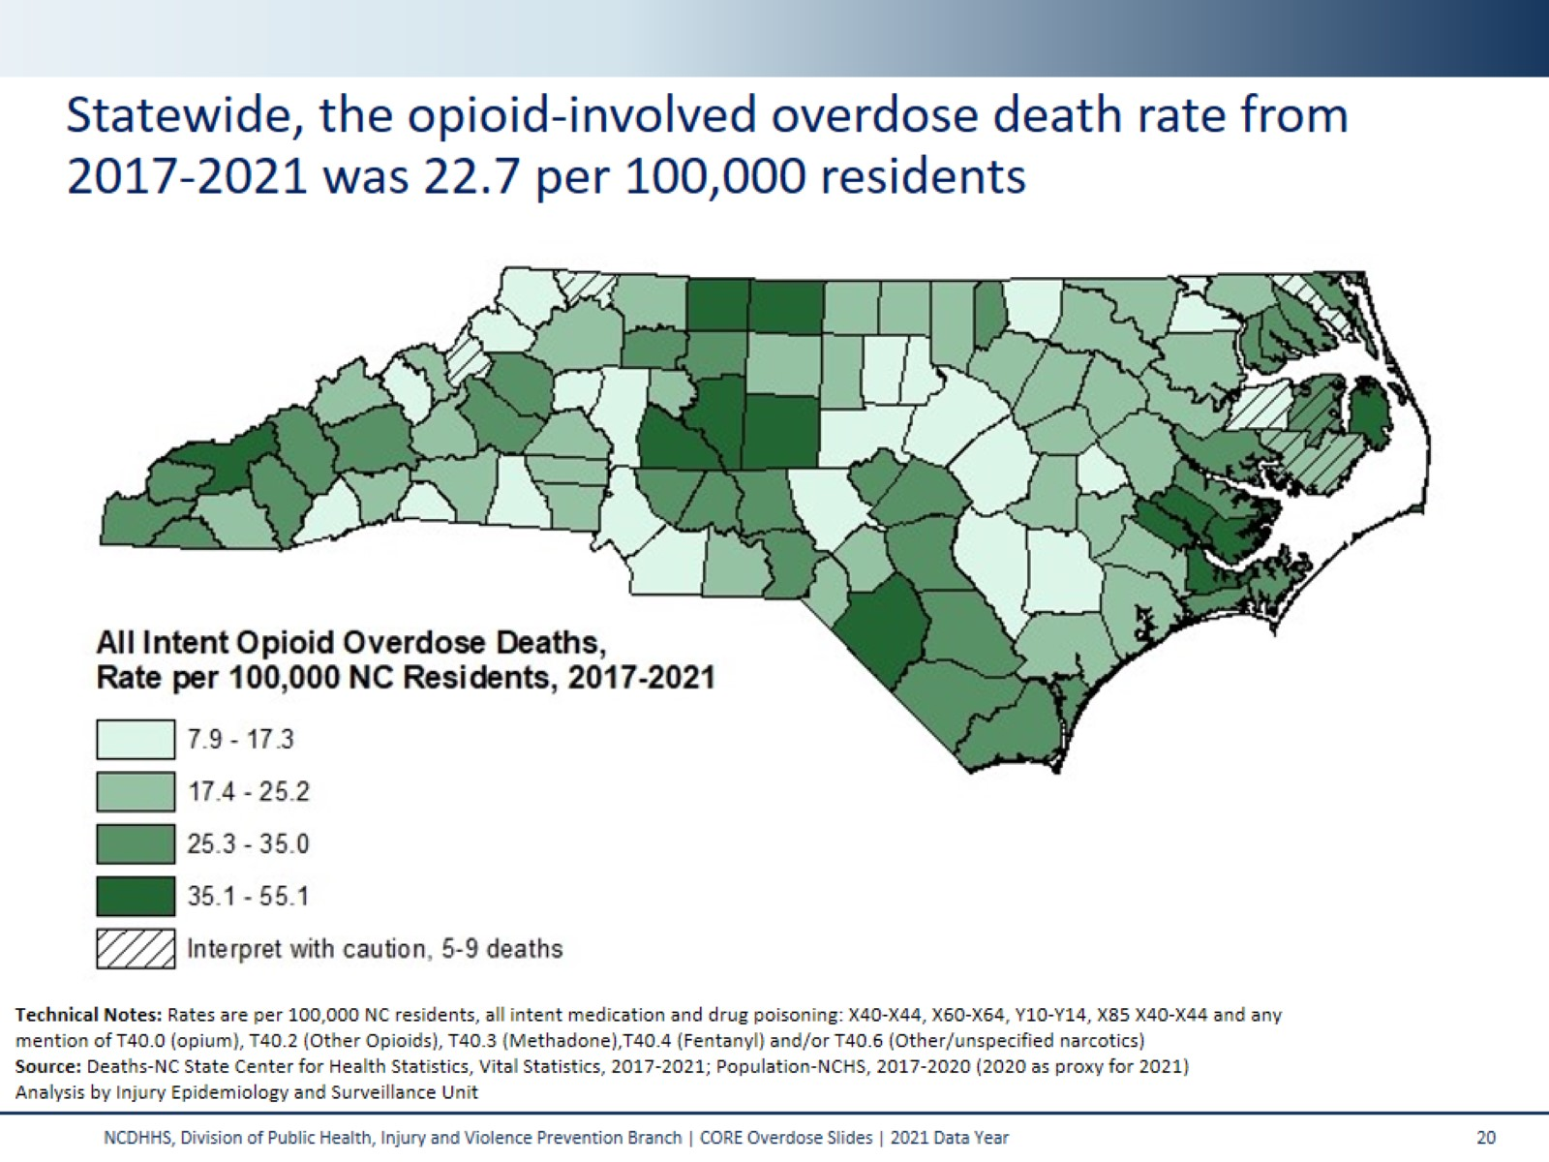
Statewide, the opioid-involved overdose death rate from
2017-2021 was 22.7 per 100,000 residents
Notes:
This map shades the counties of NC based on their respective opioid-involved overdose death rate; a subset of medication/drug overdose deaths which involved an opioid (prescription or illicit). The statewide rate was 22.7 per 100,000 residents (2017-2021). This five-year period was used in order to provide greater reliability in county-level rate estimates.
All counties had more than four deaths, so all rates were calculated. Interpret rates with caution in counties with fewer than 10 deaths.
Technical Notes:
Due to changes within NC SCHS, the 2021 population file is currently on hold. The 2020 population file will be used as a proxy for 2021. Rates will be subject to change until a new file is created.

Slide 20
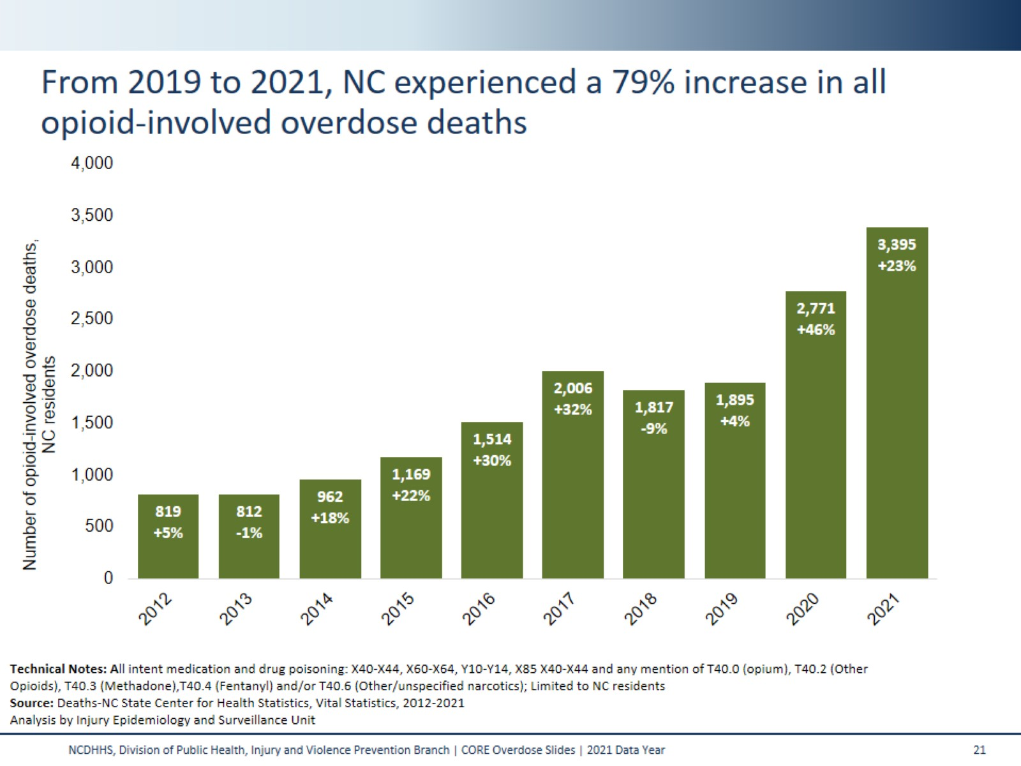
From 2019 to 2021, NC experienced a 79% increase in all opioid-involved overdose deaths
Notes:
This slide looks at both the number and the percent change in all opioid-involved overdose deaths among NC residents over the last decade. Under the number of deaths in each bar, the percent increase or decrease compared to the previous year is displayed in parenthesis.

Slide 21
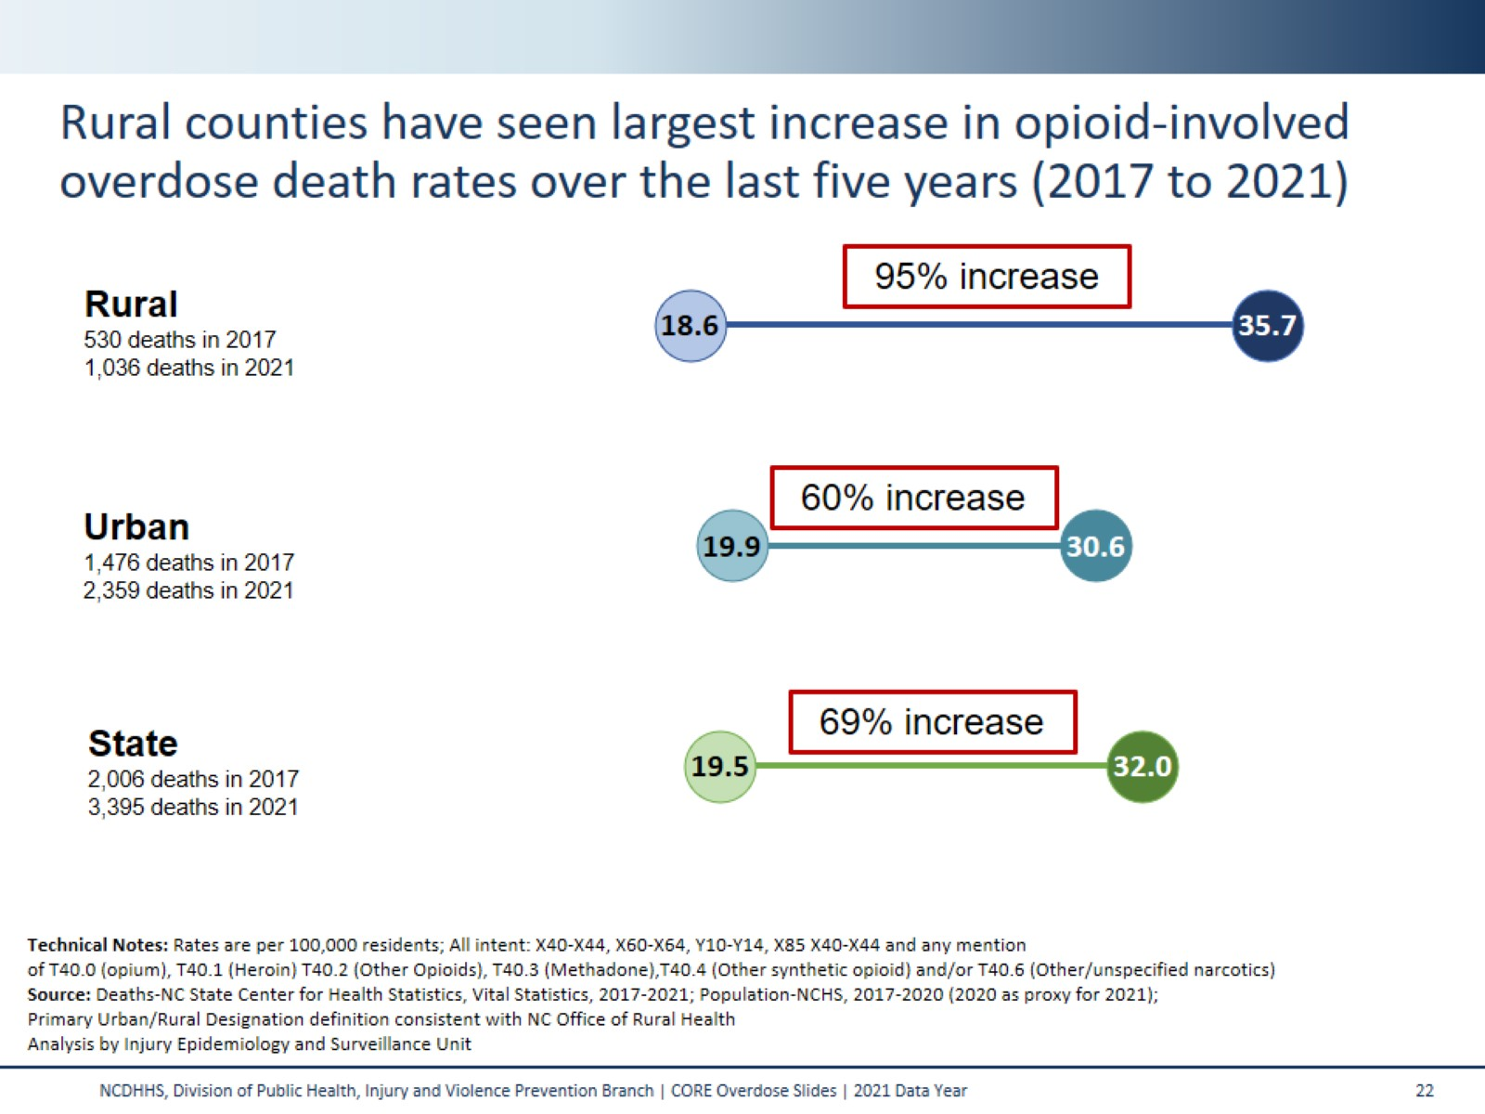
Rural counties have seen largest increase in opioid-involved overdose death rates over the last five years (2017 to 2021)
Notes:
Opioid-involved overdose death rates for NC residents have greatly increased from 2017 to 2021. This shift has been true for the state as a whole, and also stands true when the data are stratified by primary designation (urban/rural).
Among rural counties, the opioid-involved overdose death rate has increased from 18.6 per 100,000 in 2017 to 35.7 per 100,000 in 2021 – a 95% increase.
Among urban counties, the opioid-involved overdose death rate has increased from 19.9 per 100,000 in 2017 to 30.6 per 100,000 in 2021 – a 60% increase.
Statewide, the opioid-involved overdose death rate has increased from 19.5 per 100,000 in 2017 to 32.0 per 100,000 in 2021 – a 69% increase.
Technical Notes:
Due to changes within NC SCHS, the 2021 population file is currently on hold. The 2020 population file will be used as a proxy for 2021. Rates will be subject to change until a new file is created.

Slide 22
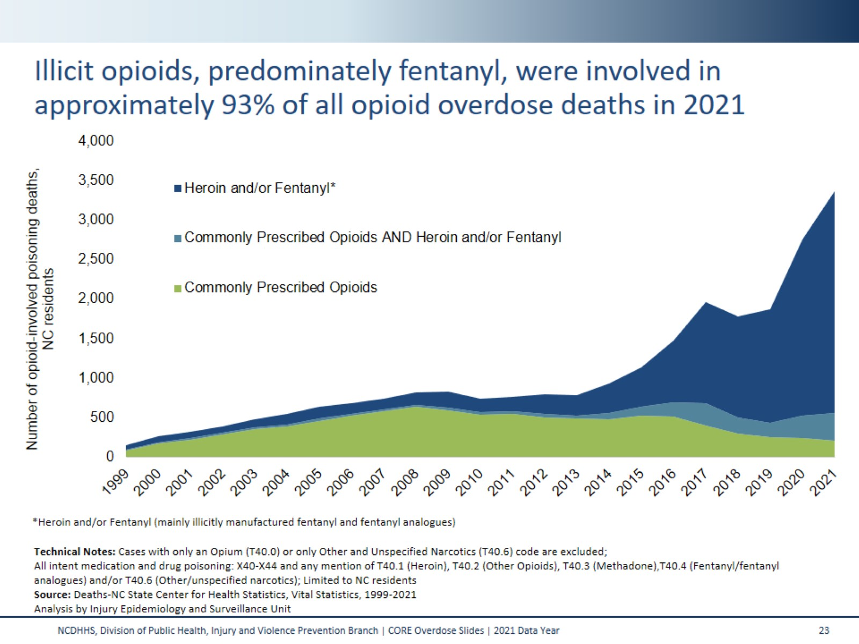
Illicit opioids, predominately fentanyl, were involved in approximately 93% of all opioid overdose deaths in 2021
Notes:
This graph depicts the increase in opioid-involved overdose deaths (X40-X44, Y10-Y14, X85, X60-X64). Opioid-involved overdose deaths have increased from 148 deaths in 1999 to 3,395 deaths in 2021. These numbers include deaths from both prescription and illicit opioids.
The green, bottom portion of this graph shows the number of opioid overdose deaths involving prescription opioids (T40.2=other opioids or T40.3=methadone). The dark blue top portion shows the number of opioid overdose deaths involving illicit opioids (T40.1=heroin or T40.4=fentanyl/fentanyl analogues*). The light blue, middle portion of the graph are deaths involving both prescription and illicit opioids.
Technical Notes:
*While the other synthetic narcotics ICD-10 code (T40.4) does include some prescription drugs, we believe that the majority of these cases are due to illicitly manufactured fentanyl and therefore chose to include this code in the illicit opioid grouping. Deaths coded with only T40.0 (opium) and T40.6 (other and unspecified narcotics) are excluded from this analysis due to low numbers and as it is unclear in which category these deaths fall. Fentanyl analogues are drugs that are similar to fentanyl but have been chemically modified in order to bypass current drug laws.

Slide 23
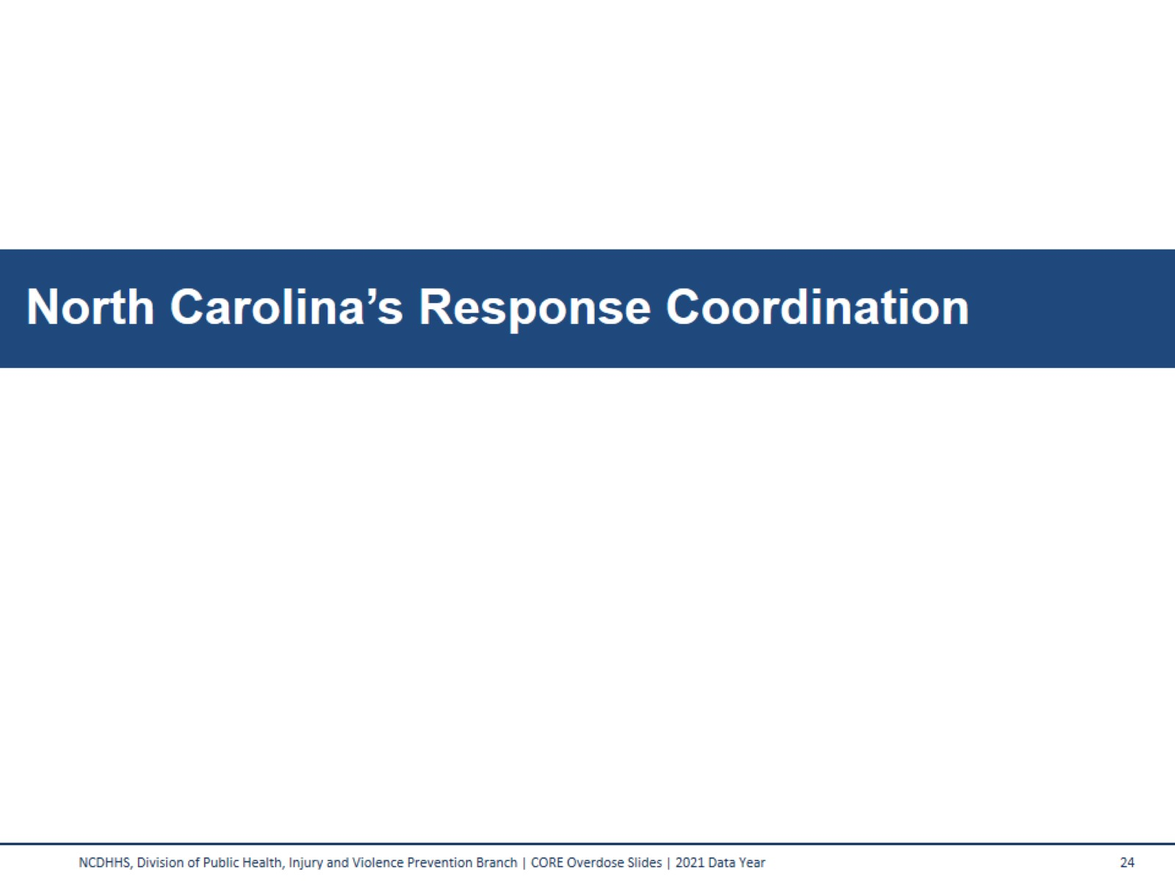
North Carolina’s Response Coordination

Slide 24
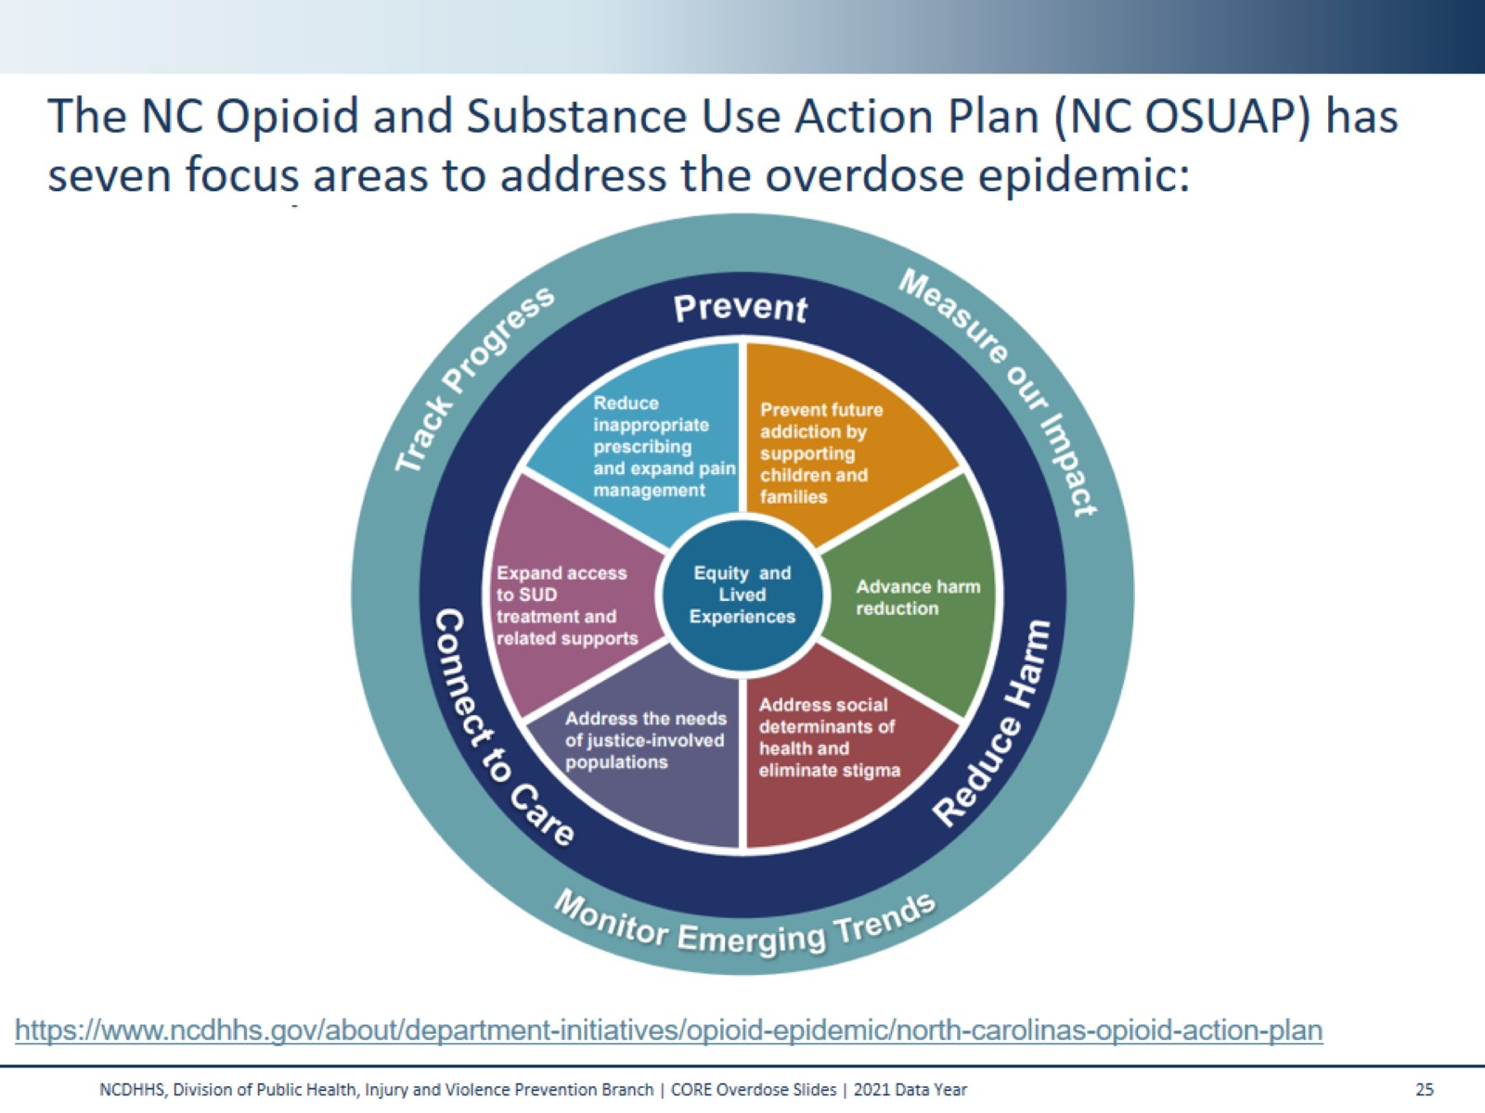
The NC Opioid and Substance Use Action Plan (NC OSUAP) has seven focus areas to address the overdose epidemic:
Notes:
To combat the opioid crisis, the North Carolina Department of Health and Human Services worked with community partners to develop the original North Carolina Opioid Action Plan (NC OAP) in June 2017. Version 2.0 launched in June 2019, and version 3.0 (now the Opioid and Substance Use Action Plan, OSUAP) launched in May 2021.
The NC OSUAP, version 3.0, includes a broadened focus on polysubstance use as well as centering equity and lived experiences to ensure that the strategies address the overdose epidemic are led by those closest to the issue.
The plan focuses on four priority areas to address the epidemic: Center Equity and Lived Experiences, Prevent Future Addiction and Address Trauma, Reduce Harm, and Connect to Care.
We track our progress and measure our impact through metrics (e.g., counts and rates) and local actions (e.g., policies and programs), each grouped under strategy areas. The Menu of Local Actions can be found here: https://www.ncdhhs.gov/osuap-menu-local-actions/download?attachment
A data dashboard provides integration and visualization of state, regional, and county-level metrics for partners across North Carolina to track progress toward reaching the goals outlined in the NC OSUAP. The dashboard can be found at: https://www.ncdhhs.gov/opioid-and-substance-use-action-plan-data-dashboard

Slide 25
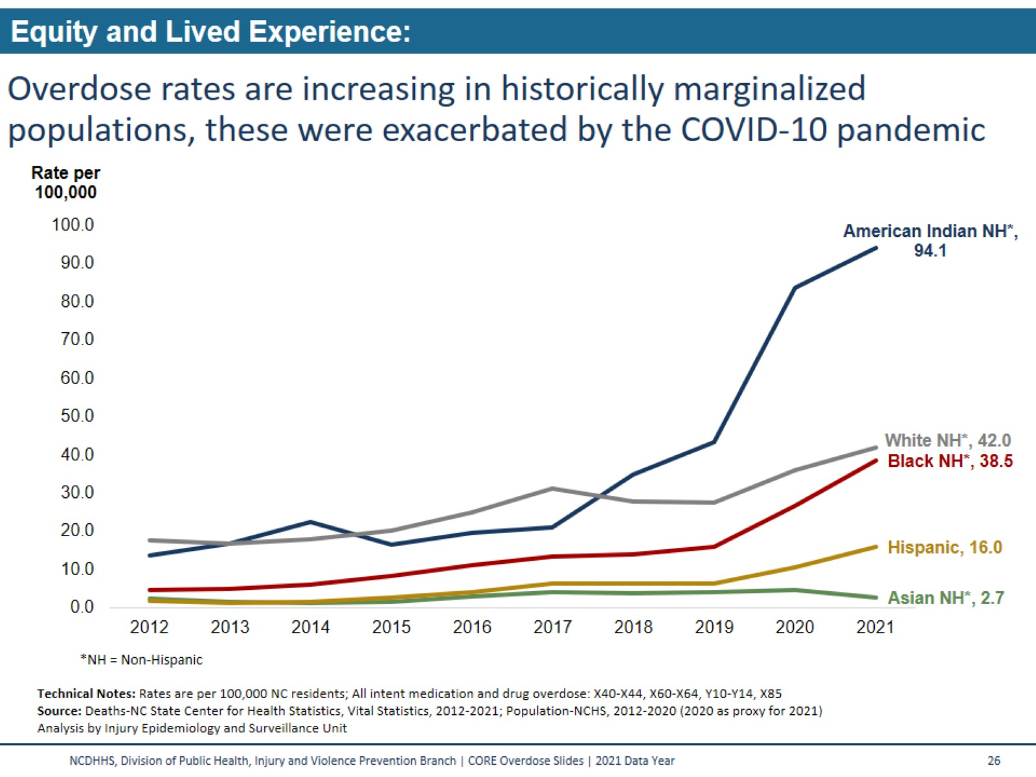
Overdose rates are increasing in historically marginalized populations, these were exacerbated by the COVID-10 pandemic
Notes:
The number of people who have died from overdose has also worsened in some historically marginalized communities. The overall number of overdose deaths is still highest among non-Hispanic white people; however, when measured as a portion of population, American Indian/Indigenous people have the highest overdose death rate. The percentage by which overdose death rates increased from 2019 rates to 2021 rates was highest among Black/African American people with a 139% increase in their overdose death rate (16.1 to 38.5 per 100,000) American Indian/Indigenous communities had the highest overdose death rate in 2021, a 117% increase from 2019 to 2021 (43.3 to 94.1 per 100,000). White NH saw a 53% increase in overdose death rates from 2019 to 2021 (27.4 to 42.0 per 100,000).
Technical Notes:
Due to changes within NC SCHS, the 2021 population file is currently on hold. The 2020 population file will be used as a proxy for 2021. Rates will be subject to change until a new file is created.

Slide 26
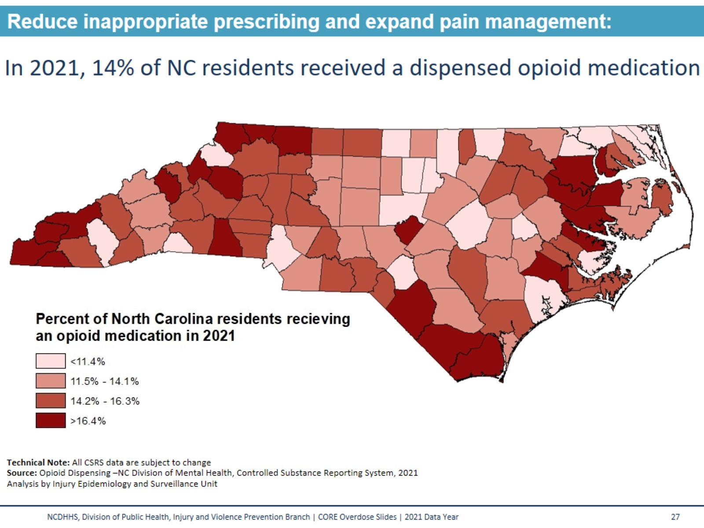
In 2021, 14% of NC residents received a dispensed opioid medication
Notes:
As part of the OSUAP 3.0 strategy to ‘Reduce inappropriate prescribing and expand pain management’, the North Carolina Controlled Substances Reporting System (CSRS) reports on how many North Carolinians receive an opioid medication, per 100 residents. This map depicts these data for 2021. The statewide rate for those North Carolinians receiving an opioid medication for 2021 was 14.1 per 100 residents, or 14.1% of all North Carolina residents.
Free resources on safe prescribing are available at www.ncmedboard.org
Technical Notes:
Due to changes within NC SCHS, the 2021 population file is currently on hold. The 2020 population file will be used as a proxy for 2021. Rates will be subject to change until a new file is created.

Slide 27
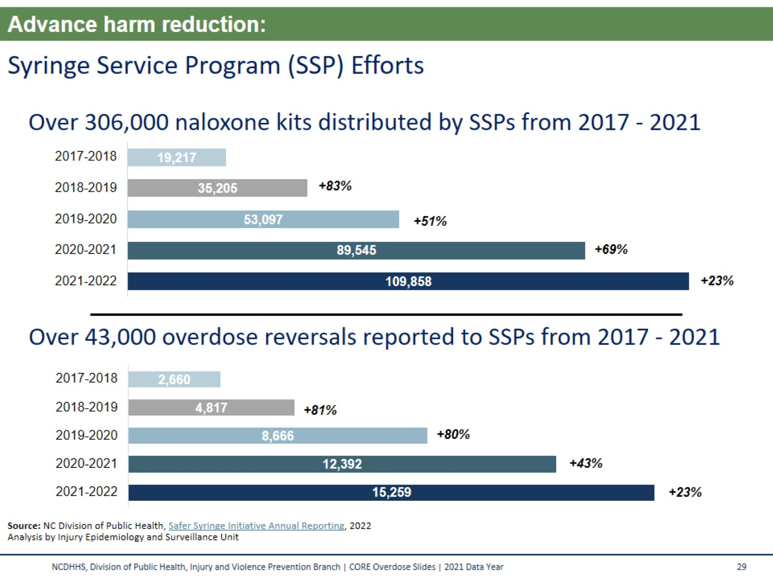
Syringe Service Program (SSP) Efforts
Notes:
In North Carolina, Syringe Service Programs, or SSPs, were legalized in 2016. As part of the OSUAP 3.0 strategy to ‘Advance Harm Reduction’, SSPs report data regarding their activities to the state on an annual basis. From 2017-2021, SSPs distributed over 306,000 naloxone kits. During this time, over 43,000 opioid overdose reversals were reported to SSPs.
For more on the work of SSPs in North Carolina visit:
https://www.ncdhhs.gov/divisions/public-health/north-carolina-safer-syringe-initiative

Slide 28
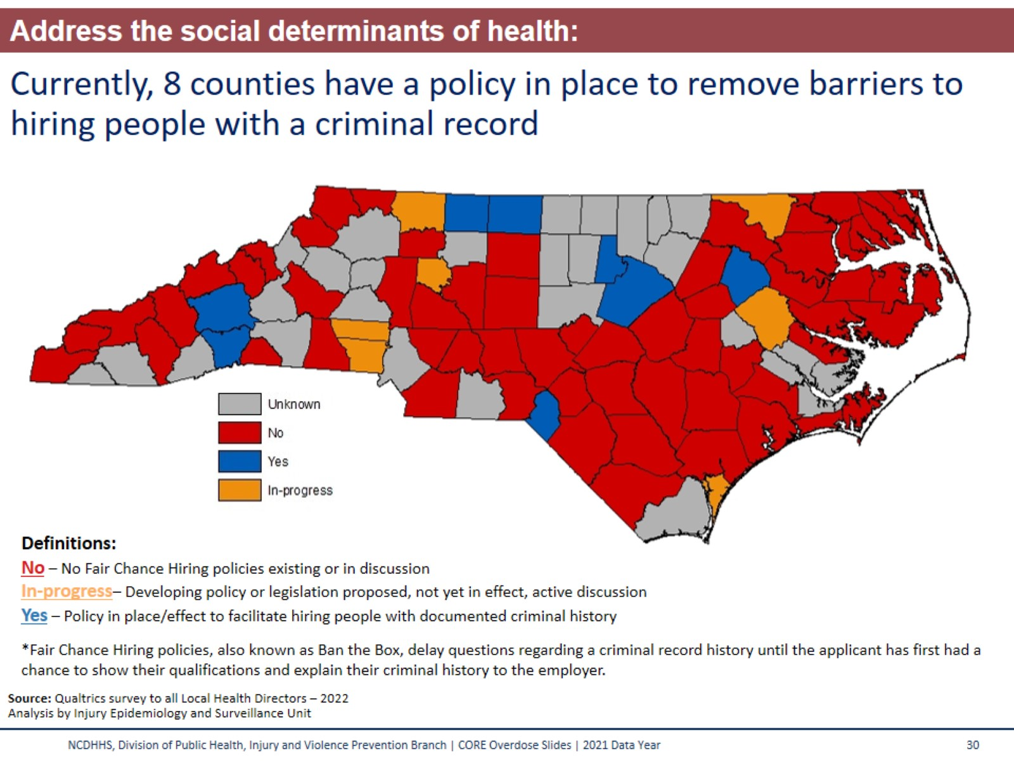
Currently, 8 counties have a policy in place to remove barriers to hiring people with a criminal record
Notes:
Fair Chance Hiring Ordinances aim to ‘Address the social determinants of health and eliminate stigma’ strategy in OSUAP 3.0.
Across North Carolina, 1.6 million residents have a criminal record of some kind. These individuals face significant challenges to find stable and meaningful employment. People with a criminal record are 50% less likely to have an employer call back, significantly increasing their risk for recidivism, or going back to jail or prison and returning to drug use. Within three years, 68% of people who are released from prison or jail will be incarcerated again, resulting in an enormous economic burden to taxpayers to incarcerate these individuals, but also negative social impacts affecting families and children. Stable employment (and hopefully increased access to healthcare and stable housing) can also help prevent people from returning to chaotic drug use.
Fair Chance Hiring policies delay questions regarding a criminal record history until the interview process when the applicant has had a chance to show their qualifications and explain their criminal history to the employer. Employers can still conduct background checks under a Fair Chance Hiring policy but will do so typically after the interview or once a conditional offer has been made to the applicant. Exceptions for jobs that involve law enforcement or childcare are normally made under Fair Chance Hiring policies.

Slide 29
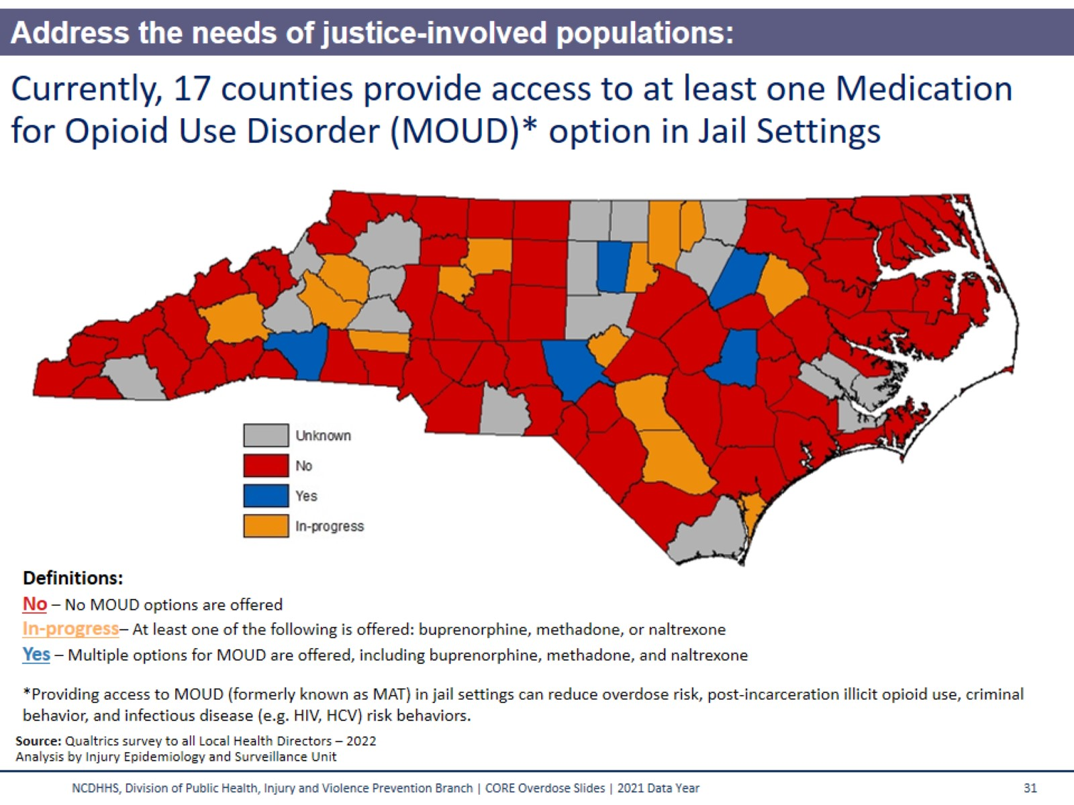
Currently, 17 counties provide access to at least one Medication for Opioid Use Disorder (MOUD)* option in Jail Settings
Notes:
The OSUAP 3.0 strategy to ‘Address the needs of justice-involved populations’ includes providing access to Medications for Opioid Use Disorder (MOUD) in jail settings. Overdose is a leading cause of death among people recently released from correctional facilities; this risk is the highest during the first two weeks post-release. Providing access to MOUD in jail settings can reduce not only overdose risk but also post-incarceration illicit opioid use, criminal behavior, and infectious disease (like HIV or HCV) risk behaviors. Additional social, medical, and economic benefits to providing MOUD to incarcerated persons with opioid use disorder are well-documented.
There are currently three types of FDA approved MOUD: methadone, buprenorphine (either by itself or combined with naloxone), and naltrexone.
Methadone is an opioid agonist that lessens the symptoms of withdrawal and blocks the euphoric effects of opioids. Methadone offered as a liquid is nearly impossible to divert in jail facilities. However, a major barrier to offering methadone for opioid use disorder in jails and prisons is the fact that only clinics that are federally designated as opioid treatment providers (OTPs) can prescribe and dispense it for this purpose.
Buprenorphine, combined with or without naloxone, is a partial agonist, which means that it has some of the same properties as other opiates but not the sedative effects. Suboxone can be taken as a pill or a film. Many jails like Suboxone in film form because it can decrease the risk of diversion.
Naltrexone, an opioid antagonist, blocks the euphoric and sedative effects of opioids. Naltrexone can be given as a long acting injectable or pill form. The long-acting injectable form of naltrexone has no diversion potential, which makes it an attractive option for jail administrators.

Slide 30
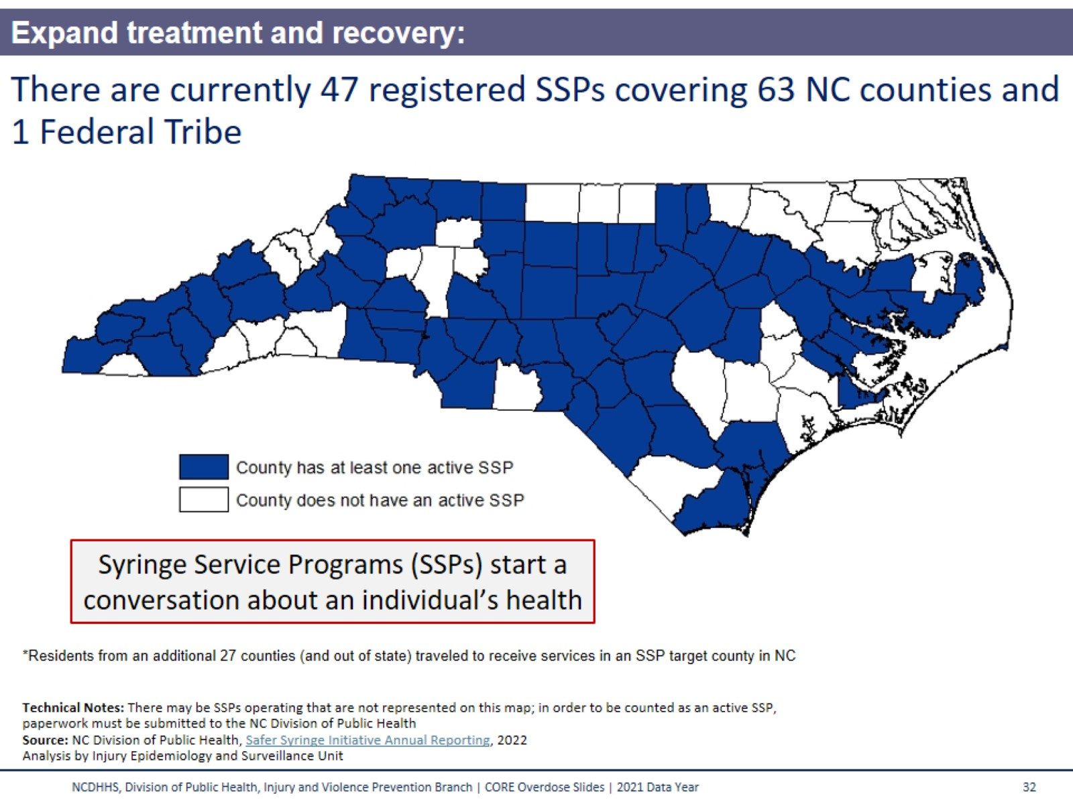
There are currently 47 registered SSPs covering 63 NC counties and 1 Federal Tribe
Notes:
The implementation of Syringe Service Programs, or SSPs, is part of the ‘Expand access to SUD treatment and related supports’ strategy of the OSUAP 3.0. Counties shaded in blue were served by at least one SSP at the end of the most recent year’s annual reporting period. Individuals traveled from an additional 27 counties, and from out of state, to reach a NC SSP.
There may be SSPs operating that are not represented on this map. In order to be counted as an official SSP, paperwork must be completed with the Division of Public Health. Additional SSPs may have started operating since the end of the most recent years annual reporting ended.
For additional information on the NC Safer Syringe Initiative visit: https://www.ncdhhs.gov/divisions/public-health/north-carolina-safer-syringe-initiative

Slide 31
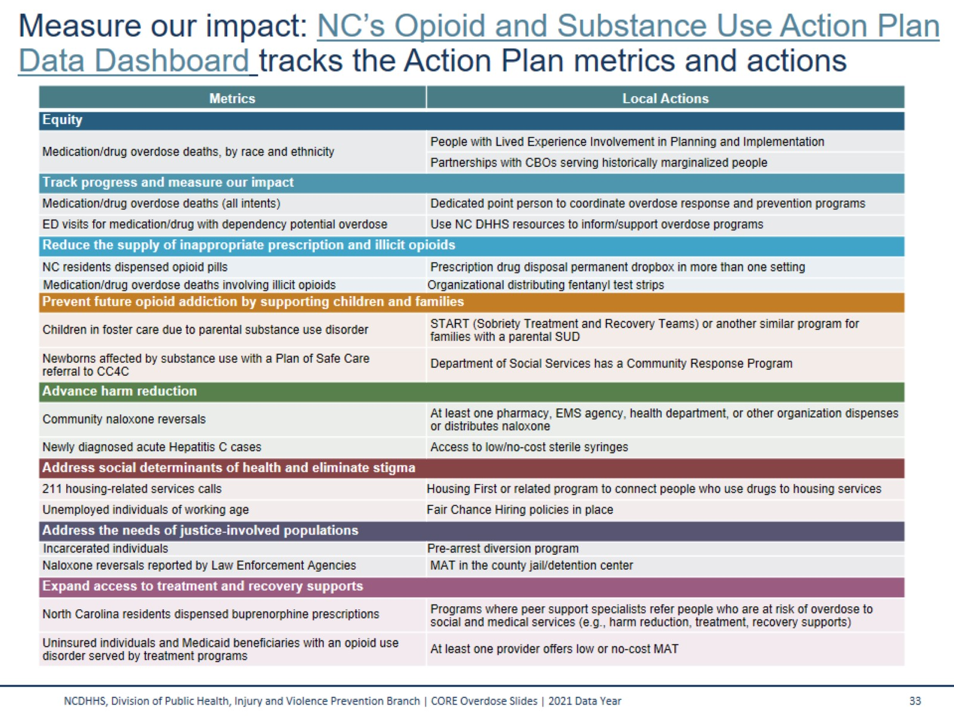
Measure our impact: NC’s Opioid and Substance Use Action Plan Data Dashboard tracks the Action Plan metrics and actions
Notes:
This table outlines the 15 key metrics that comprise the strategy areas of the NC Opioid and Substance Use Action Plan (NC OSUAP), along with 16 relevant, recommended local actions. The strategies are as follows:
Center equity and lived experience
Track progress and measure our impact
Reduce inappropriate prescribing and expand pain management
Prevent future addiction by supporting children and families
Advance harm reduction
Address social determinants of health and eliminate stigma
Address the needs of justice-involved populations
Expand access to SUD treatment and recovery supports
Dashboard data are updated monthly whenever possible. Data are available on the dashboard for the state and at a county and regional level. NC OSUAP Data Dashboard: https://www.ncdhhs.gov/opioid-and-substance-use-action-plan-data-dashboard

Slide 32
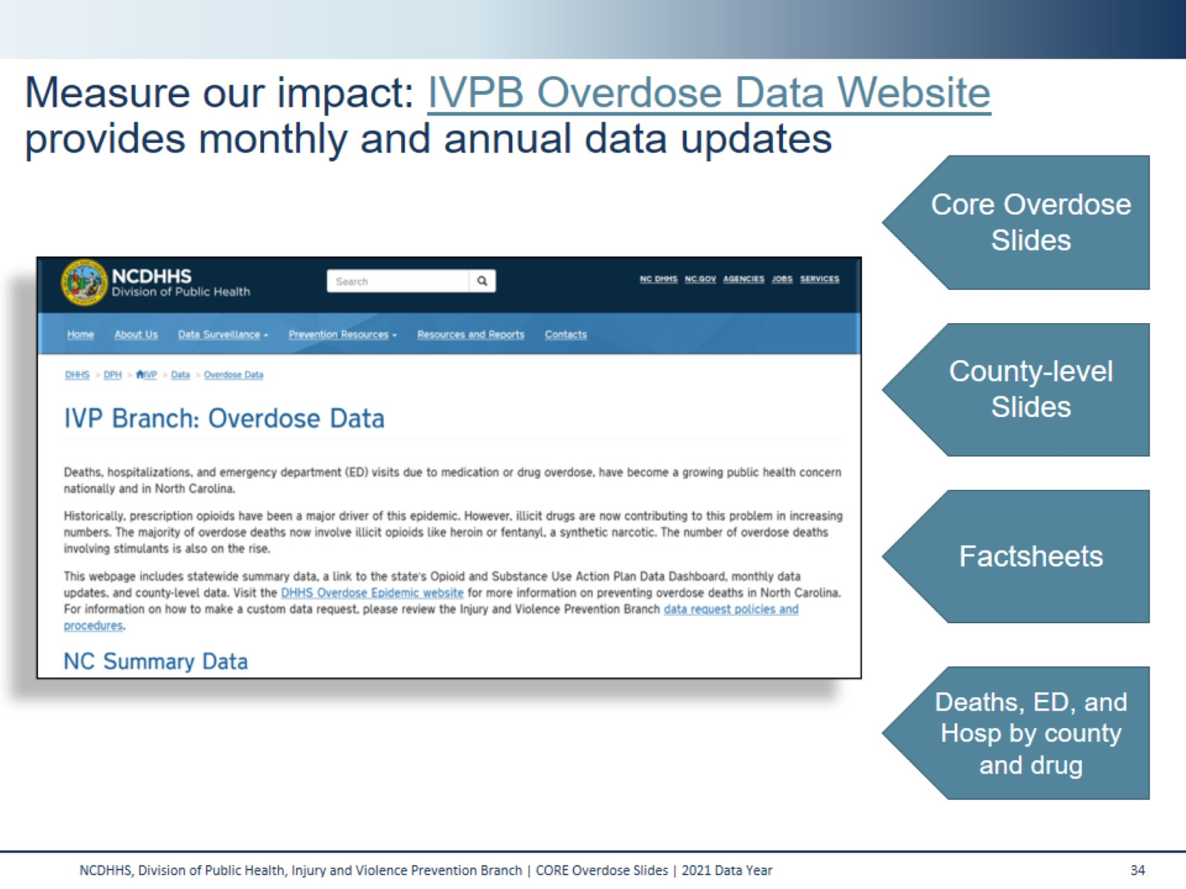

Slide 33
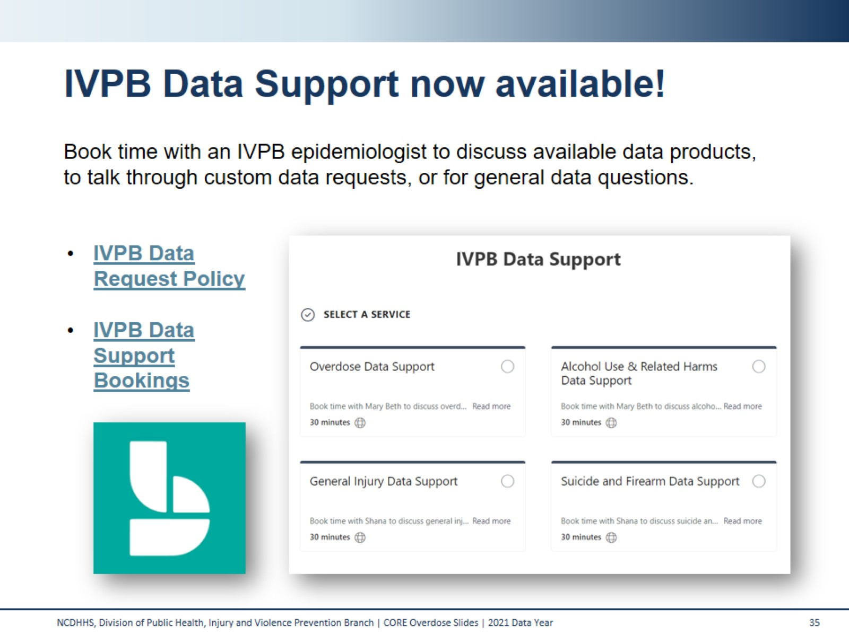
IVPB Data Support now available!

Slide 34
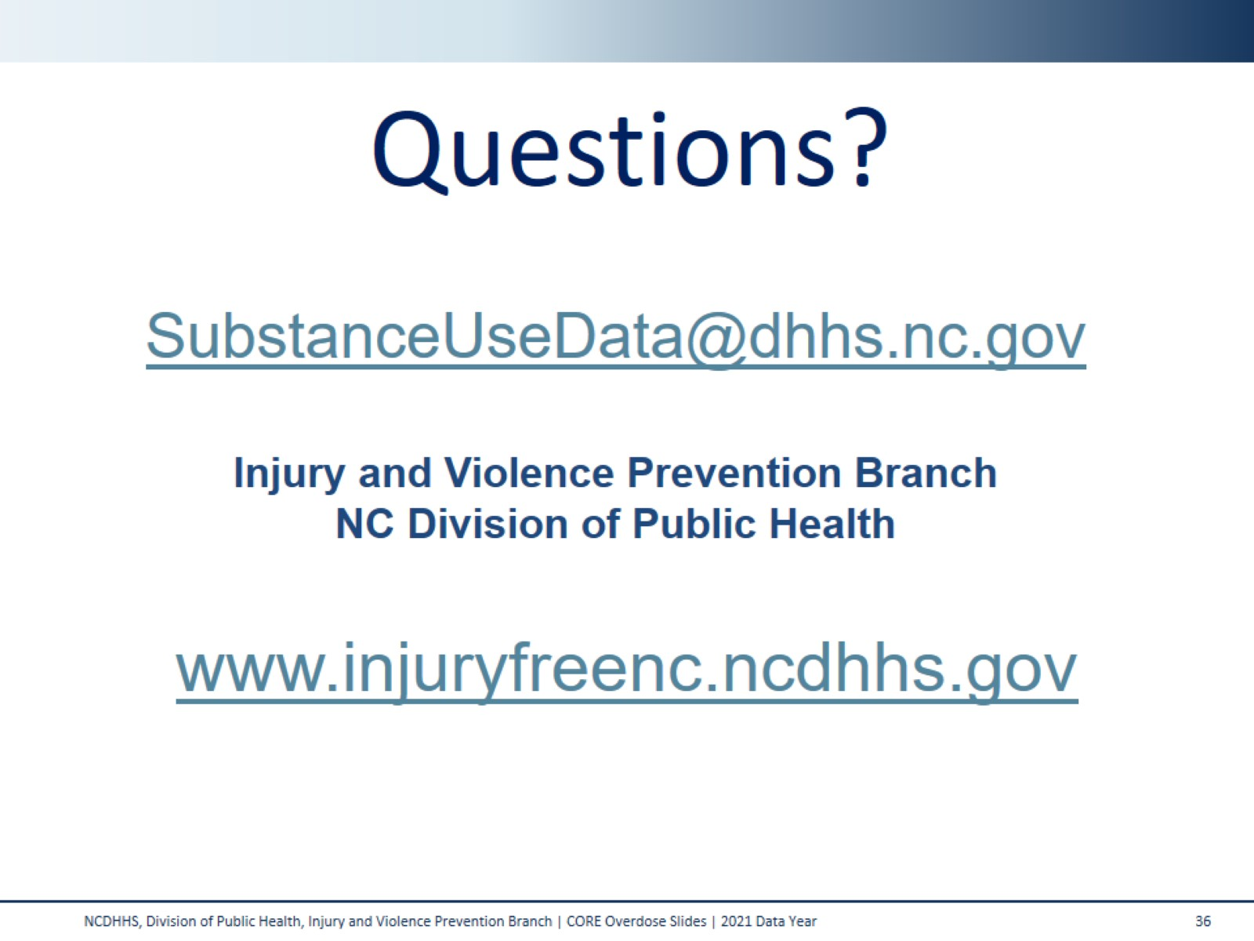
Questions?

