Slide 1
Notes:
This slide set was created to provide basic data trends and public health surveillance around the drug overdose epidemic. They are meant to offer a state-level background on drug overdose. If you’d like a copy of the slides please visit the Poisoning Data page on our branch website, Injuryfreenc.dhhs.gov. The direct link is also shared at the end of this presentation.
Feel free to incorporate these slides into your own presentations, grant proposals, reports, or any other way they may be useful.
Please read both the speaking and technical notes to ensure that data are presented in a consistent manner.

Slide 2
Notes:
For more detailed technical notes on any of the data shared in this slide set, please contact us at SubstanceUseData@dhhs.nc.gov

Slide 3
Notes:
This presentation is not intended to cover all data related to the overdose epidemic. Rather it gives an overview of some of the key trends in North Carolina. It includes information on statewide medication and drug overdoses, opioid-related overdoses, and our state’s response coordination.
The Injury and Violence Prevention Branch maintains a master slide set that also includes national data and more information on our state’s response. Please contact us if this presentation does not contain the information you’re looking for.
County and Regional Level slides are available on the IVPB Poisoning Data page linked on this slide.

Slide 4
Notes:
First, we’ll begin with statewide medication and drug overdose background and trends. Medication and drug overdose deaths consist of a broad category of medications, drugs or biological substances, including prescription, over-the-counter, and illicit substances.

Slide 5
Notes:
Here are nearly 50 years of data for two specific types of injuries. For most of the past century, motor vehicle deaths were the leading cause of injury death in NC and US. In North Carolina, poisonings from all intents overtook motor vehicle crashes in 2010 to become the leading cause of injury death.
The decrease in motor vehicle incidents can be attributed to the implementation of seat belt laws, and several changes to safety measures in the construction of automobiles and roadways.
The rise in poisoning deaths can be linked to a shift in focus to treating pain as the 5th vital sign, new formulations of opioids such as oxycodone, and increased marketing of pain medications to the public.
Motor vehicle deaths continue to decline, but drug poisoning deaths continue to rise. These two lines tell a powerful story of public health’s ability, and that of society at large, to address a significant health issue over time. With a combined approach, similar to that used to reduce motor vehicle incidents, poisoning deaths can be prevented as well.

Slide 6
Notes:
In North Carolina, as in the United States as whole, deaths due to medication/drug overdoses have been steadily increasing since 1999, and the vast majority (92%) of these are unintentional.
The number of medication/drug deaths has increased 120%, over the last 10 years (2010-2019).
While the number of self-inflicted deaths have remained relatively stable, less than 200 a year, unintentional drug overdoses have continued to rise, though there was a decrease in deaths from 2017 to 2018. Opioids, specifically, have contributed to the majority of these deaths.
Technical Notes:
The data provided here are part of the Vital Registry System of the State Center for Health Statistics and have been used to historically track and monitor the drug overdose burden in NC using ICD10 codes. The definitive data on deaths come from the NC Office of the Chief Medical Examiner (OCME). For the most recent data and data on specific drugs, please contact at OCME at http://www.ocme.dhhs.nc.gov/annreport/index.shtml

Slide 7
Notes:
In 2019, an average of 6 North Carolinians died each day from unintentional medication or drug overdose. Though largely driven by opioids, this number includes overdose deaths from other medications and drugs (cocaine, benzodiazepines, etc).
Technical Notes:
The data provided here are part of the Vital Registry System of the State Center for Health Statistics and have been used to historically track and monitor the drug overdose burden in NC using ICD10 codes. The definitive data on deaths come from the NC Office of the Chief Medical Examiner (OCME). For the most recent data and data on specific drugs, please contact at OCME at http://www.ocme.dhhs.nc.gov/annreport/index.shtml

Slide 8
Notes:
The highest rates of unintentional medication/drug poisoning deaths occurred amongst NC residents ages 25-54, males, whites and American Indians.
These rates are calculated over a five-year time period (2015-2019).
Technical Notes:
The data provided here are part of the Vital Registry System of the State Center for Health Statistics and have been used to historically track and monitor the drug overdose burden in NC using ICD10 codes. The definitive data on deaths come from the NC Office of the Chief Medical Examiner (OCME). For the most recent data and data on specific drugs, please contact at OCME at http://www.ocme.dhhs.nc.gov/annreport/index.shtml

Slide 9
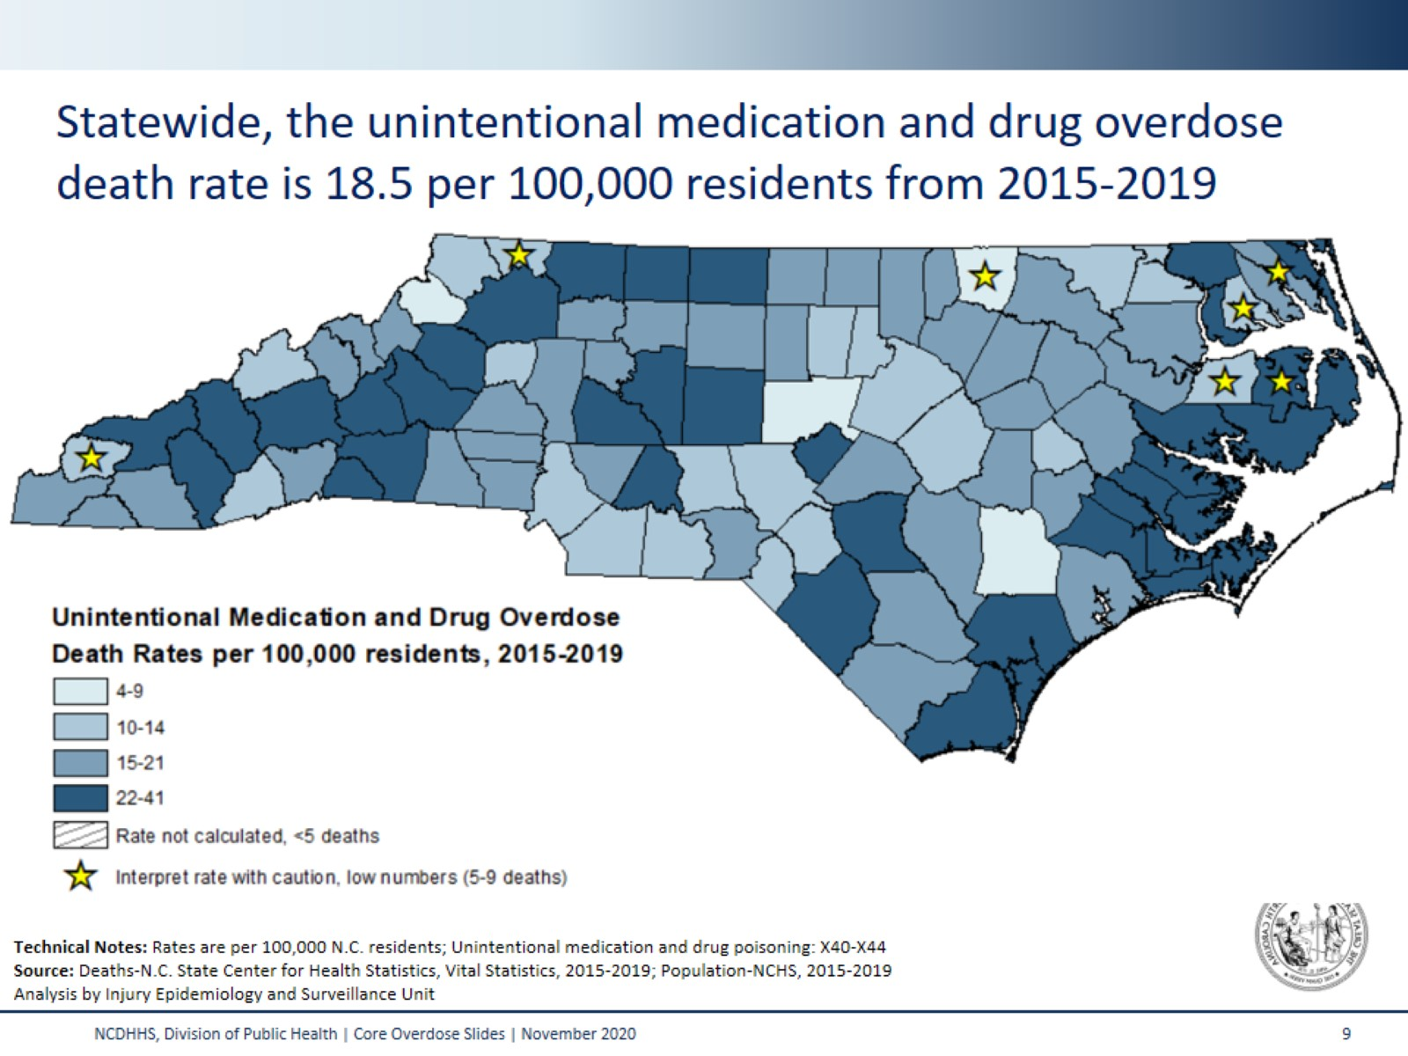
Notes:
This map shades the counties of NC based on their respective unintentional medication/drug overdose death rate. The statewide rate of unintentional medication and drug overdose deaths was 18.5 per 100,000 persons from 2015-2019. This five-year period was used in order to provide greater reliability in county-level rate estimates.
In counties with fewer than five deaths, rates were not calculated. Interpret rates with caution in counties with fewer than 10 deaths.
Technical Notes:
The data provided here are part of the Vital Registry System of the State Center for Health Statistics and have been used to historically track and monitor the drug overdose burden in NC using ICD10 codes. The definitive data on deaths come from the NC Office of the Chief Medical Examiner (OCME). For the most recent data and data on specific drugs, please contact at OCME at http://www.ocme.dhhs.nc.gov/annreport/index.shtml

Slide 10
Notes:
The epidemic of med/drug overdose is mostly driven by opiates. Historically, prescription opioids (drugs like hydrocodone, oxycodone, morphine) have contributed to an increasing number of medication/drug overdose deaths. In recent years, other synthetic narcotics (heroin, fentanyl, and fentanyl analogues*) have resulted in increased deaths, and while there was a decrease in the number of deaths involving heroin and other synthetic narcotics from 2017 to 2018, it increased again in 2019. The number of deaths involving other substances like cocaine, benzodiazepines, alcohol, antiepileptics, and psychostimulants with misuse potential (which includes methamphetamine) continue to rise.
These counts are not mutually exclusive. If the death involved multiple drugs it can be counted on multiple lines. A growing number deaths involve multiple substances in combination.
*Fentanyl analogues are drugs that are similar to fentanyl but have been chemically modified in order to bypass current drug laws.
Technical Notes:
The data provided here are part of the Vital Registry System of the State Center for Health Statistics and have been used to historically track and monitor the drug overdose burden in NC using ICD10 codes. The definitive data on deaths come from the NC Office of the Chief Medical Examiner (OCME). For the most recent data and data on specific drugs, please contact at OCME at http://www.ocme.dhhs.nc.gov/annreport/index.shtml

Slide 11
Notes:
This slide looks at both the number and the percent change in unintentional medication and drug overdose deaths among NC residents over the last decade. Under the number of deaths in each bar, you’ll see the percent increase or decrease compared to the previous year in parenthesis. From 2018 to 2019, North Carolina saw a 4% increase in the number of unintentional medication and drug overdose deaths.
Technical Notes:
The data provided here are part of the Vital Registry System of the State Center for Health Statistics and have been used to historically track and monitor the drug overdose burden in NC using ICD10 codes. The definitive data on deaths come from the NC Office of the Chief Medical Examiner (OCME). For the most recent data and data on specific drugs, please contact at OCME at http://www.ocme.dhhs.nc.gov/annreport/index.shtml

Slide 12
Notes:
This slide shows counts and percent increase or decrease in the number of unintentional medication and drug overdose visits to the Emergency Department (ED) and hospitalizations. From 2018 to 2019, the number of unintentional medication and drug overdose ED visits and hospitalizations decreased by less than 1%.
Technical Notes: In October 2015, there was a change in the coding system used in administrative data sets that impacted the definition used to identify poisoning-related injury cases. Because of this change, some data are currently unavailable for 2015, and data pre-2015 are not comparable to data collected after this change occurred.

Slide 13
Notes:
This slide contains data from the NC Youth Risk Behavioral Survey (YRBS). YRBS is a representative sample of high school students in NC. Self-reported survey data often gives an underestimate of drug use.
In 2013 and 2015 students were asked if they’d ever taken a prescription drug without a prescription or differently than indicated by a doctor. This question included any type of Rx drug, such as oxycontin, Percocet, Vicodin, codeine, Adderall, Ritalin, or Xanax. In 2017, this question was changed to ask specifically about prescription pain medicines such as codeine, Vicodin, oxycontin, hydrocodone, or Percocet.
Technical Notes:
The YRBS is administered every other year to a representative sample of high school students across the state.

Slide 14
Notes:
Let’s take a closer look at overdoses involving opioids across the state.

Slide 15
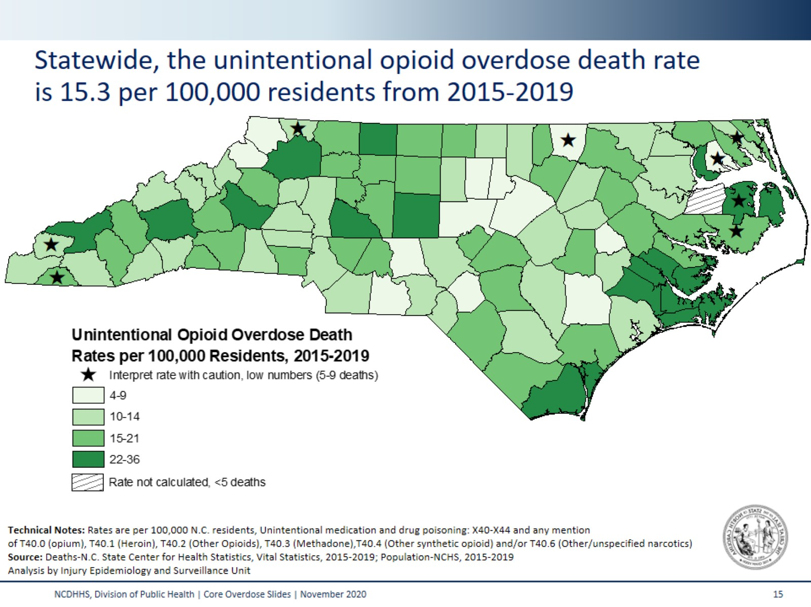
Notes:
This map shades the counties of NC based on their respective unintentional opioid overdose death rate. The statewide rate of unintentional opioid-related overdose deaths was 15.3 per 100,000 persons (2015-2019). Again, this five-year period was used in order to provide greater reliability in county-level rate estimates.
In counties with fewer than five deaths, rates were not calculated. Interpret rates with caution in counties with fewer than 10 deaths.
Technical Notes:
The data provided here are part of the Vital Registry System of the State Center for Health Statistics and have been used to historically track and monitor the drug overdose burden in NC using ICD10 codes. The definitive data on deaths come from the NC Office of the Chief Medical Examiner (OCME). For the most recent data and data on specific drugs, please contact at OCME at http://www.ocme.dhhs.nc.gov/annreport/index.shtml

Slide 16
Notes:
This slide looks at both the number and the percent change in unintentional opioid overdose deaths among NC residents over the last decade. Under the number of deaths in each bar, you’ll see the percent increase or decrease compared to the previous year in parenthesis. From 2018 to 2019 North Carolina saw a 5% increase in the number of unintentional opioid overdose deaths.
Technical Notes:
The data provided here are part of the Vital Registry System of the State Center for Health Statistics and have been used to historically track and monitor the drug overdose burden in NC using ICD10 codes. The definitive data on deaths come from the NC Office of the Chief Medical Examiner (OCME). For the most recent data and data on specific drugs, please contact at OCME at http://www.ocme.dhhs.nc.gov/annreport/index.shtml

Slide 17
Notes:
Unintentional opioid-involved overdose death rates for N.C. residents have greatly increased from 2015 to 2019. This shift has been true for the state as a whole, and also stands true when the data are stratified by primary designation (urban/rural).
Statewide, the opioid-involved poisoning death rate has increased from 10.5 per 100,000 in 2015 to 17.2 per 100,000 in 2019 – a 64% increase.
Among urban counties, the opioid-involved poisoning death rate has increased from 9.5 per 100,000 in 2015 to 16.1 per 100,000 in 2019 – a 69% increase.
Among rural counties, the opioid-involved poisoning death rate has increased from 12.6 per 100,000 in 2015 to 19.5 per 100,000 in 2019 – a 55% increase.
Technical Notes:
The data provided here are part of the Vital Registry System of the State Center for Health Statistics and have been used to historically track and monitor the drug overdose burden in NC using ICD10 codes. The definitive data on deaths come from the NC Office of the Chief Medical Examiner (OCME). For the most recent data and data on specific drugs, please contact at OCME at http://www.ocme.dhhs.nc.gov/annreport/index.shtml

Slide 18
Notes:
With an unprecedented availability of cheap heroin and fentanyl, more people are dying. Heroin is twice as potent as morphine, fentanyl is 100 times as potent as morphine, and carfentanil (a fentanyl analogue) is 10,000 times as potent as morphine.
Note: Figure not to scale.

Slide 19
Notes:
This graph depicts the increase in unintentional opioid overdose deaths (X40-X44). Unintentional opioid overdose deaths have increased from 114 deaths in 1999 to 1,808 deaths in 2019. These numbers include deaths from both prescription and illicit opioids.
The green, bottom portion of this graph shows the number of opioid deaths due to prescription opioids (T40.2=other opioids or T40.3=methadone). The dark blue top portion shows the number of opioid deaths due to illicit opioids (T40.1=heroin or T40.4=other synthetic narcotics*). The light blue, middle portion of the graph are deaths due to both prescription and illicit opioids.
Prescription opioid deaths have been slightly decreasing (with the occasional small increase) since 2008. Deaths due to illicit opioids have been increasing and are accounting for a larger proportion of the total unintentional opioid overdose deaths. Though there was a decrease from 2017 to 2018, in 2019 the number of deaths involving illicit opioids increased again.
Technical Notes:
*For this analysis, other synthetic narcotics were included in the illicit opioid category. While the other synthetic narcotics ICD-10 code (T40.4) does include some prescription drugs, we believe that the majority of these cases are due to illicitly manufactured fentanyl and therefore chose to include this code in the illicit opioid grouping. Deaths coded with only T40.0 (opium) and T40.6 (other and unspecified narcotics) are excluded from this analysis due to low numbers and as it is unclear in which category these deaths fall.
The data provided here are part of the Vital Registry System of the State Center for Health Statistics and have been used to historically track and monitor the drug overdose burden in NC using ICD10 codes. The definitive data on deaths come from the NC Office of the Chief Medical Examiner (OCME). For the most recent data and data on specific drugs, please contact at OCME at http://www.ocme.dhhs.nc.gov/annreport/index.shtml

Slide 20
Notes:
The concept of the injury pyramid is that deaths are only the smallest tip of a much larger burden on the health care system and the economy.
In 2019, for every 1 opioid overdose death (all intents), there was 1 hospitalization and 3 ED visits due to opioid overdose.
The National Survey on Drug Use and Health estimates that over 332,000 people 12 and older in North Carolina misused opioids.
Technical Notes:
2019 national NSDUH data was applied to 2019 NC population data for residents 12 years of age and older.
The data provided here are part of the Vital Registry System of the State Center for Health Statistics and have been used to historically track and monitor the drug overdose burden in NC using ICD10 codes. The definitive data on deaths come from the NC Office of the Chief Medical Examiner (OCME). For the most recent data and data on specific drugs, please contact at OCME at http://www.ocme.dhhs.nc.gov/annreport/index.shtml

Slide 21
Notes:
Emergency Department (ED) visits for opioid overdoses were steadily increasing from 2010-2017. The use of naloxone by Emergency Medical Services (EMS) has also increased dramatically during this time. However, in 2018 there was a decrease both in opioid overdose ED visits and naloxone administrations by EMS, and numbers decreased again slightly in 2019.
Technical Notes:
Note that naloxone administration alone does not necessarily equate to an opioid overdose as EMS may administer naloxone when an individual is suffering from a different condition with similar signs and symptoms to an opioid overdose. Additionally, the coding transition of ICD-9-CM to ICD-10-CM occurred in October 2015, making it difficult to assess trends before and after the transition. However, this metric still serves as an indication of the number of opioid overdoses seen by EMS. Some ED visits are coded as substance abuse rather than overdose, therefore, the counts represented above are likely an undercount of overdoses.

Slide 22
Notes:
Hepatitis C (HCV), the most common blood-borne infection, is most often spread by sharing injection supplies.
New hepatitis C infections increased more than 395% from 2010 to 2019 (over the last 10 years).
The biggest increases in acute hepatitis C are often in the same regions and the same demographic groups with the highest rates of overdose deaths.
Technical Notes:
In 2016, the case definition for HCV changed. The new 2016 case definition includes:
-includes both confirmed and probable cases;
-timeline of transmission changed from 6 months to 12 months. i.e. a patient could have had a negative screen on January 1, 2016 and then a reactive antibody December 31, 2016 and still be considered acute; and
-ALT threshold was cut from >400 IU/L to >200 IU/L.

Slide 23
Notes:
The number of heart valve infections (endocarditis) associated with injection drug use have increased more than 4,000% since 2010.

Slide 25
Notes:
To combat the opioid crisis, the North Carolina Department of Health and Human Services worked with community partners to develop North Carolina's Opioid Action Plan (NC OAP). The NC OAP launched in June of 2017 and the updated NC OAP 2.0 launched in June 2019. The plan sets key strategies that the state is focused on to reduce addiction and overdose deaths.
The opioid data dashboard on this site is meant to provide integration and visualization of state and county-level metrics for stakeholders across NC to track progress towards reaching the goals outlined in NC OAP. For more information on the NC OAP visit: https://www.ncdhhs.gov/opioids

Slide 26
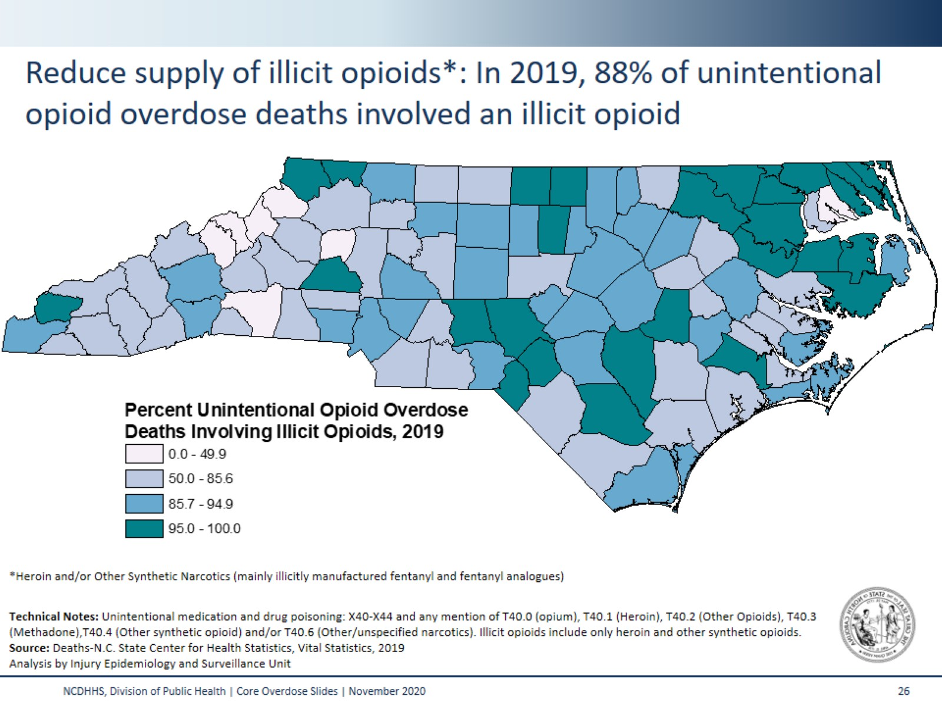
Reduce supply of illicit opioids: In 2019, 88% of unintentional opioid overdose deaths involved an illicit opioid*
Notes:
As part of the OAP 2.0 strategy to ‘Reduce the supply of inappropriate prescription and illicit opioids’, North Carolina reports on the percent of unintentional opioid deaths that involve illicit opioids (T40.1=heroin or T40.4=other synthetic opioids [mainly fentanyl and fentanyl analogues]). This map depicts these data for 2019.
Statewide, illicit opioids were involved in 88% of unintentional opioid overdose deaths.

Slide 27
Notes:
Within the OAP 2.0 effort to ‘Prevent future opioid addiction by supporting children and families’ we also monitor the number of hospitalizations due to drug withdrawal in newborns. Often referred to as neonatal abstinence syndrome (NAS), this number has increased 154% from 2010 to 2019 (10 years).
This syndrome occurs when the fetus is exposed to certain drugs in the womb and then experiences withdrawal when the supply of drugs is severed following birth. Drug withdrawal in newborns is often, but not always, due to maternal use of opioids during pregnancy; however, drugs other than opioids can also result in withdrawal in newborns.
NAS is not currently a reportable condition in NC.
Technical Note: The following numbers represent the number of hospitalizations related to drug withdrawal in newborns based on medical billing codes. Drug withdrawal in newborns is associated with maternal substance use during pregnancy, but does not differentiate whether that substance was medically indicated or was part of the woman’s treatment. Drug withdrawal in newborns is also not limited to opioid use.

Slide 28
Notes:
In North Carolina, Syringe Service Programs, or SSPs, were legalized in 2016. As part of the OAP 2.0 strategy to ‘Advance Harm Reduction’, SSPs report data regarding their activities to the state on an annual basis. From 2016-2019, SSPs distributed over 113,000 naloxone kits. During this time, over 18,000 opioid overdose reversals were reported to SSPs.
For more on the work of SSPs in North Carolina visit:
https://www.ncdhhs.gov/divisions/public-health/north-carolina-safer-syringe-initiative

Slide 29
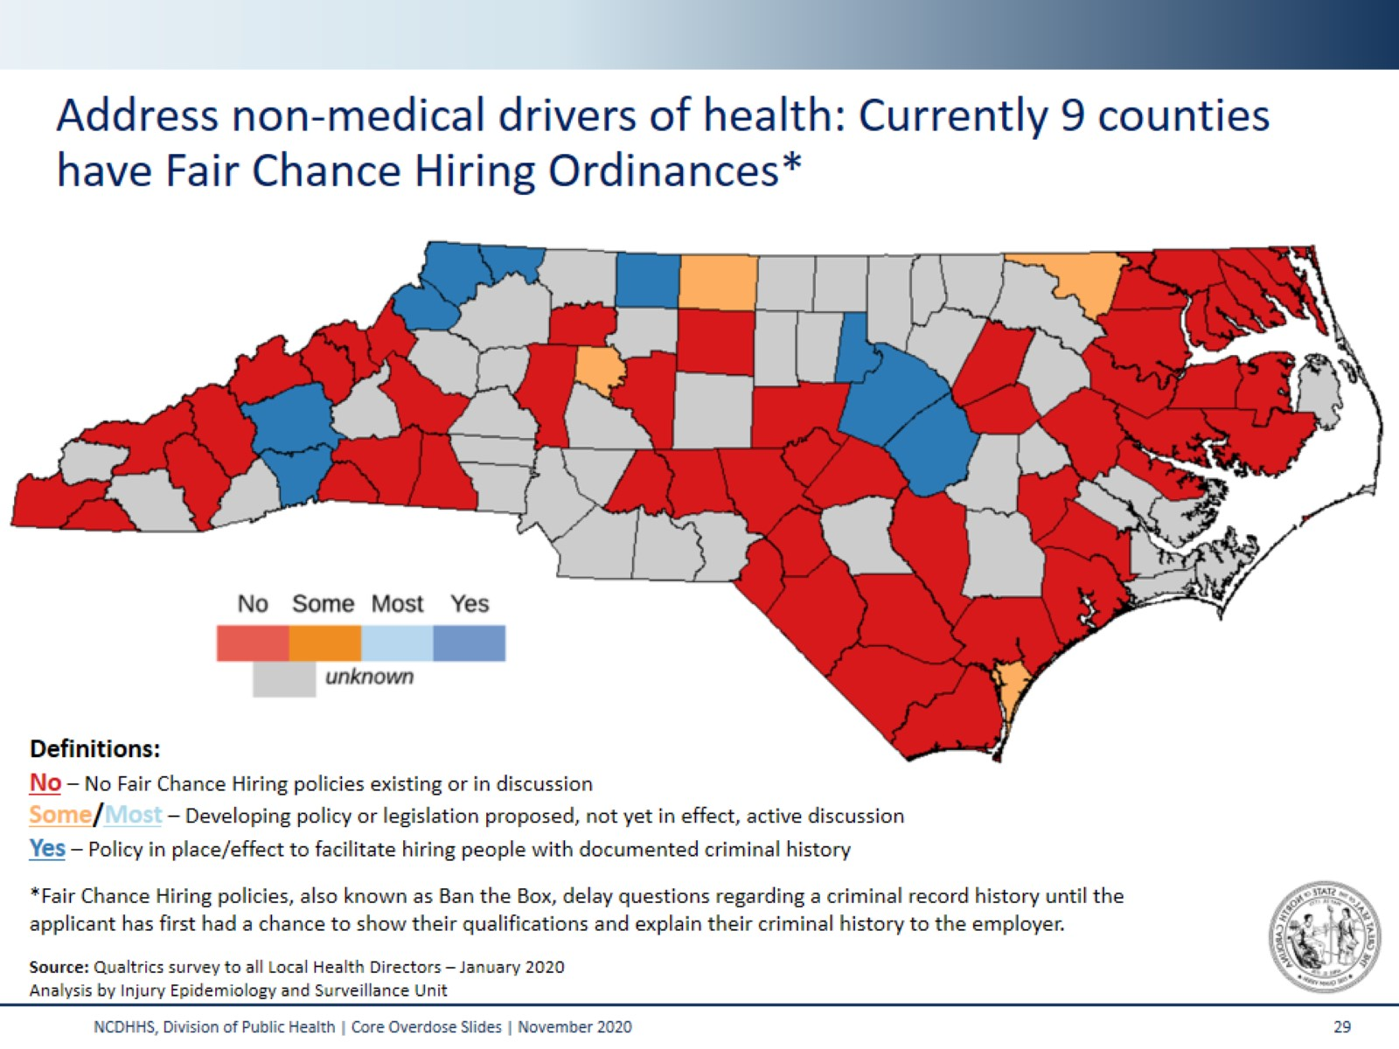
Notes:
Fair Chance Hiring Ordinances Address the ‘Non-medical drivers of health’ strategy in OAP 2.0. Across North Carolina, 1.6 million residents have a criminal record of some kind. These individuals face significant challenges to find stable and meaningful employment. People with a criminal record are 50% less likely to have an employer call back, significantly increasing their risk for recidivism, or going back to jail or prison and returning to drug use. Within three years, 68% of people who are released from prison or jail will be incarcerated again, resulting in an enormous economic burden to taxpayers to incarcerate these individuals, but also negative social impacts affecting families and children. Stable employment (and hopefully increased access to healthcare and stable housing) can also help prevent people from returning to chaotic drug use.
Fair Chance Hiring policies delay questions regarding a criminal record history until the interview process when the applicant has had a chance to show their qualifications and explain their criminal history to the employer. Employers can still conduct background checks under a Fair Chance Hiring policy, but will do so typically after the interview or once a conditional offer has been made to the applicant. Exceptions for jobs that involve law enforcement or childcare are normally made under Fair Chance Hiring policies.
Research shows that Fair Chance Hiring policies boost income and sales tax revenue and reduce court costs due to a lower recidivism rate. Fair Chance Hiring policies are a bi-partisan issue drawing support from both Republicans and Democrats who are committed to giving all Americans a fair chance at employment, reducing the number of people who go to jail/prison, increasing the tax base and ensuring a healthy economy.
http://www.nchrc.org/fair-chance-hiring/

Slide 30
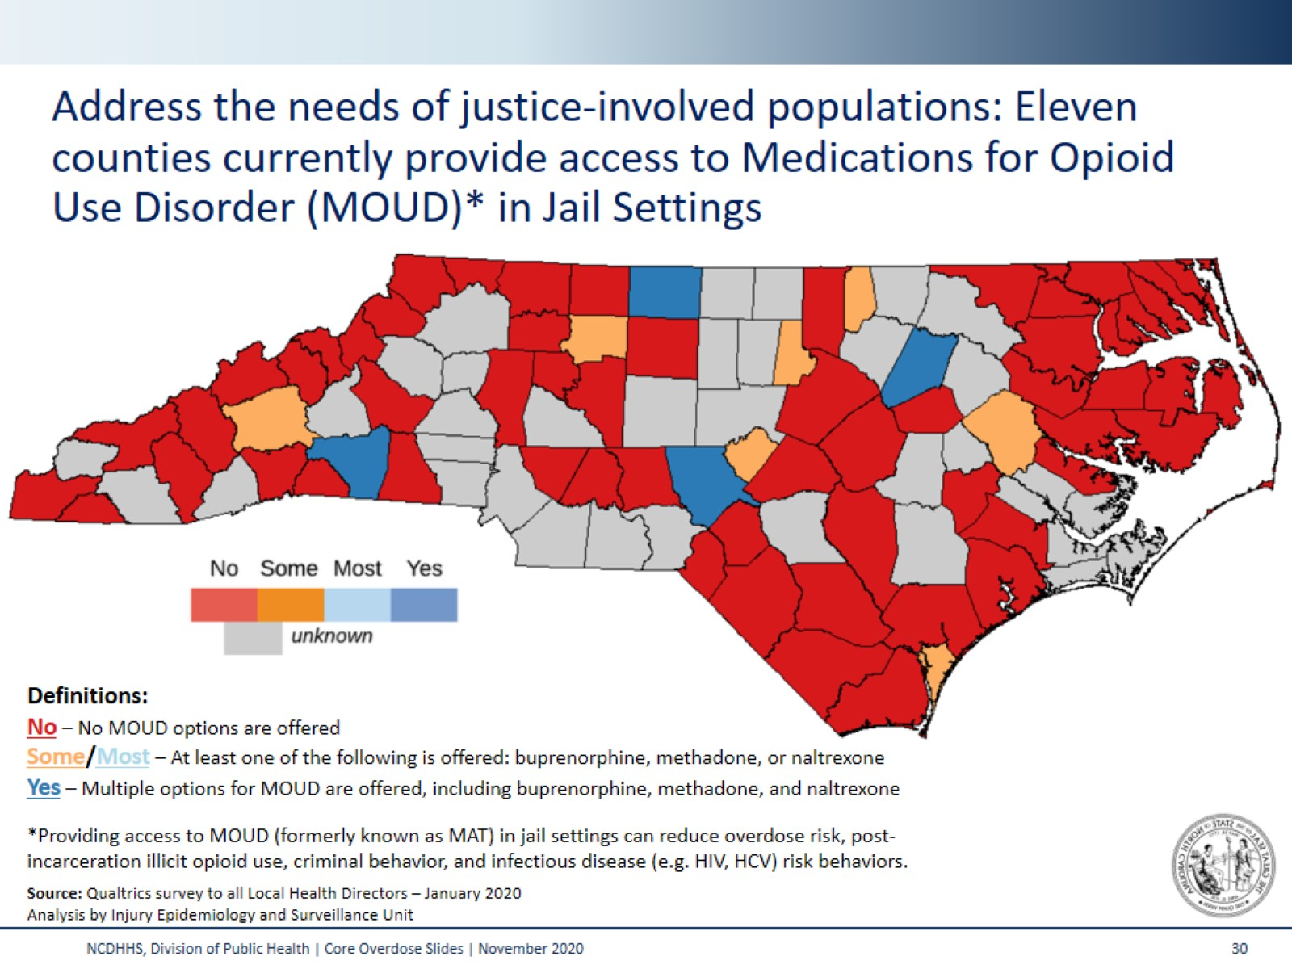
Notes:
The OAP 2.0 strategy to ‘Address the needs of justice-involved populations’ includes providing access to Medications for Opioid Use Disorder (MOUD) in jail settings. Overdose is a leading cause of death among people recently released from correctional facilities; this risk is the highest during the first two weeks post-release. Providing access to MOUD in jail settings can reduce not only overdose risk but also post-incarceration illicit opioid use, criminal behavior, and infectious disease (like HIV or HCV) risk behaviors. Additional social, medical, and economic benefits to providing MOUD to incarcerated persons with opioid use disorder are well-documented.
There are currently three types of FDA approved MOUD: methadone, buprenorphine (either by itself or combined with naloxone), and naltrexone.
Methadone is an opioid agonist that lessens the symptoms of withdrawal and blocks the euphoric effects of opioids. Methadone offered as a liquid is nearly impossible to divert in jail facilities. However, a major barrier to offering methadone for opioid use disorder in jails and prisons is the fact that only clinics that are federally designated as opioid treatment providers (OTPs) can prescribe and dispense it for this purpose.
Buprenorphine, combined with or without naloxone, is a partial agonist, which means that it has some of the same properties as other opiates but not the sedative effects. Suboxone can be taken as a pill or a film. Many jails like Suboxone in film form because it can decrease the risk of diversion.
Naltrexone, an opioid antagonist, naltrexone blocks the euphoric and sedative effects of opioids. Naltrexone can be given as a long acting injectable or pill form. The long-acting injectable form of naltrexone has no diversion potential, which makes it an attractive option for jail administrators.

Slide 31
Notes:
The implementation of Syringe Service Programs, or SSPs, is part of the ‘Expand Treatment and Recovery’ strategy of OAP 2.0. Counties shaded in blue were served by at least one as of the end of year 3 annual reporting period in June 2020.
Individuals traveled from an additional 38 counties, and from out of state, to reach a NC SSP.
There may be SSPs operating that are not represented on this map. In order to be counted as an official SSP, paperwork must be completed with the Division of Public Health. Additional SSPs may have started operating since Year 3 annual reporting ended.
For additional information on the NC Safer Syringe Initiative visit: https://www.ncdhhs.gov/divisions/public-health/north-carolina-safer-syringe-initiative

Slide 32
Notes:
This table outlines the 14 key metrics and related recommended local actions being tracked as part of the NC Opioid Action Plan 2.0 Metrics and actions are divided into the plan’s seven strategy areas:
This table outlines the 14 key metrics that comprise the seven strategy areas of NC OAP 2.0, along with relevant, recommended local actions. The seven strategies are as follows:
Track progress and measure our impact
Reduce the supply of inappropriate prescription and illicit opioids
Prevent future opioid addiction by supporting children and families
Advance harm reduction
Address non-medical drivers of health and eliminate stigma
Address the needs of justice-involved populations
Expand access to treatment and recovery supports
Dashboard data are updated monthly whenever possible. Data are available on the dashboard for the state and at a county and regional level. NC Opioid Action Plan (OAP) Data Dashboard: https://www.ncdhhs.gov/about/department-initiatives/opioid-epidemic/opioid-action-plan-data-dashboard

Slide 33
Notes:
The Injury and Violence Prevention Branch (IVPB) posts multiple resources (many of which are updated monthly) to the IVPB Poisoning Data Page: https://www.injuryfreenc.ncdhhs.gov/DataSurveillance/Poisoning.htm
To join our listserv and receive email notification of new reports, please email us at SubstanceUseData@dhhs.nc.gov

Slide 34
Notes:
Thank you!

