Slide 1
Unintentional Motor Vehicle Traffic Injuries in North Carolina
2023
Division of Public Health
Data Updated March 7, 2024
Notes:
This slide set was created to provide basic data trends and public health surveillance around motor vehicle traffic mortality and morbidity. They are meant to offer a state-level background on unintentional motor vehicle traffic injuries. If you’d like a copy of the slides, please visit the “Motor Vehicle Crashes” Injury Data page on our branch website, https://www.dph.ncdhhs.gov/programs/chronic-disease-and-injury/injury-and-violence-prevention-branch. The direct link is also shared at the end of this presentation.
Feel free to incorporate these slides into your own presentations, grant proposals, reports, or any other way they may be useful.
Please read both the speaking and technical notes to ensure that data are presented in a consistent manner.

Slide 2
Unintentional Motor Vehicle Traffic Technical Notes
Surveillance methods have been updated to identify any mention of an injury in our morbidity data sources. Individual records with multiple injuries listed will be included in the total for each of those injuries but only counted once for overall total injury count. Previously, only the first listed injury was counted, which has resulted in an increase in the number of specific injuries identified.
For questions or for more information, see technical notes document available at https://www.injuryfreenc.ncdhhs.gov/DataSurveillance/
Case Definitions used:
*Data is limited to unintentional motor vehicle traffic (MVT)
Deaths – ICD-10 codes listed as cause of death
  [V02–V04](.1,.9), V09.2, [V12–V14](.3–.9), V19(.4–.6), [V20–V28](.3–.9), [V29–V79](.4–.9), V80(.3–.5), V81.1, V82.1, [V83–V86](.0–.3), V87(.0–.8), V89.2
*See technical notes document for a full list of ICD-10 codes for TBI deaths
Notes:
For more detailed technical notes on any of the data shared in this slide set, please contact us at InjuryData@dhhs.nc.gov.

Slide 3
Technical Notes, Continued
  Hospitalizations – Among records with an ICD-10-CM injury code*, any mention of the following ICD-10-CM codes (includes records resulting in death)
  Emergency Department Visits – Any mention of the following ICD-10-CM codes (includes records resulting in hospitalization or death)
V02.1, V02.9, V03.1, V03.9, V04.1, V04.9, V09.2, V09.3 | MVT Pedestrian
V12-V14 (.3-.9), V19.4-V19.6, V19.9 | MVT Pedal cycle
V20-V28 (.3-.9), V29.4-V29.9 | MVT Motorcycle
V30-V79 (.4-.9), V83-V86 (.0-.3), V87.0-V87.8, V89.2 | MVT Occupant
V80.3-V80.5, V81.1, V82.1 | MVT Other
*7th character of A, B, or missing (reflects initial encounter, active treatment)
*See technical notes document for a full list of ICD-10-CM injury diagnosis codes
Notes:
For more detailed technical notes on any of the data shared in this slide set, please contact us at InjuryData@dhhs.nc.gov.

Slide 4
Overview
Unintentional Motor Vehicle Traffic (MVT) Death
Unintentional MVT Morbidity
  Hospitalizations and Emergency Department Visits
Resources
Unintentional MVT Injury/Harm data are available at https://injuryfreenc.dph.ncdhhs.gov/DataSurveillance/MVCData.htm
For custom data requests see https://injuryfreenc.dph.ncdhhs.gov/DataSurveillance/DataRequestPolicy.htm
Notes:
This presentation is not intended to cover all data related to unintentional motor vehicle traffic (MVT)-related injury. Rather it gives an overview of some of the key trends in North Carolina. It includes information on statewide unintentional MVT deaths, unintentional MVT injury hospitalizations and emergency department visits, and resources. Please note that when the COVID-19 pandemic began in 2020, there were many implications, including major changes to the numbers and rates within the unintentional MVT injury data in this slide deck. The Injury and Violence Prevention Branch is still assessing how each aspect of the data were impacted.
If this slide deck does not contain the information you need, please see our custom data request policy and contact us at InjuryData@dhhs.nc.gov.

Slide 5
Unintentional MVT death is the third leading cause of injury-related death
Limited to NC Residents, 2023
Source: NC State Center for Health Statistics, Vital Statistics-Deaths (2023)
Analysis by Injury Epidemiology and Surveillance Unit
Notes:
In 2023, unintentional motor vehicle traffic (MVT) deaths were the third leading cause of injury-related death in North Carolina, with 1,757 unintentional MVT deaths among North Carolina residents.

Slide 6
Proportion of demographic groups reporting always wearing a seatbelt, 2023 BRFSS
Overall 91.7%
Overall 91.7%
Source: NC State Center of Health Statistics, 2023 Behavioral Risk Factor Surveillance System (BRFSS) Survey Results
Notes:
The Behavioral Risk Factor Surveillance System, developed by the Centers for Disease Control and Prevention (CDC), is a random telephone survey of state residents aged 18 years and older. The purpose is to obtain estimates of the prevalence of personal health behaviors that contribute to morbidity and mortality. In 2023, 91.7% NC adults surveyed reported that they always wore a seatbelt. However, when broken out by demographics and socioeconomic status, less than 91.7% (state overall) of respondents in certain groups reported always wearing a seatbelt. These groups included males (88.2%), ages 18-54 years old (87.6-91.6%), residents with a functional disability (89.4%), those with incomes between $15,000 and $74.9K (87.7-91.2%), non-veterans (91.6%), and individuals living in suburban areas (90.4%). Nearly 95% of females (94.8%), those ages 55 and older (94.3-96.1%), individuals without disability (92.9%), individuals with incomes less than $15,000 (95.1%), individuals with incomes more than $75K (94.4%), veterans (92.1%), urban and rural residents (92.6% and 91.9%, respectively) reported that they always wore a seatbelt.

Slide 7
Proportion of groups reporting driving while having had too much to drink,* 2023 BRFSS
Overall 2.2%
Overall 2.2%
*in the last 30 days
Source: NC State Center of Health Statistics, 2023 Behavioral Risk Factor Surveillance System (BRFSS) Survey Results
Notes:
In 2023, 2.2% of NC adults surveyed reported that, in the last month, they drove while having too much to drink. More than 2.2% (state overall) of respondents in certain demographic groups reported that they drove while having too much to drink. These groups included males (2.7%), ages 18-34 years old (3.9%), those with a disability (5.1%), and individuals living in urban and rural areas (2.3% and 2.8%, respectively). Females (1.7%), college graduates (1.9%), non-veterans (2.1%), and those with no disability (1.9%) had lower proportions of reporting driving while having too much to drink compared to the state overall (2.2%).

Slide 8
Unintentional MVT deaths are the tip of the iceberg
1,757
Deaths
Despite NC’s excellent reporting systems, the total burden of MVT injury in the state
is unknown.
7,495
Hospitalizations
121,930
ED Visits
? EMS
? Outpatient Visits
? Medically Unattended Injuries
INJURY ICEBERG
Limited to NC Residents, 2023
Source: NC State Center for Health Statistics, Vital Statistics-Deaths (2023) and Hospitalization Discharge Data (2023); NC DETECT (2023)
Analysis by Injury Epidemiology and Surveillance Unit
Notes:
In 2023 there were 1,757 deaths, 7,495 hospitalizations, and 121,930 emergency department visits related to unintentional motor vehicle traffic crashes in North Carolina. However, this is just the tip of the iceberg and the total burden of unintentional MVT injury in NC is unknown.

Slide 9

Unintentional
Motor Vehicle Traffic Deaths

Slide 10
Unintentional MVT deaths have continued to increase from 2014 to 2023
31%
increase
Limited to NC Residents, 2023
Source: NC State Center for Health Statistics, Vital Statistics-Deaths (2023)
Analysis by Injury Epidemiology and Surveillance Unit
Notes:
The number of unintentional motor vehicle traffic-related deaths in North Carolina has increased by 31% over the last 10 years (2014-2023). While there was a slight decrease from 2021 to 2023, unintentional MVT-related deaths remain high.

Slide 11
Rates of unintentional MVT deaths were highest among men and non-Hispanic American Indians
Rate of Unintentional MVT Deaths by Demographic Group, 2023
Limited to NC residents, 2023, N=1,757; NH-non-Hispanic; Rate not calculated for Other, NH
Race/ethnicity was unknown for 5 (<0.1%) injury deaths.
Source: NC State Center for Health Statistics, Vital Statistics-Deaths (2023)
Analysis by Injury Epidemiology and Surveillance Unit
Notes:
In 2023, the highest rates for unintentional MVT-related deaths occurred amongst male North Carolina residents (23.1 per 100,000), non-Hispanic (NH) American Indians (51.1 per 100,000) and NH Blacks (19.6 per 100,000).

Slide 12
Unintentional MVT death rates are highest among those ages 20 to 24 years old
Rate of Unintentional MVT Deaths by Age Group, 2023
Limited to NC Residents, 2023, N=1,757
Source: NC State Center for Health Statistics, Vital Statistics-Deaths (2023)
Analysis by Injury Epidemiology and Surveillance Unit
Notes:
Unintentional MVT-related death rates increase with age. In 2023, the highest rates for MVT deaths occurred amongst NC residents ages 20-24 years old (23.0 per 100,000) followed by those ages 75-84 (22.1 per 100,000).

Slide 13
Most unintentional MVT deaths with a known sub-cause were pedestrians killed in an MVT incident
Percent of MVT Injury Deaths by Known Subcause, 2023
Limited to NC Residents, 2023, N=1,757
Source: NC State Center for Health Statistics, Vital Statistics-Deaths (2023)
Analysis by Injury Epidemiology and Surveillance Unit
Notes:
Over half of unintentional MVT-related deaths have an unspecified/unknown sub-cause (58.6%). Among those with a known sub-cause, pedestrians accounted for the most deaths (15.1%), followed by motorcyclists (12.4%).

Slide 14

Unintentional Motor Vehicle
Traffic Hospitalizations

Slide 15
Unintentional MVT hospitalizations increased by 8% from 2019 to 2023
8%
increase
Limited to NC Residents, 2019-2023
Source: NC State Center for Health Statistics, Hospitalization Discharge Data (2019-2023)
Analysis by Injury Epidemiology and Surveillance Unit
Notes:
The number of unintentional motor vehicle traffic-related injury hospitalizations in North Carolina has increased by 8% since 2019.

Slide 16
Unintentional MVT hospitalization rates were highest among men and NH American Indians
Rate of Unintentional MVT Hospitalizations by Demographic Group, 2023
Limited to NC residents, 2023, N=7,495; NH-non-Hispanic; Rate not calculated for Other NH
Sex was unknown for 5 (<0.1%) injury hospitalizations and race/ethnicity was unknown for 162 (<0.1%) injury hospitalizations.
Source: NC State Center for Health Statistics, Hospitalization Discharge Data (2023)
Analysis by Injury Epidemiology and Surveillance Unit
Notes:
In 2023, the highest rates for unintentional MVT-related hospitalizations occurred amongst male NC residents (88.3 per 100,000), non-Hispanic (NH) American Indians (103.2 per 100,000) and NH Blacks (89.2 per 100,000).

Slide 17
Rates of unintentional MVT hospitalizations are highest among adults 75 and older
Rate of Unintentional MVT Hospitalizations by Age Group, 2023
Limited to NC residents, 2023, N=7,495
Source: NC State Center for Health Statistics, Hospitalization Discharge Data (2023)
Analysis by Injury Epidemiology and Surveillance Unit
Notes:
In 2023, the highest rates for unintentional MVT-related hospitalizations occurred amongst NC residents ages 85 and older (109.2 per 100,000) and those ages 75-84 (95.6 per 100,000).

Slide 18
MVT-Occupant was the leading sub-cause for unintentional MVT hospitalizations
Percent of Unintentional MVT Injury Hospitalizations by Known Subcause, 2023
Limited to NC residents, 2023, N=7,495
Source: NC State Center for Health Statistics, Hospitalization Discharge Data (2023)
Analysis by Injury Epidemiology and Surveillance Unit
Notes:
In 2023, vehicle occupants accounted for the majority (73.2%) of unintentional MVT-related hospitalizations in North Carolina.

Slide 19

Unintentional
Motor Vehicle Traffic Emergency Department Visits

Slide 20
Unintentional MVT ED visits decreased by 2% from 2019 to 2023
2%
decrease
Limited to NC residents, 2019-2023
Source: NC DETECT (2019-2023)
Analysis by Injury Epidemiology and Surveillance Unit
Notes:
Overall, the number of unintentional motor vehicle traffic-related injury emergency department (ED) visits in North Carolina has decreased by 2% over the last 5 years (2019-2023). A decrease was observed until the pandemic in 2020. Since 2020, there has been an increase in ED visits related to unintentional MVT injuries.

Slide 21
Rates of unintentional MVT ED visits were highest among women and NH Black residents
Rate of Unintentional MVT ED Visits by Demographic Group, 2023
Limited to NC residents, 2023, N=121,930; Rate not calculated for Other
NH - non-Hispanic; sex was unknown for 415 (<0.1%) injury ED visits and race/ethnicity was unknown for 2,679 (<0.1%) injury ED visits.
Source: NC DETECT (2023)
Analysis by Injury Epidemiology and Surveillance Unit
Notes:
In 2023, the highest rates for unintentional MVT-related ED visits occurred amongst female North Carolina residents (1,162.3 per 100,000), non-Hispanic Blacks (2,266.9 per 100,000), and non-Hispanic American Indians (1,427.4 per 100,000).

Slide 22
Adults ages 20-24 have the highest rates of unintentional MVT ED Visits
Rate of Unintentional MVT ED Visits by Age Group, 2023
Age was unknown for 697 ED visits
Limited to NC residents, 2023, N=121,930
Source: NC DETECT (2023)
Analysis by Injury Epidemiology and Surveillance Unit
Notes:
In 2023, the highest rates for unintentional MVT-related ED visits occurred amongst North Carolina residents ages 20-24 (1,905.8 per 100,000).

Slide 23
MVT-Occupant was the leading sub-cause for unintentional MVT ED visits
Percent of Unintentional MVT Injury ED Visits by Known Subcause, 2023
Limited to NC residents, 2023, N=121,930
Source: NC DETECT (2023)
Analysis by Injury Epidemiology and Surveillance Unit
Notes:
In 2023, vehicle occupants accounted for the majority (93.5%) of unintentional MVT-related ED visits in North Carolina.

Slide 24
Summary of Unintentional Motor Vehicle Traffic Injury in North Carolina
In 2023, motor vehicle traffic-related injuries resulted in:
  Almost 1,800 deaths
  Nearly 7,500 hospitalizations
  Over 121,000 emergency department visits
Most MVT-related injuries and deaths occur among male, Black, and American Indian residents
Rates of MVT-related injuries are highest in the 20-24, 25-34, and 85 and older age groups
*See technical notes document for a full list of ICD-10 codes for TBI deaths
Notes:
In 2023, motor vehicle traffic-related injuries resulted in almost 1,800 deaths, nearly 7,500 hospitalizations, and over 121,000 emergency department visits in North Carolina. Most of MVT-related injuries and death occurred among males, NH Blacks and NH American Indians, and residents 20-34 and 85 and older years of age.

Slide 25
Where to find more data on motor vehicle traffic-related death and injury?
NC Injury and Violence Prevention Branch Motor Vehicle Traffic Injury Data
NC Vision Zero Initiative Data and Analytics Dashboard
State Center for Health Statistics (SCHS) Death Certificate Data
  NC Health Data Query System
CDC WISQARS – Fatal Injury and Violence Data

Slide 26
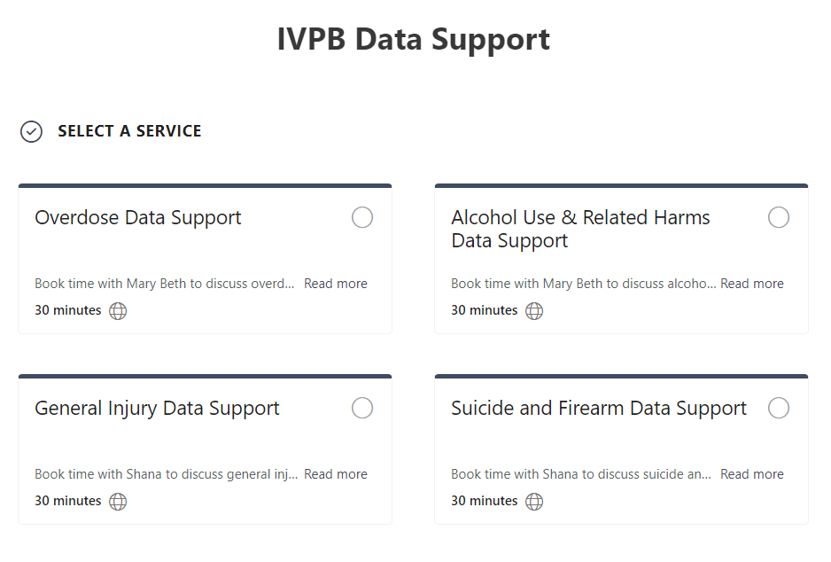

IVPB Data Support now available!
Book time with an IVPB epidemiologist to discuss available data products, to talk through custom data requests, or for general data questions.
IVPB Data Request Policy
IVPB Data Support Bookings

Slide 27
Questions?
InjuryData@dhhs.nc.gov
Injury and Violence Prevention Branch
NCDHHS Division of Public Health
www.injuryfreenc.dph.ncdhhs.gov

